Slide 1

Designate Adult or Youth Content
Your Name
Date
Notes:
This course can only be presented by those who have completed the Train the Trainer course given by a CALM Developer or Master Trainer
Purpose: CALM – Counseling on Access to Lethal Means – was developed to assist clinicians and others to approach Lethal Means Counseling with an informed, collaborative and respectful attitude. It is explicitly anti-suicide and neither anti- or pro-gun nor anti- or pro-medication.
Course description - This course reviews public health data regarding suicide and access to lethal means. It highlights the importance of removing access to highly lethal means, discusses what means are most lethal and describes how to have a culturally competent conversation regarding securing lethal means and firearms.
This slide set should be presented in its entirety with the exception of slides noted as OPTIONAL and a choice based on anticipated audience of either the Hunter or the Steve scenarios in Part 1 and either the Teen or the Adult subject video in Part 3. Please try to include at least two scenarios in Part 4.
Any significant alterations must be approved by a Master Trainer and one of the Developers prior to being presented. Additional slides that show local data or suicide prevention resources may be added with approval of a Master Trainer to ensure that they are accurate and in keeping with the CALM approach to Suicide Prevention.
Suggested Time: 3 hours

Slide 2
Acknowledgements
CALM Developers
Cathy Barber and Elaine Frank
With thanks to
Mark Ciocca
Harvard Injury Control Research Center
JP Jameson, Bridget Matarazzo, Kurt Michael
Missouri Safer Homes Collaborative
San Francisco VA Lethal Means Project
Joe Simonetti, the Utah Suicide Prevention Coalition
and all the others who have provided input and inspiration
Notes:
2
Brief acknowledgement of contributors to the program – this demonstrates the collaborative nature of the program and encourages same from Instructors
Pronunciations:
Mark Ciocca – Mark See-oh-ka
Harvard Injury Control Research Center
JP Jameson,
Bridget Matarazzo – Bridget Ma-terra-zo
Kurt Michael
Missouri Safer Homes Collaborative
SF VA Lethal Means Project
Joe Simonetti – Joe Sigh-mon-etti
the Utah Suicide Prevention Coalition

Slide 3
Before we Begin
Introductions
What CALM is and isn’t
Just one part of a comprehensive approach to suicide prevention
        Can be effective in our personal lives as well
    Not THE answer but should be part of all Safety Planning
Anti-suicide, not anti-gun or anti-medication
Suicide is generally preventable
This may be stressful- practice self-care
Some of this information is not for public consumption
Notes:
3
May skip introductions if it is a big room.- can do a show of hands to get a sense of representation instead.
Not meant to stand alone. CALM adds value to what you’re currently doing.
Also valuable in your personal life if you or someone you care about is in a very tough period.
We’re not here to push a political agenda; we’re here to save lives.
That said, not every suicide can be prevented. As clinicians, it is possible to lose a loved one or patient in spite of our best efforts and intentions.
The training covers material that can be distressing; we all bring our own personal experiences to this topic. If you are getting distressed and need to take some time, please do, And feel free to speak with me after.
On a couple of slides we present information that is wiser not to share with clients and the general public. We’ll point those out.
TAKE AWAY – means reduction is an evidence based component of suicide prevention
CALM is injury prevention
Approach is grounded in public health – helps care-givers support those they care for (clients, family, friends) who may be at risk of suicide to stay safer
Demonstrates why and how to bring up the topic of access to lethal means as a safety planning concern

Slide 4
Objectives
At the conclusion of this workshop, participants will be able to:
Explain that reducing access to lethal means is an evidence-based strategy that can prevent a suicide.
Recognize that lethal means counseling is appropriate when concerns for suicide are present.
Demonstrate strategies to bring-up the topic of lethal means with comfort and competence.
Discuss specific off-site and in-home secure storage options for firearms as a strategy that increase time and distance between a person at risk and lethal means
Work collaboratively with clients and their families on safety planning and follow-up for reducing access to lethal means.
Notes:
4

Slide 5
CALM Outline
How can CALM help prevent suicide?
Why focus on guns?
How do you talk about firearms?
How do you talk about other suicide methods?
Video
Case studies/role plays
Notes:
5
This is meant to be a quick list to let people know what the training will cover.

Slide 6
CDC WONDER, accessed 2018
Notes:
This is a slide that you would customize using CDC WONDER. See support materials for help navigating that database.
Suicides outnumber homicides in MO, and the gap has been widening in recent years.
(Aside to trainers – the suicide rates actually went down in the late 1990s and only in very recent years returned to, and then exceeded, the higher rates from the late ‘80s. People often seem to “like” the narrative that things are getting worse, life is getting harder and more complicated, etc., even in periods in which we actually see declines.)
Also, in case you are asked- suicide rates have increased by 33% since 1999- can add context so that individuals do not assume it is something about their state or region that is increasing.
Interestingly, suicide rates in other parts of the world have declined; declines have been most notable in other industrialized nations. This is not something that you need to point out but it might come up.

Slide 8



Part 1
Why “Means Matter”
Notes:
Why would reducing access to lethal means make a difference?

Slide 9
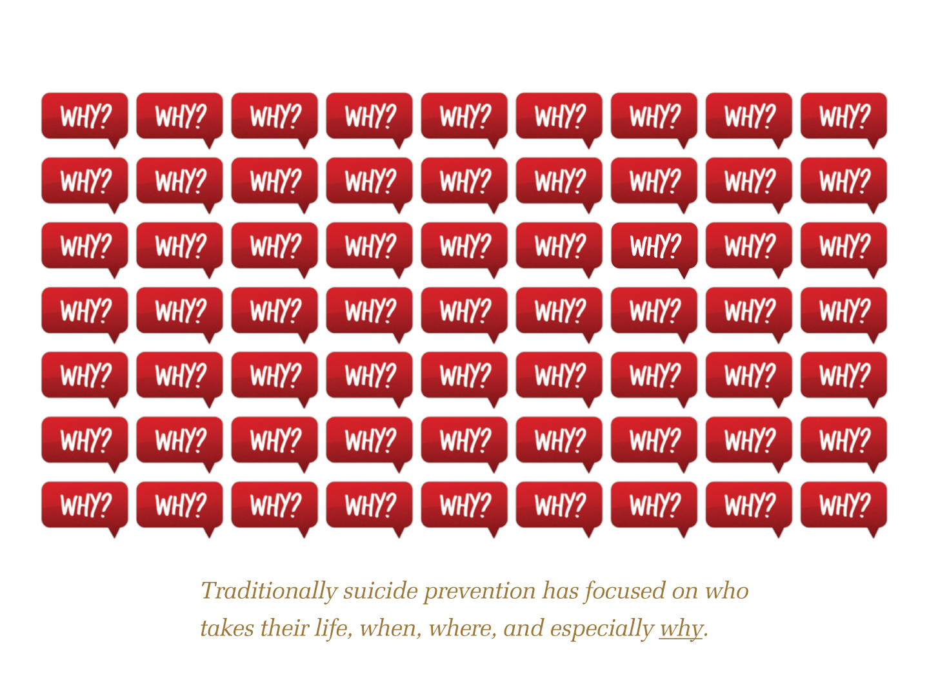
Much of the focus in suicide prevention is on why a person attempts suicide. We seek to relieve the mental distress that leads to a suicide attempt.
Notes:
Much of the focus in suicide prevention is on why a person attempts suicide. We seek to relieve the mental distress that leads to a suicide attempt, as well we should. However, the progress we have made answering the “why” questions has not been sufficient to prevent many suicides.

Slide 10
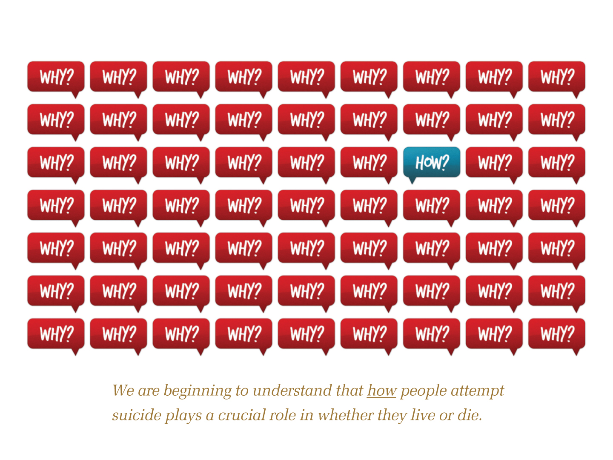
But how a person attempts plays a crucial role in whether they live or die.
CALM covers “how to address the how” through lethal means counseling
Notes:
But how a person attempts plays a crucial role in whether they live or die, so this is something we also need to attend to in our work.
In fact, some of the more striking examples in which a country or community significantly cut its suicide rate have come from reducing access to a highly lethal suicide method.

Slide 11

Pesticides and Sri Lanka
Sri Lanka had one of the world’s highest suicide rates in mid-1990s; pesticides were the leading method. Why?
The most highly human-toxic pesticides were banned in the mid- to late-’90s.
Suicide rate dropped 50% from 1996 to 2005, saving 20,000 lives.
The drop was driven by a decline in pesticide suicides.
Suicides by other methods did not drop. Nor did nonfatal pesticide attempts.
The behavior (trying to die) didn’t appear to change.
What changed was the lethality of that behavior.
Gunnell 2007. Int’l J of Epi.
Notes:
11
(Note to trainers: the info you need is on the slide. But to feel comfortable with the study, please read the paper included in your resource materials. )
The method by which pesticides were banned was primarily through import restrictions. Other countries have tried other methods of pesticide means reduction (e.g., communal storage facilities in India; household lockboxes in Sri Lanka and China), but the effectiveness of these other methods has not been as clearly established.

Slide 12

Firearms and Israeli Defense Force (IDF)
In the early 2000s, IDF focused on preventing suicides—most of which were by firearm, many on weekends while soldiers were on leave.
In 2006, IDF required soldiers to leave weapons on base during weekend leaves.
The suicide rate decreased by 40%.
Weekend suicides dropped significantly.
Weekday suicides did not.
Lubin, SLTB 2010
Notes:
12
(Note to trainers: The study is in your packet. This study is a little less dramatic than the Sri Lankan one because the population of the IDF is much smaller than that of Sri Lanka.)
Decrease in suicide rates after a change of policy reducing access to firearms in adolescents: a naturalistic epidemiological study.
https://www.ncbi.nlm.nih.gov/pubmed/21034205
This specific tactic is only one piece of the IDF’s Suicide Prevention Program.
A military suicide prevention program in the Israeli Defense Force: a review of an important military medical procedure; htt
ps://www.ncbi.nlm.nih.gov/pmc/articles/PMC5329935/
(Additional background: it is widely believed that service in the IDF is compulsory for all healthy Israeli citizens at age 18. However, 30% of Israelis are ultra-Orthodox or Arab, and these groups are exempted from service. Additionally, the mandatory service laws are rarely enforced. This means that in recent years, approximately 35% of 18-year old Israelis served. Source: Jager, A. (18 October, 2018). The myth of compulsory military service in Israel. Jerusalem Post.

Slide 13
WHY??
How could such a simple change save lives?
Why didn’t suicides go up on Monday, or hangings go up on the weekends?
After all, if you remain committed to ending your life, eventually you truly can find a way.
So why do Means Matter?
Notes:
13
Some groups will want to engage in discussions around these questions; others will see them as rhetorical. OK to roll with either, depending on audience response.

Slide 14
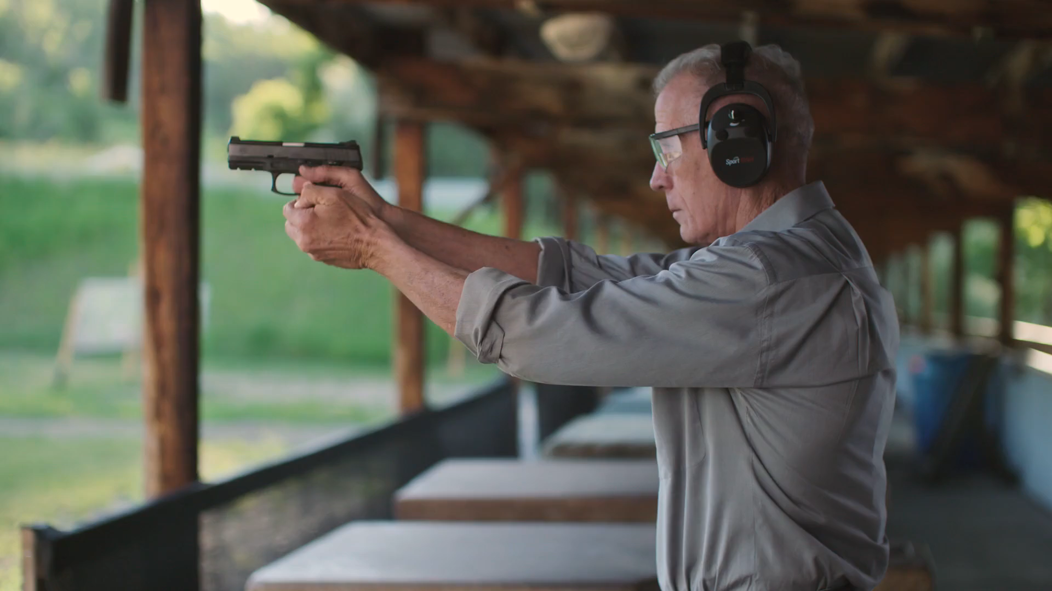
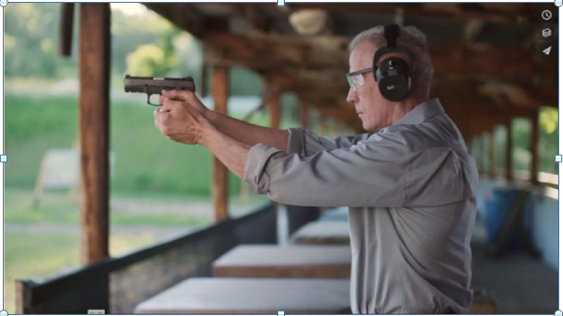
Why Do Means Matter?
Not everyone who becomes suicidal remains suicidal.
Notes:
14
https://vimeo.com/175761640
Discuss what this video points out about means reduction and the nature of suicidal feelings

Slide 15
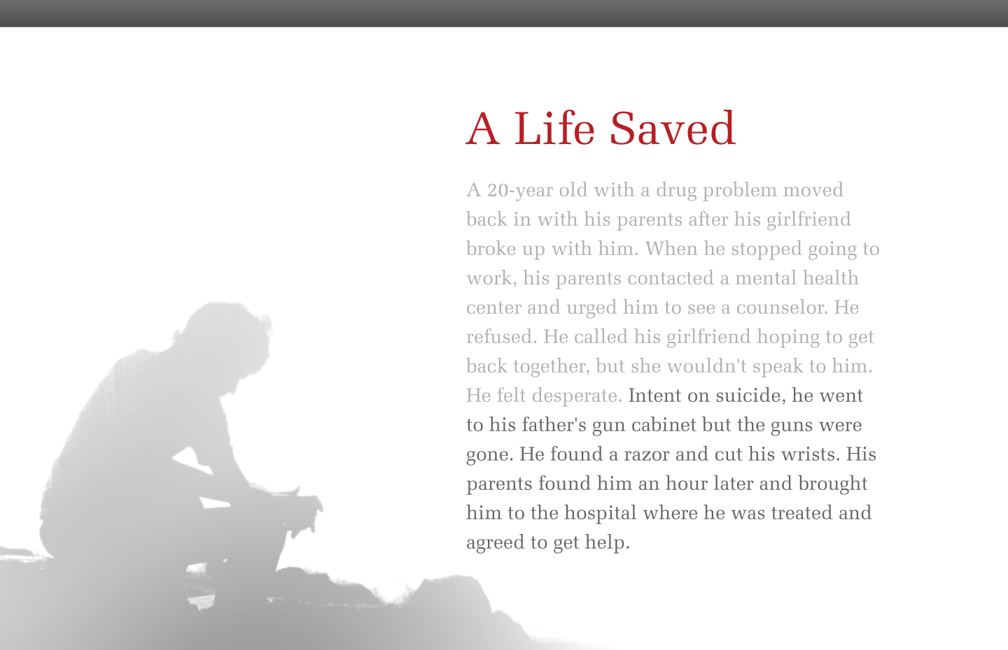
A Suicide…
Hunter is a 16 year-old struggling with a recent breakup. Lately he has been missing school, withdrawing from friends, and drinking alcohol. His parents contacted the counselor at his school and urged him to speak with her. He refused.
He called his girlfriend, hoping to get back together, but she wouldn’t speak to him. Feeling desperate, he went to the gun cabinet…
Notes:
Have a workshop participant read the case.

Slide 16
…or a Life Saved?
Hunter is a 16 year-old struggling with a recent breakup Lately he has been missing school, withdrawing from friends, and drinking alcohol. His parents contacted the counselor at his school and urged him to speak with her. He refused. He called his girlfriend, hoping to get back together, but she wouldn’t speak to him. Feeling desperate, he went to the gun cabinet, but the guns were gone.
Notes:
Or was this a life saved, because when he got to the cabinet the guns weren’t there. We don’t know for any one individual what their next step will be. But let’s play out a few scenarios.

Slide 17
…or a Life Saved?
Hunter is a 16 year-old struggling with a recent breakup. Lately he has been missing school, withdrawing from friends, and drinking alcohol. His parents contacted the counselor at his school and urged him to speak with her. He refused. He called his girlfriend, hoping to get back together, but she wouldn’t speak to him. Feeling desperate, he went to the gun cabinet, but the guns were gone. Frustrated, Hunter drove to a friends to borrow a gun.
By the time he got there he had calmed down. He was still miserable, but no longer acutely suicidal.
Notes:
This is the first of three scenarios involving Hunter.

Slide 18
Why did Hunter survive?
Notes:
18

Slide 19
Why Means Matter
1. The acute phase of a suicidal crisis is often brief.
Notes:
19
There are four pillars of Means Matter. Let’s take the reasons one by one.
First, the acute phase of a suicidal crisis – that period when you’re actually ready to pull the trigger or swallow the poison-- is often brief.
The overwhelming impulse to die often fades and may never recur or may flare up episodically. It is rarely a chronic state.
Escalation from misery to ideation to an attempt can occur rapidly.

Slide 20
Suicidal Crises
People seen in the hospital following a suicide attempt were asked when they had first started thinking about making that attempt.
What percent do you think said within 10 minutes prior to attempting?
Deisenhammer 2009

Slide 21
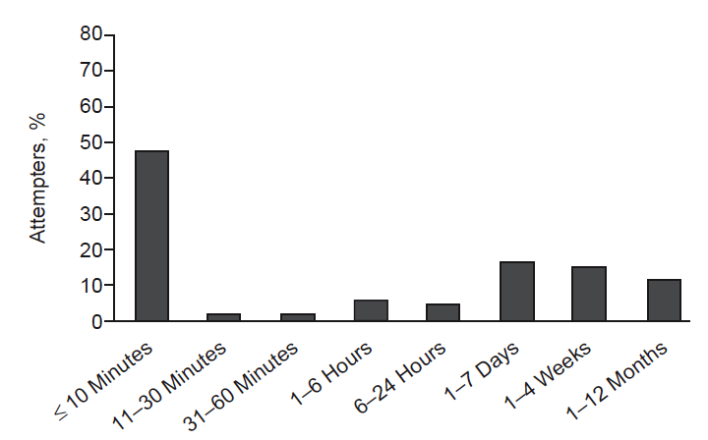
Suicidal Crises
48% said within 10 minutes of the attempt.
NOTE: This doesn’t mean the attempt occurred out of the blue.
Notes:
This doesn’t mean the attempt occurred out of the blue.
Most people who become suicidal struggle with ongoing, underlying problems.
But the transition from suicidal thought to attempt can be rapid, which makes it very hard to predict. Often it is triggered by an external event like an argument.
When many of us think of a suicidal person, we picture the folks over at the right side of the chart. But many of the people who actually attempt do so with little deliberation.

Slide 22
…or a Life Saved?
Hunter is a 16 year-old struggling with a recent breakup. He recently has been missing school, withdrawing from friends, and drinking alcohol. His parents contacted the counselor at his school urged him to speak with her. He refused. He called his girlfriend, hoping to get back together, but she wouldn’t speak to him. Feeling desperate, he went to the gun cabinet, but the guns were gone.
He slashed his wrists.
His mother found him and took him to the hospital where he was treated and survived.
Notes:
Second Hunter scenarion

Slide 23
Why did Hunter survive?
Notes:
23

Slide 24
Why Means Matter
The acute phase of a suicidal crisis is often brief.
Some methods are far less lethal than others.
Notes:
24

Slide 25

Lethality of Suicide Methods
1-2% fatal
83-90% fatal
What are Hunter’s odds of dying using sharps or overdose? (Both are about the same)
1-2% 10% 25% 35%
98% nonfatal, ED-treated
10-17% nonfatal, ED-treated
Firearms
Cutting & Poisoning
CDC WISQARS
Based on data from emergency departments and death certificates.
Notes:
This pyramid shows the lethality of a firearm used in a suicide attempt. Had Hunter used a firearm, it is no surprise that when you combine emergency department data and death certificate data, you learn that 9 out of 10 firearm attempts are fatal. But what would you guess is the case for sharp instruments like razors and for overdosing on meds?

Slide 26
Lethality of Suicide Methods
Are all of these suicide attempts?
83-90% fatal
1-2% fatal
98% nonfatal, treated in hospital ED
10-17% nonfatal, ED-treated
Firearms
Sharps & Overdose
NOTE: We caution against informing your patients about the very low fatality for sharps and overdose. The perception that these methods are more lethal than they usually are may save lives.
Notes:
See the tiny red spot on top of the pyramid?
That represents the odds of dying in an attempt using sharps or medications - about 1 to 2%.
But are all of the attempts on the right serious attempts? Some will be gestures and some of the sharp instrument wounds are non-suicidal self-injury. But even if we set aside HALF, the case fatality rate would still be at most 4%: far lower than for guns.
We caution against providing the information about the very low fatality for sharps and overdose to your patients. The perception that overdose and cutting are more lethal than they usually are probably saves many lives.

Slide 27
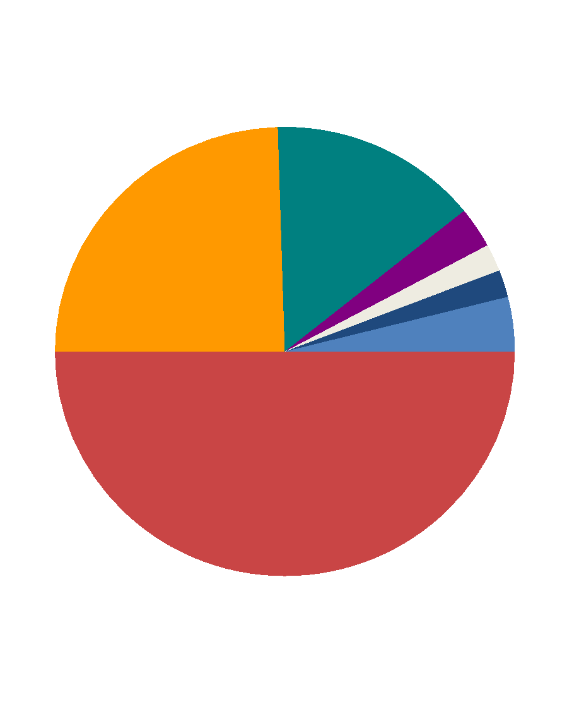
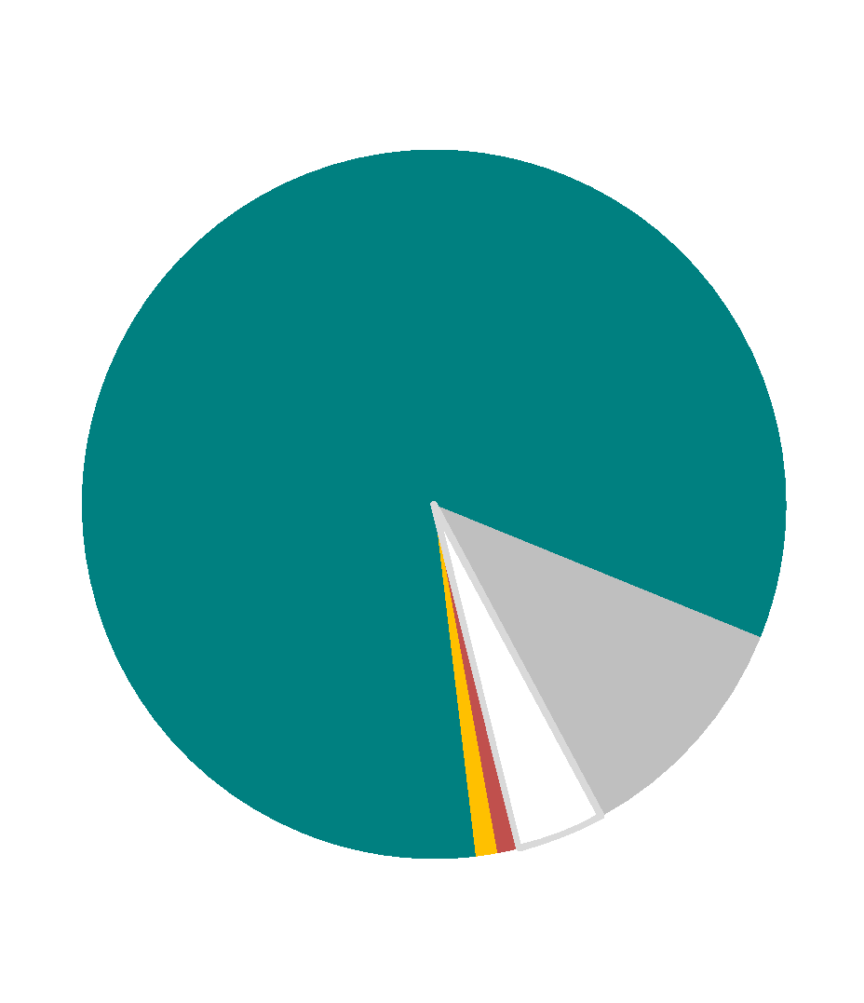
Suicide Methods, U.S.
Overdose/
Poison
12%
Hanging/
Suffocation
26%
Gas 3%
Jump 2%
Sharps 2%
Other 4%
Overdose/Poison
66%
Firearm
51%
Sharps
22%
Other 9%
Suffocation 2%
Firearm 1%
Fatal
Nonfatal
CDC WONDER (2016)
Canner 2018
Notes:
27
The leading methods are strikingly different depending on whether a suicide attempt ends in a trip to the morgue vs. a trip to the hospital.

Slide 28








Suicide Methods – MISSOURI 2017
GUNS
SUFFOCATION
POISON
OTHER
AgA
Notes:
57% of firearm deaths in Missouri are by suicide.
Compare age groups – among those over 65 firearms represent 74%.

Slide 29
Relative Lethality of Suicide Methods
HIGH
Lethality
LOW
Lethality
Firearm
Jump from very great height
Carbon monoxide
Hanging/suffocation
Overdose/poisoning
Cutting
Notes:
(Optional)
Among suicide methods there is a hierarchy of lethality, with firearms and jumps from a very great height at the top.
Had Hunter used hanging or carbon monoxide, his odds of surviving would have been better than with a gun, but not as good as with the low-lethality methods. The bottom of the chart – especially the overdoses—account for hundreds of thousands of attempts a year. If even a small percentage of the people down at the bottom of the chart moved up to a higher-lethality method, we would see a measurable increase in suicides.
It is interesting to note that the most lethal methods on the hierarchy are also not reversible. I.e., once an individual jumps or pulls the trigger, there is no opportunity to undo this action.
Within the overdose category there is also a hierarchy of methods, with some medications, like opioids, having far greater lethality than others.

Slide 30
Lethality Matters
Lethality of the method used is one of the biggest factors determining whether the person lives or dies.
Intent matters; but means also matter.
Ready access to a lethal method is particularly important when attempts occur rapidly with little or no planning, as was the case for Hunter.
Notes:
30
It is fine to acknowledge that CALM does not necessarily reduce the numbers of attempts; it instead reduces the likelihood that attempts are lethal. Preventing attempts is ideal, but given the difficulty we have doing this, preventing death deserves our clinical attention.

Slide 31
…or a Life Saved?
Hunter is a 16 year-old struggling with a recent breakup. He recently has been missing school, withdrawing from friends, and drinking alcohol. His parents contacted the counselor at his school urged him to speak with her. He refused. He called his girlfriend, hoping to get back together, but she wouldn’t speak to him. Feeling desperate, he slashed his wrists.
As the minutes passed, he decided he did not want to die and called 911.
He was treated for his injuries and went on to get help. His road to recovery was difficult, but he has made no more suicide attempts.
Notes:
Third and final Hunter scenario

Slide 32
15%
Long Term Survival
Hunter survived his attempt.
But was this simply a suicide delayed or a life saved?
Put another way, what percent of people who attempt suicide and survive do NOT eventually die by suicide?
15%
40%
75%
>90%
Carroll 2014
Notes:
Carroll et al’s review of 170 studies that followed suicide attempters over time found that, on average, by the end of ten years, 4.2% had taken their lives.
Even one study of people who jumped in front of a train and survived—presumably attempts with very high intent to die--found a longterm suicide rate of only 10%.
In the Carroll review, nonfatal re-attempts were more common; about 22% made another nonfatal attempt over a 5-year period.
5-10% do eventually take their lives—which is MUCH higher than for the general population. This is why an attempt is a risk factor for suicide. But 90% survival is a good prognosis.
https://www.ncbi.nlm.nih.gov/pubmed/24587141
(Trainers: This review article is in your packets)

Slide 33
Why Means Matter
The acute phase of a suicidal crisis is often brief.
Some methods are far less lethal than others.
Over 90% of people who attempt suicide and survive do NOT go on to die by suicide.
A life saved in the short run is run is typically a
life saved in the long run.
Notes:
33

Slide 34
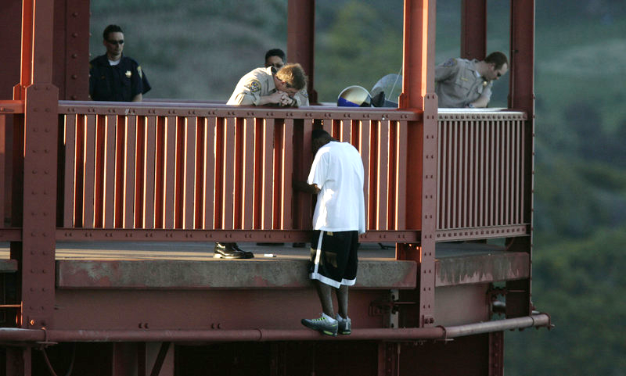
Does the man in the t-shirt want to live or die?
What are thoughts on living or dying?
(Image: Npr.org, 2019)
Notes:
ACTIVITY:
You can offer this as a brief small group activity in pairs or more.
Or you can have a large group discussion.
In either case, the goal is to focus on ambivalence.
Background: Officer Kevin Briggs & Kevin Berthia – in March 2005, Kevin Berthia attempted to end his life at the Golden Gate Bridge. He says – “I parked and walked towards the bridge. As I jumped over the railings I heard someone say: “Hey, wait a minute.” I was convinced I was going to end my life , but at the last moment his voice made me stop and grab the railings. That’s what you see in the picture – me standing on the ledge. I now know that was Officer Briggs (center, leaning on the railings). He snapped me back to reality. I was on that ledge for 92 minutes, and for 89 of those I just talked. I got everything out and he listened without judging.’
Image is used via public domain Source: Npr.org. (2019). NPR Choice page. [online] Available at: https://www.npr.org/2015/03/06/390970491/ten-years-later-two-strangers-revisit-what-might-have-been-lost [Accessed 30 Sep. 2019].

Slide 35
Why Means Matter
1. The acute phase of a suicidal crisis is often brief.
2. Some methods are far less lethal than others.
3. Over 90% of people who attempt suicide and survive do NOT go on to die by suicide.
4. Many people who are suicidal are ambivalent
Notes:
35
4th Reason
Reasons for living vs reasons for dying – ASIST concept that people have their reasons for wanting to die and also have reasons for staying alive/living.
Demonstration of ambivalence - coming to a counseling session to TALK about wanting to die with you rather than making an attempt
Source: Drum, D. J., Brownson, C., Burton Denmark, A., & Smith, S. E. (2009). New data on the nature of suicidal crises in college students: Shifting the paradigm. Professional Psychology: Research and Practice, 40(3), 213-222.
http://dx.doi.org/10.1037/a0014465

Slide 36
Ambivalence
Among young adults who seriously considered suicide in past 12 months | n=1321
Began attempt, then reconsidered | ??
Carried through an attempt | ??
Drum, 2009
Notes:
Activity

Slide 37
Ambivalence
Among young adults who seriously considered suicide in past 12 months | n=1321
Began attempt, then reconsidered | 15%
Carried through an attempt | 12%
Drum, 2009
Notes:
In one study, among college and university students who had seriously considered suicide, 12% (160/1321)reported carrying through with an attempt, but a greater number (196/1321) reported starting an attempt but then stopping.
Given the ambivalence, we don’t want people to attempt with methods—like guns and jumps—that don’t allow a window of opportunity for a change of heart.
https://www.researchgate.net/publication/232465762_New_Data_on_the_Nature_of_Suicidal_Crises_in_College_Students_Shifting_the_Paradigm
Drum, D. J., Brownson, C., Denmark, A. B., & Smith, S. E. (2009). New Data on the Nature of Suicidal Crises in College Students: Shifting the Paradigm. Professional Psychology: Research and Practice, 40(3), 213-222. https://doi.org/10.1037/a0014465

Slide 38

“I instantly realized that everything in my life that I’d thought was unfixable was totally fixable—except for what I’d just done [jumped].”
Ken Baldwin as quoted in “Jumpers” The New Yorker (2003)
Notes:
In the third scenario we see in Hunter’s case what Elaine Frank has called the “Oh, shit” moment.
Most suicidal people are not sure whether they want to live or die. For most, they want the pain of their current situation to stop and can’t – in the moment – see any alternative but to end their life.
Many people who survive highly lethal attempts say something like this:
Quote from slide - “I instantly realized that everything in my life that I’d thought was unfixable was totally fixable—except for what I’d just done.” Tad Friend, “Jumpers.” The New Yorker (2003) Many other survivors of lethal attempts have said similar things.
Source: Friend, T. (2003). Many other survivors of lethal attempts have said similar things. The New Yorker .
This image is being used as public domain

Slide 39
Summary: Why Means Matter
Suicidal crises are often brief.
Some methods, especially guns, are far more lethal than others.
>90% of those who attempt and survive do not go on to die by suicide.
Many people who are suicidal are ambivalent.
Putting time and distance between a suicidal person and a highly lethal means
– especially a firearm – can save a life.
Notes:
39
source: Deisenhammer, E. A., Ing, C.-M., Strauss, R., Kemmler, G., Hinterhuber, H., & Weiss, E. M. (2009). The Duration of the Suicidal Process. The Journal of Clinical Psychiatry, 70(1), 19–24.

Slide 40
Why Firearms Matter Most
They are the leading method in MO
They are highly lethal
They are highly accessible in many homes
They are fast and irreversible
Notes:
An estimated 27.1 % Missouri homes have firearms
https://injuryprevention.bmj.com/content/injuryprev/early/2015/06/09/injuryprev-2015-041586.full.pdf?keytype=ref&ijkey=doj6vx0laFZMsQ2
The other consideration with firearms – non-fatal attempts typically result in catastrophic injury that have life-long consequences
Note to trainers: when we say they are highly accessible in many homes we are referring to a couple of different types of accessibility. First, the gun in the nightstand poses far more threat than the bridge located an hour away, simply because during the hour it takes to drive to the bridge, the person may have changed their mind. We see in incident narratives from the National Violent Death Reporting System that at times firearm suicides occur right during the midst of an argument, a circumstance where easy access clearly matters. But there is another type of “accessiblity.” Everyone has access to fire, for example. And in parts of India, suicide by fire (self-immolation) is not uncommon. But in the U.S. almost no one uses fire for suicide. It isn’t acceptable to us as a method; so a method needs to be both physically accessible and “cognitively” accessible (personally acceptable to the would-be attempter).

Slide 41
What Made the Difference for Hunter?
When Hunter’s parents contacted the mental health center, the clinician reviewed treatment options and ways to support their son. She also suggested that they store guns away from home while Hunter is in crisis. She helped Hunter’s parents develop a plan for temporarily moving the guns to a relative’s house across town.

Slide 42
Common Ground
Whether you own a gun or not, suicide prevention is an area on which people find common ground.
Gun owners value responsible firearm ownership and protecting their families.
If you feel uncomfortable about raising the issue, it might help to learn that many firearm instructors, gun shop owners, and gun rights advocates have begun advising that if a family member is at risk for suicide, it is wise to store guns away from home or otherwise inaccessible to them until they have recovered.
You might also want to take a basic firearm safety class to increase your familiarity with guns and how to handle and store them safely.
Notes:
42
Association, Second Amendment Foundation, NH Firearm Safety Coalition, National Shooting Sports Foundation, and others have gotten involved.)

Slide 43
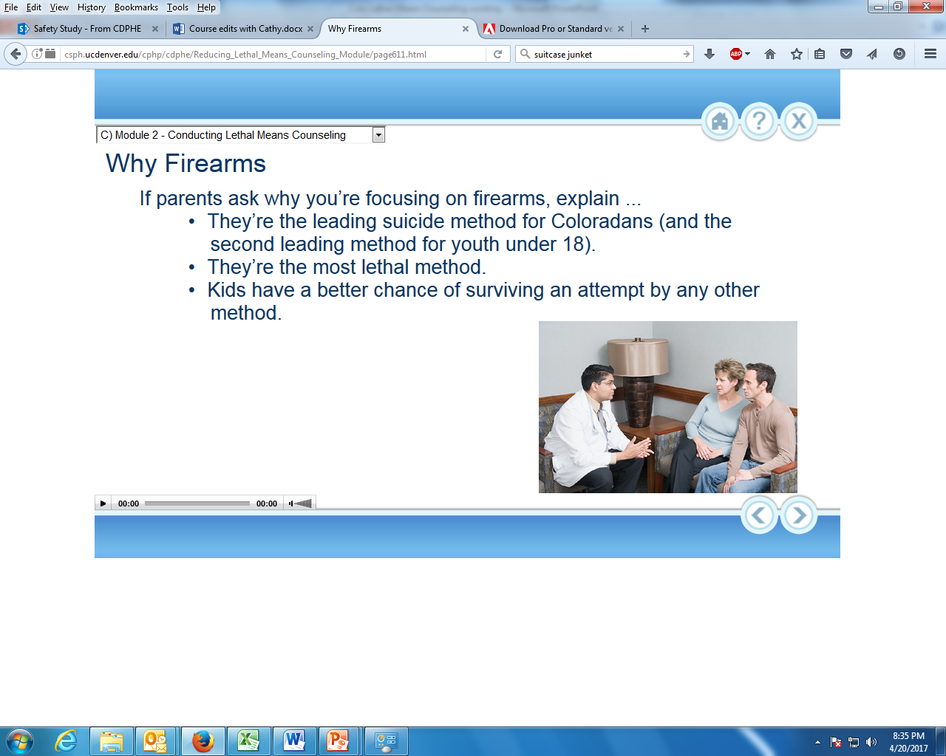


Module 2
Conducting Lethal Means Counseling
Notes:
Re-grouping – What are the Four Pillars of CALM & Means Matters??
Suicidal crisis is often brief
Some methods are less lethal
90% of attempters who survive do NOT go on to die by suicide.
Ambivalence is strong

Slide 44
Overview of Lethal Means Counseling
Assess suicide risk using standardized risk assessment tools.
Explain risk to patient and parent/support person: suicidal feelings can come and go; reducing access to lethal means – especially firearms – can help the patient stay safe.
Collaborate on a plan to reduce access to firearms (leading suicide method) and medications (leading method of attempt), as well as on any method on which ideation focuses.
Agree on roles and timetable and document the plan in the chart (e.g., patient’s wife will hold onto the keys to the gun safe tonight; tomorrow he’ll arrange to have his friend stop by to pick up the guns).
Follow up within 24 hours (or the next school day in school settings) and at next appointment.
Notes:
44
Read through the steps.
Emphasize that CALM does not teach risk assessment; we are only giving some background info to help determine if CALM is appropriate for a given client.
Urge participants who have not been trained recently in Suicide Risk Assessment that they pursue training.
Resources are in the handouts.
Source: CALM Developers

Slide 45
Limits to the “Screen & Treat” Model
Many clinicians have been trained to screen for suicide risk by asking a patient:
  “Are you feeling suicidal?”
    (if yes) -> “Have you made a plan?”
    (if yes) -> “Have you thought about a method?”
    (if yes) -> Focus on reducing access to planned method
What are the problems with this approach?
Notes:
45
(Note to Trainer: have participants discuss.)
“Old School” approach – focus only on suicide and ending those feelings, not what is driving/causing the feelings.
Minimizes person’s perspective of the situation
This approach overlooks the episodic and unplanned nature of many suicidal crises.
A person who was suicidal a month ago is not necessarily suicidal today but may be two weeks from now when, say, his or her spouse walks out.
Not all attempts are planned or deliberated over, so lethal means counseling makes sense with anyone at risk.
Refer back to the Deisenhammer study
For training in a more thoughtful approach to suicide risk assessment and treatment visit: zerosuicide.sprc.org
Source: CALM Developers

Slide 46
Suicide plans
Among people who attempted suicide, what % reported they had made a plan? (National Comorbidity Survey, Borges 2006)
? % had a suicide plan
? % did NOT have a suicide plan
(Borges et al 2006)
Notes:
46
(Background for trainer: the National Comorbidity Survey is the “Cadillac” psychiatric epidemiology survey of adults for the U.S. It is powered to measure the prevalence of mental health problems like depressive and anxiety disorders. The survey also asks respondents whether each of the following occurred over the past 12 months: they seriously considered suicide, they made a suicide plan, they attempted suicide. The table on the slide covers the relatively small number who said that they actually attempted suicide in the past year; ask participants to guess what proportion had said they had made a plan.)
Borges, G, 2006 - A risk index for 12-month suicide attempts in the National Comorbidity Survey Replication (NCS-R). https://www.ncbi.nlm.nih.gov/pmc/articles/PMC1924761/
Results. Twelve-month prevalence estimates of suicide ideation, plans and attempts are 2·6, 0·7 and 0·4% respectively.
Although ideators with a plan are more likely to make an attempt (31·9%) than those without a plan (9·6%), 43% of attempts were described as unplanned.
History of prior attempts is the strongest correlate of 12-month attempts.
Other significant correlates include shorter duration of ideation, presence of a suicide plan, and several sociodemographic and parental psychopathology variables.
Source:
Borges, G., Angst, J., Nock, M. K., Ruscio, A. M., Walters, E. E., & Kessler, R. C. (2006). A risk index for 12-month suicide attempts in the National Comorbidity Survey Replication (NCS-R). Psychological Medicine, 36(12), 1747–1757.

Slide 47
Suicide plans
Among people who attempted suicide, what % reported they had made a plan? (National Comorbidity Survey, Borges 2006)
57 % had a suicide plan
43 % did NOT have a suicide plan
(Borges et al 2006)
Notes:
47
While slightly more than 50% had made a plan; more than 40% of those who made an attempt say they had not made a plan.
Source:
Borges, G., Angst, J., Nock, M. K., Ruscio, A. M., Walters, E. E., & Kessler, R. C. (2006). A risk index for 12-month suicide attempts in the National Comorbidity Survey Replication (NCS-R). Psychological Medicine, 36(12), 1747–1757.

Slide 48
Lethal Means Counseling Approach
Recent past
  Over the past couple of months, have there been times when things were so bad you felt like you didn’t want to live? Did you want to kill yourself?
Ever attempted
  Have you ever attempted or started to attempt or prepared to attempt?
Today
  What about today? Are you thinking about killing yourself?
If yes to any of above
  Discuss reducing access to firearms and dangerous medications, regardless of whether any plans are mentioned
  Ask about other methods the patient has thought of using
  Ask about access to those methods
Notes:
(Note to trainer: read through the slide. The one caveat is if there is no serious distress in the past couple of months and none today, and the only time they ever attempted or got close to attempting suicide was years ago and it has never come up again, lethal counseling is not necessarily indicated.)

Slide 49
A Word about Motivational Interviewing
MI is a collaborative, goal-oriented style of communication with particular attention to the language of change.
It is designed to strengthen personal motivation for and commitment to a specific goal by eliciting and exploring the person’s own reasons for change within an atmosphere of acceptance and compassion.
The OARS Model of MI utilizes:
  Open-ended questions
  Affirmations
  Reflections
  Summaries
To be effective with MI, you must accept that it is, in the end, the client’s decision to reduce access to means.
You must be willing to accept a decision with which you do not agree.
(Britton et al 2016)
Notes:
Purpose of this slide is NOT TO train in MI, but to pull key tenets and tie them to CALM.
Really working with the O.A.R.S steps – basic active listening and keeping focus on client/contact
Bottomline with MI – person focused, decision to make an attempt is still their choice
Open-ended questions - Invites person to problem solve
“How do you think we can increase your daughter’s safety?”
vs closed-ended: “Will you remove all of the guns?”
Affirmations – Related to individual values and culture, Increase self-efficacy
“I know this is a difficult situation. On one hand, you keep guns to protect your family. On the other hand, your son is struggling with serious depression right now.”
Reflections: repeat and rephrase – perhaps amplifying the point or highlighting ambivalence
“You worry about not having immediate access to a gun, but you also are worried about your son.”
Summaries: collect, reflect and transition to a decision.
“So, what I’m hearing is you think removing the guns might be too drastic a step, but you also worry how devastated your family would be if your daughter used one on herself. Is that accurate? Where do we go from here?”
Source: Britton, P., Bryan, C., & Valenstein, M. (2016). Motivational interviewing for means restriction counseling with patients at risk for suicide. Cognitive and Behavioral Practice 23, 51–61.

Slide 50
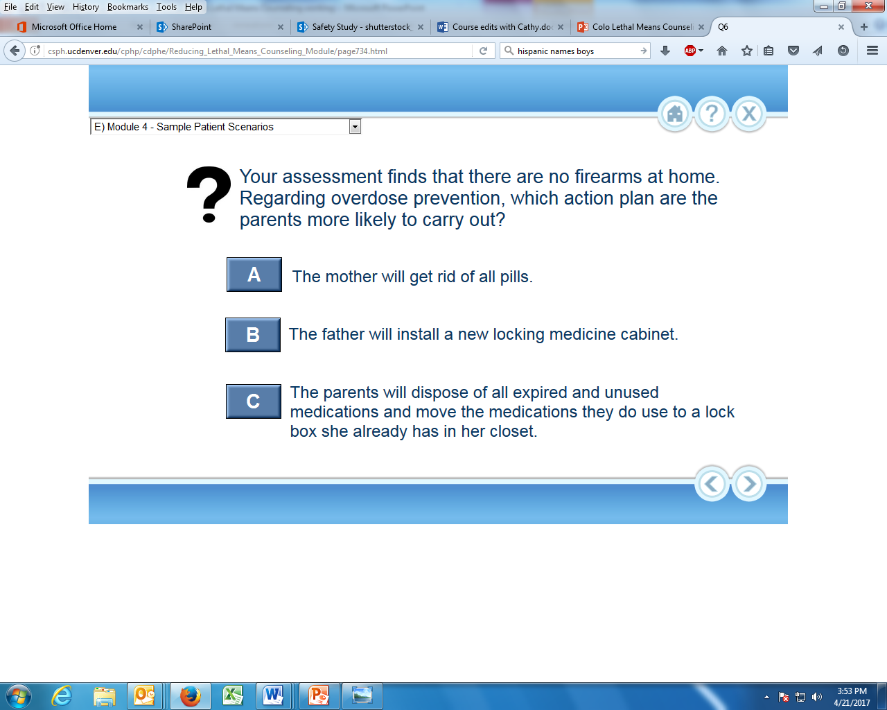
When is Lethal Means Counseling Appropriate?
  When The patient has attempted suicide or disclosed suicidal thoughts.
  When the patient denies current suicidality but is experiencing notably severe or comorbid disorders, safety concerns, significant life stressors, problematic substance use, etc.
  Both
(Bernecker et al., 2019)
Notes:
50
We would say both, as it is difficult to predict whether and when an attempt may occur.
Module 1 showed that almost half of people who had attempted suicide said they’d thought about making that attempt for 10 minutes or less before acting. That means you need to think about making things safer at home before a patient becomes suicidal. It is difficult to predict who among those struggling with a mental health problem will become suicidal. Therefore it is wise to take simple precautions.
A recent study asked a large sample of military personnel about lifetime history of suicidal ideation and followed them over time. Among those who attempted suicide during the follow-up period, two-thirds had NOT reported any current or lifetime history of suicidal ideation on their baseline survey. This suggests that we are not going to “screen and treat” our way out of the suicide problem.
Source:
Bernecker, S., Zuromski, K., Gutierrez, P., Joiner, T., King, A., Liu, H., Nock, M., Sampson, N., Zaslavsky, A., Stein, M., Ursano, R. and Kessler, R. (2019). Predicting suicide attempts among soldiers who deny suicidal ideation in the Army Study to Assess Risk and Resilience in Servicemembers (Army STARRS). Behaviour Research and Therapy, 120, p.103350.
Bernecker SL et al, 2018. Predicting suicide attempts among soldiers who deny suicidal ideation in the Army Study to Assess Risk and Resilience in Servicemembers (Army STARRS). https://www.ncbi.nlm.nih.gov/pubmed/30598236
This study is available in the Source materials file on the CALM T-t-T Google Drive.

Slide 51
Raising the Issue of Lethal Means
Current SI or History of SI/SA:
No current or lifetime SI/SA but in serious distress:
  “I’d like us to work on a plan for how to safely handle things if the suicidal feelings come back.”
  “I’m glad to hear you’re not feeling suicidal. Sometimes when people are struggling the way you’ve described, a crisis hits and suicidal feelings can develop quickly. They typically don’t last, but it can feel overwhelming. If by chance a crisis develops and you’re faced with suicidal thoughts, let’s come up with a plan for how you’d get through it safely.”
  Safety Plan, Coping Plan, Wrap-around Plan (Individualized plan you use)
  Intro to reducing access to lethal means:
    ”Now let’s talk about things you can do today at home to keep yourself safe.
    Putting time and distance between you and a method that could do serious harm - especially a firearm - is a good way to stay safer while you’re struggling.”
Notes:
51
This slide shows examples of language to use when raising the topic of lethal means safety with patients.
Of course, you’ll want to use your own style. These are just sample language.
On the left is how to raise the issue when the patient has disclosed current or recent SI or has had an attempt in the not too distant past.
We refer to creating a Safety Plan with the patient which we’ll briefly review on the next slide.
Again, if this is a topic you are unfamiliar with, the handout lists resources for training in this area.
On the right is an example of how to raise the topic when a person is struggling but they are not suicidal.
It isn’t something to raise when, for example, someone is in only mild distress.
Do raise it when a person is suffering and especially when they are also experiencing difficult crises like relationship break-ups, family fights, legal problems, eviction, etc. and/or have a history of SI or attempts.
Raising the issue that the suicidal feelings could possibly develop isn’t meant to frighten the person.
It is akin to a fire drill or to the flight attendant saying, “In the unlikely event of a water landing…” We hope that it will help the person feel more confidence that even if a suicidal period were to hit them, they will be able to weather the storm.
TAKE AWAY – Talking about reducing access to lethal means should be framed as safety issue.
Typically, some form of the word safe is used several times during a means reduction conversation.
Source: CALM Developers

Slide 52
Practice in Starting the CALM Conversation
Partner up – preferably with someone you don’t know/work with
Decide who will be the Clinician & Client/Person at Risk
Part 1 – Client has said that they are having suicidal thoughts or behaviors
  ‘Clinician’ restates, in their own words, why they are concerned about suicide. S/he then introduces the topic of Lethal Means Access.
  Continue the conversation until asked to stop.
  Follow the Flow Chart on the screen for ideas but use your own words.
Part 2 – Switch Roles - Client has denied having suicidal thoughts or behaviors but clinician is nonetheless concerned due to behavioral health status and/or life situation
  Clinician states why they are concerned about suicide and introduces the topic of Lethal Means Access. Continue the conversation until asked to stop.
  Follow the Flow Chart on the screen for ideas but use your own words.
Notes:
Practice talking about Access to Lethal Means when you are concerned that your client may be or may become suicidal.
If you want to give participants a chance to stand up and move around, you can have them pair up by lining up in some order – birthday, height, whatever – and pairing up with the person next to them. These instructions are also in the Handouts. You can then return to the Flow Chart on the screen.
After giving instructions and pairs are ready to do the activity, click back to S49 so the Flow Chart is on the screen
Go forward to S50, click to Part 2, ask pairs to switch roles
Debrief
This exercise is about bringing up the topic of access to lethal means, not necessarily about a perfect or complete intervention
In practice, this would most likely be part of creating a Safety Plan but might need to be a stand-alone topic if time is short or the client is not willing to develop a full plan at this time.
Source: CALM developers

Slide 53
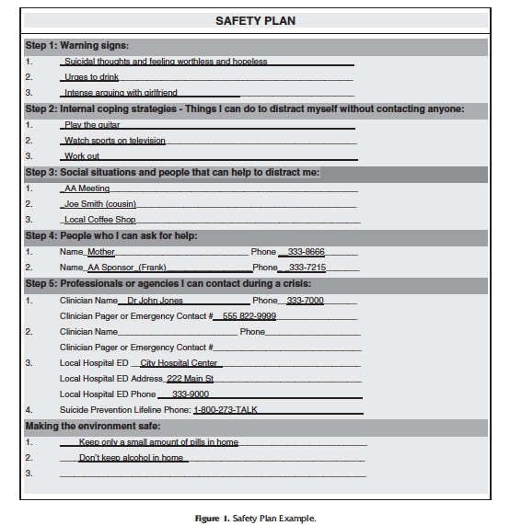
Safety Plan (Stanley & Brown, 2012)
Notes:
This is an example of a Safety Plan that you fill out with a client. This one was completed with a patient who did not have any guns at home. Information on accessing a safety plan is available in the CALM Drive under Workshop Materials.

Slide 54
Firearms: Starting the Conversation
Which approach to starting the conversation do you think would feel more comfortable to gun owners?
“Lots of us in Missouri have guns. But when people feel really down or suicidal, the gun may pose more of a threat than a protection. What some of my patients in your situation have done is put some distance between them and their guns. What do you think about an option like that?”
“You don’t have any guns at home, do you?”
A
B
Notes:
54
This approach has a lot of advantages. It normalizes guns, gives a peer example, lets patients know this is their decision as it is not interrogating or judgmental. Patients without guns are likely to say so. Even if a patient doesn’t want to disclose the fact that they have guns, they at least will have heard the suggestion.
A disadvantage to this approach, is that if a person is in great distress, it may be too complex for cognitive processing. If a patient answers in a vague way, “I haven’t really thought about it,” you can ask, “May I ask you how you currently store your guns”” so as to elicit a concrete answer.
B. This approach has the advantage of cognitive simplicity, but it has some disadvantages. The patient may worry that the clinician will disapprove if they say yes or might fear that their gun rights may be endangered. They may be more likely to say “no” even if they do have guns at home. Still, simplicity is important if a patient is in extreme distress and having trouble processing information, or if time is short.

Slide 55
Gun Storage: Behavioral Objective
Safest
Next Best
Temporarily store guns away from home while the person is at increased risk.
Store in a gun safe or lock box at home and keep the keys/combination from the at-risk person.
Why isn’t in-home locking as safe?
Notes:
55
Off-site storage is the safest option, we believe this because every U.S. study that has examined the question to date (16 or more) have found that firearm access is a risk factor for suicide death (that is, people who die by suicide are more likely to have guns at home than demographically similar people who did not die by suicide).
In many cases, storing guns away from home may not be immediately accessible, feasible or acceptable to patients. Secure in-home storage is the second-best alternative. Ask the person to enlist a trusted person to lock up the guns and change the combination or hold onto the key to the locks. Other options are steps like not keeping ammunition at home for now or removing the slide or firing pin and storing them away from home.
Why isn’t in-home locking as safe as storing guns away from home? Even if someone other than the patient holds onto the key or changes the combination, locking devices can be defeated, some more easily than others.

Slide 56
Firearms: Off-site Storage
Relative or friend
    Convenient, free option.
    Legally, owners shouldn’t store with someone they know is a prohibited possessor.
Prohibited possessors under federal & MO law have a history of:
  Felony or domestic violence (DV) misdemeanor conviction
  DV restraining order
  Involuntary commitment or found mentally incompetent by a court
  Drug abuse problem
  Dishonorable discharge, fugitive from justice, undocumented immigrant
Transfers of this kind are legal in Missouri.
Notes:
56
It can be hard for families to know this information, but it should be discussed and families should be warned to take care to find out about legal ramifications if they are not sure.

Slide 57
Firearms: Other Options
  Gun ranges/Gun shops
  Self-storage facility
  Pawn shops
  Police/sheriff’s office
Notes:
57
[Note to trainer: Below is information on off-site storage options. If you are presenting outside of your local area and don’t know the local storage options, take a little time to get acquainted with them.]
Gun shops – Some gun shops will store guns, either as a commerical venture or as a free or low-cost service to regular customers. Depending on the storage style, they may need to enter the guns on their books and completed a background check before returning the guns. This isn’t the case if they provide locker rental storage, where the customer controls holds the key to the locks.
Private gun clubs and ranges sometimes offer locker rental storage to the public and/or to members. These typically do not involve a formal transfer or background check. An example is a public range that offers $20/month locker rental for the convenience of range shooters who, for example, can’t store their guns at work and go to the range directly from work.
Storage facility – Many self-storage facilities allow gun storage. Typically the smallest unit is 5’ by 5’, but a few offer drawers, which are the least expensive option. Prices typically involve a $20 administrative fee and start at $20-$75+/month depending on unit size. Store guns locked and unloaded. An advantage to this approach is that you don’t need to deal with background checks or let anyone in on the problem.
Pawn shops - Pawning guns for a very small loan amount is another storage option. Monthly interest on loans typically runs 15-20% or so. If the owner pawns their guns for a $100 loan, when they reclaim the guns they must pay back the $100 plus $15-$20 per month interest and go through a background check. (There are a few states – e.g., NY – that don’t allow pawn shops to receive or sell guns.)
Police/sheriff’s office – Local law enforcement may agree to temporarily hold firearms. Contact your local sheriff/police department to inquire about storage. Always call before bringing guns in so that you aren’t mistaken for a threat.

Slide 58
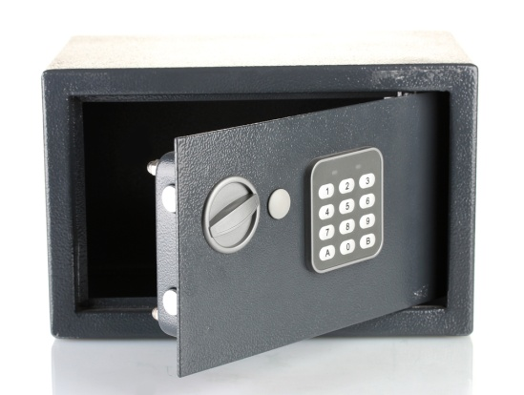

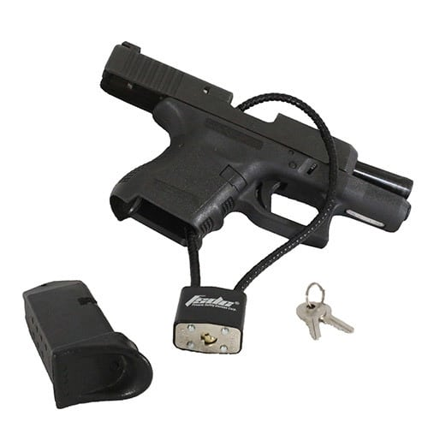

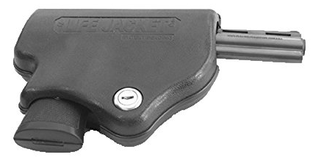
Firearms: Locking
If patient/client unwilling or unable to store guns away from home, or until they do, advise them to...
Lock guns unloaded in a gun safe or lock box.
Keep ammunition out of the home for now or locked separately.
Trigger locks, cable locks, and clamshell locks aren’t as safe as locking in a secure gun safe—but are better than not locking at all and can be used inside a gun safe for extra protection.
Ask the patient/client to enlist a trusted person to change the combination or hold onto the keys for now.
Notes:
58
High quality safes and lock boxes are the most secure in-home storage. But if the patient has access to the key or combination, the locks pose little barrier. Ask the patient to enlist a trusted person to change the combination or hold onto the keys for now. Another option is for the patient to store the keys somewhere away from home so that he or she doesn’t have access during a suicidal crisis—for example in a bank safe deposit box, which can run only $25 to $50 for a full year.
Among the small external locking devices, the cable lock is the most versatile because it works on most handguns and long guns. Cable locks are available free or for a very low price from www.projectchildsafe.org or in many cases from local police. However, they do not provide definitive security, as the cable can be snipped with bolt cutters. People who are serious about firearm security may laugh at you if you offer cable locks; but for those who have no locking option, anything is better than nothing until they can arrange for definitive storage.
Links to more information on locking options:
http://www.projectchildsafe.org/sites/default/files/GunSafeInfographic_LetterSize--with%20ORS%20logo_0.pdf
https://www.kingcounty.gov/depts/health/violence-injury-prevention/violence-prevention/gun-violence/LOCK-IT-UP/types-purchase.aspx

Slide 59
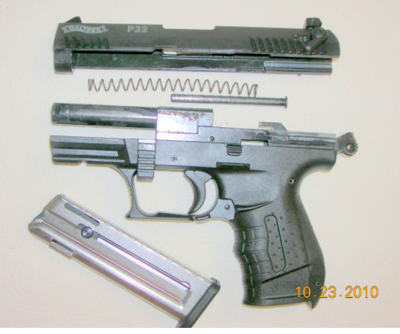
Firearms: Other Options
Remove a key component of the gun, such as the slide or firing pin, and store those away from home.
Hiding guns is not recommended. Family members often know one another’s hiding places.
  In one study, roughly 20% of parents who thought their children hadn’t handled their guns were mistaken; their kids reported they actually had handled the guns.
Baxley 2006
Notes:
59
CONCLUSIONS: Many parents who were living in homes with firearms and who reported that their children had never handled firearms in their homes were contradicted by their children's self-reports. Parents who locked their guns away and discussed gun safety with their children were as likely to be contradicted as parents who did not take such safety measures.
If you only have small lock boxes available, removing a component and locking it up can be an effective way to disable firearms that themselves don’t fit.
Ask participants how many knew where their parents hid their Christmas presents or liquor bottles or Playboy magazines.
Source: Baxley F, Miller M. Parental Misperceptions About Children and Firearms. Arch Pediatr Adolesc Med. 2006;160(5):542–547. doi:10.1001/archpedi.160.5.542

Slide 60
When the At-Risk Person is a Minor
Ask the minor about access (“How long would it take you to get your hands on a gun at home?”).
Speak with the parent or guardian without the child present.
If the parent in front of you does not control gun storage decisions, try to talk with the one who does (e.g., by phone), unless there are contraindications.
The non-owning parent (usually mother) often doesn’t know if there are guns that are unlocked.
If the youth lives in more than one home (e.g., joint custody situations), make plans for both homes.
While Missouri has a CAP (Child Access Prevention) Law, it does not apply to parents or to unsafe storage. It makes it illegal to recklessly sell, lease, loan, give or deliver any firearm to a child under 18 without parental permission.
Notes:
60
Often when you’re working with the parent or guardian of a minor, you are talking to the mother. A recent study in Utah learned from the Behavioral Risk Factor Surveillance System (a telephone survey) that while married men and married women report there being guns at home at the same rate, many more married men than married women report that at least one of those guns is unlocked and loaded.
Source: Suicide and Firearm Injury in Utah Linking Data to Save Lives, October 2018 Harvard T. H. Chan School of Public Health https://dsamh.utah.gov/pdf/suicide/Suicide%20and%20Firearm%20Injury%20in%20Utah%20-%20Final%20Report.pdf

Slide 61
What about a Self-Defense Gun?
This needs to be a separate question and discussion
First bring up the high short-term risk of suicide when someone is struggling vs. the risk of home invasion
Explore substituting other means of self-defense like pepper spray, outdoor alarms, etc.
If self-defense gun is essential, and the gun owner is not the one at risk, owner keeps it on their person or in quick access lock box and ensures at-risk person can’t get it.
If owner is at risk, work with them and a support person to put time and distance between owner and the gun, e.g., his friend holds the keys, he puts pictures of grandkids on lock box etc..
Seek ways to reduce access over time.
Notes:
Gun owners sometimes don’t think you’re talking about their self-defense gun when they say that they store all of their guns locked when not in use. So, it’s a good idea when talking about gun storage to ask specifically, “And what about your self-defense gun, if you have one. When you’re sleeping, how do you store it?”
In some cases you’ll run into patients who suffer from an anxiety problem for whom the gun is serving in an iconic way to help allay their anxiety. For example, a veteran peer support volunteer relayed his own experience at a training. When he returned from active combat duty and he had severe PTSD, to feel safer, he slept with a gun under his pillow. He was in treatment, and he started to realize that in reality his neighborhood was not dangerous., Because his anxiety was so extreme and he couldn’t imagine not having his gun nearby, his therapist suggested that he experiment on an incremental basis. Try putting the gun on the bedside table for a couple of nights and see how that goes. It went ok. So he moved it a little further away, and over the next few days he moved it into the gun safe with the door open, then with the door closed. What surprised him was that rather than increasing his anxiety, in fact, the less access he had to his gun, the less anxious he felt. So this was a double win: he was both actually safer from suicide risk AND less distraught.
NO SOURCE: comment from E.Frank, “I believe this is related to slide 59 and 60. There is no agreed upon data on the short term risk of home invasion nor on the short term risk of suicide for any given individual. However, if there is concern about suicide for a specific person, the risk is likely higher for the short term than is the risk f home invasion.”

Slide 62
Self-Defense Gun
Your client:
  is dealing with long term chronic pain and SI
  keeps a gun for self-defense
  When you say the gun is probably more a risk than a protection right now, they say their neighborhood is dangerous.
Your reply?
At this point, the risk of suicide is greater than the risk of being killed during a break-in.
OR
I understand that protecting your home and family are very important. And you also want to keep yourself alive. Let’s talk about ways to keep everyone safe?
Notes:
Feedback if they choose A: While this may be true, given that you’ve already pointed out the likely greater risk the gun poses, this may sound argumentative and invalidate his viewpoint.
Feedback if they choose B: This invites a collaborative discussion and puts the goal on SAFETY rather than on whether guns increase or decrease safety.

Slide 63
Language Matters
Collaborative
“How can we safely store these guns and meds?”
“Let’s make a plan to keep you safer until things improve.”
Confrontational
“You need to get rid of the weapons.”
“I don’t trust you to be responsible with medications right now.”
Notes:
Ask for examples before clicking for animation
Again, note the use of safe language.
Source: CALM Developers

Slide 64
Caution: Read the Reactions
Pay attention to the way individuals respond to suggestions for means reduction
A client who readily agrees to reduce access might be “telling you what you want to hear.”
Reluctance and questions can be a good sign. Weighing pros and cons may indicate serious consideration.
It is ok to slow the conversation down.
Notes:
“Yeah, yeah, sure” is often not a good sign that a person is truly considering making a change (unless it is coming from a position of true and enthusiastic agreement). An anxious parent who agrees quickly, however, might be a good sign.

Slide 65
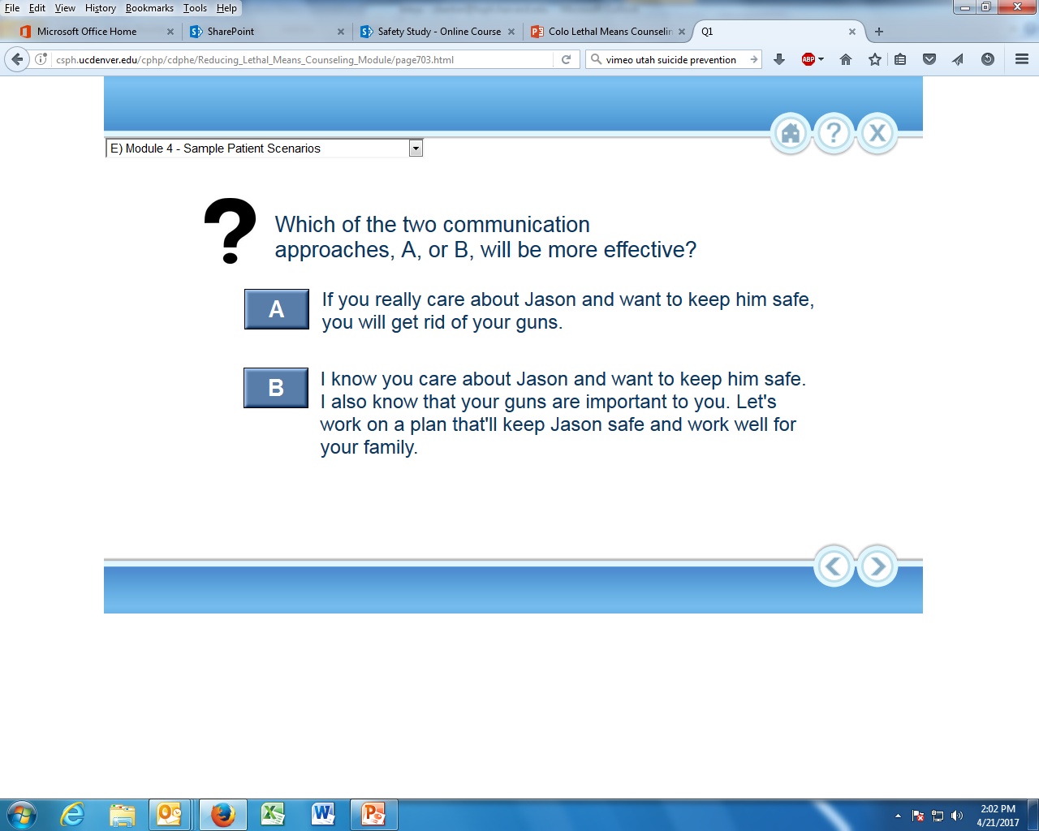
Bringing the Firearms Back
Parents or family members may ask when it is safe to bring the guns back. Which is the best answer?
  It’s a case-by-case decision. Why don’t we plan to follow up in a few weeks to see how things are going?
  Within a week or two since suicidal crises are usually short-term
Notes:
65
See next slide for discussion

Slide 66
Reintroducing Lethal Means
When is it OK to bring lethal means back into the home?
  Case-by-case decision, but some signs can be:
    No suicidal ideation for several months
    Able to cope effectively with stressors
    Development of a relapse prevention plan
Continue to encourage safe storage and limited access
  Firearms are locked
  Medications are limited to what is needed
Notes:
While it is true that the acute phase of a suicidal crisis is often short, a week or two is not nearly long enough to establish whether the patient is no longer at risk for hitting these crisis periods. The crisis periods are hard to predict. You want to see at least a few months where the person isn’t hitting very low periods and when they’re able to handle difficulties that arise in life.

Slide 67

Case Study: Jason
Jason, 16, arrived at the ER with his parents.
  After being suspended from school for fighting, he told his school counselor that he was “thinking about ending it all.”
  Later at home, Jason and his father got into an argument.
  Jason said that if his parents grounded him, he would use his hunting rifle to kill himself.
  When he began screaming and punching windows, his parents called 911.
  In the ER, Jason stated that he no longer wanted to kill himself.
Notes:
67
If you are running short on time, you can skip this Case Study – through slide 72.
Definitely include it if you are unable to show the “Sample Counseling Session”
Source: CALM developers

Slide 68
Jason’s Parents
As the behavioral health specialist in the ER, you meet with Jason’s parents.
When you suggest they store their firearms away from home for now, Jason’s father says,
  "Jason's dramatics are always interfering with the family. I’ll be damned if I’ll shortchange my younger son by canceling our hunting plans."
How would you respond?

Slide 69
Jason
Some good ideas:
“I know you care about Jason and want to keep him safe, and that hunting is important to you. Let’s work on a plan that keeps him safe and works well for your family.”
“Is there a relative you could store your guns with between hunting trips? If not, this handout lists some local storage options you could consider.”
Responses to avoid:
“You need to choose between your son’s safety and hunting.”
“If you care about Jason, you’ll get rid of your guns.”
“I think you’re being unreasonable here.”

Slide 70
Jason
Jason’s father expresses his doubt that Jason would ever actually go through with a suicide attempt.
“This is just how he manipulates us when he’s in trouble.”
What’s your response?
Notes:
Some options:
“Kids do sometimes manipulate us. Unfortunately they also can act impulsively and irrationally. I’d rather err on the side of caution and take these suicidal feelings seriously.”
“I understand your frustration. On the other hand, it’s nearly impossible to know if or when a person will carry through on a suicide threat. But we do know that these violent outbursts and suicidal thoughts put him at higher risk.”
“If this is attention-seeking behavior, he’s got my attention. I’d like to make sure he’s safe and learns some positive ways to get what he wants.”

Slide 71
Jason
Some good responses:
  “Kids do sometimes manipulate us. Unfortunately they also can act impulsively and irrationally. I’d rather err on the side of caution and take these suicidal feelings seriously.”
  “It’s nearly impossible to know if or when a person will carry through on a suicide threat. But we do know that these violent outbursts and suicidal thoughts put him at higher risk.”
Notes:
Some options: “If this is attention-seeking behavior, he’s got my attention. I’d like to make sure he’s safe and learns some positive ways to get what he wants.”

Slide 72
Jason
When his father says,
  "I’ve always taught my kids to respect guns; they'd never use them irresponsibly, not even Jason"
How would you respond?
Notes:
“You’ve worked hard to pass your values down to your kids. But when a person starts feeling suicidal, unfortunately his familiarity with guns does nothing to protect him.”
This respects the father’s perspective and gives him a new piece of information to consider. A youth’s familiarity with guns unfortunately may increase his likelihood of choosing a gun over another method in a suicide attempt.
“When people are at the height of their distress, they often can’t make wise decisions. Sometimes their thinking narrows down to ‘How do I make this pain stop NOW?’ and they cannot think through other options or consequences.”

Slide 73
Jason
Some responses:
  “You’ve worked hard to pass your values down to your kids. But when a person starts feeling suicidal, unfortunately his familiarity with guns does nothing to protect him.”
  “When people are at the height of their distress, they often can’t make wise decisions. Sometimes their thinking narrows down to ‘How do I make this pain stop NOW?’ and they cannot think through other options or consequences.”
Notes:
This respects the father’s perspective and gives him a new piece of information to consider. A youth’s familiarity with guns unfortunately may increase his likelihood of choosing a gun over another method in a suicide attempt.
“

Slide 74
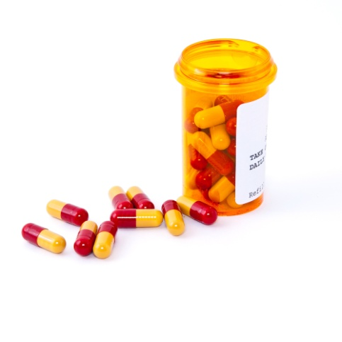
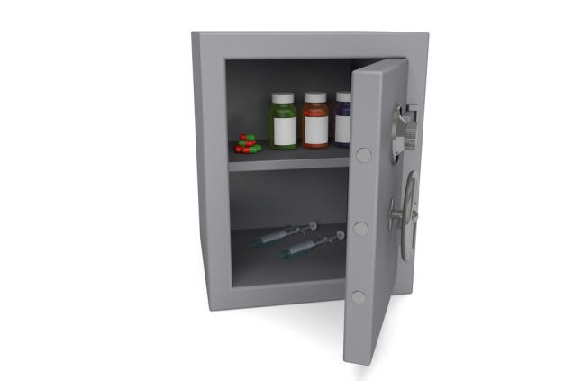

Medications
Medication overdose is the most common method of suicide attempt.
Overdose is not often fatal; however some medications are more dangerous than others, especially in combination (like opioids, benzodiazepines, and alcohol).
Finding lethal combinations on the internet is easy.
(WISQARS 2019; Canner et al 2018; Berman et al 2003)
Notes:
74
The medications that are most often implicated in intentional overdose DEATHS, according to NVDRS data, are
Opioids -- prescription pain medications like oxycodone, morphine, fentanyl, hydrocodone, as well as illicit opioids like heroin and bootlegged fentanyl are among the most common and toxic drugs involved in overdose deaths
Benzodiazepines—”Benzos” are a class of drugs prescribed to relieve anxiety and muscle tension (e.g., brand names Valium, Xanax, Clonopin, Ativan, Librium). Like opioids they can be addictive and are central nervous system depressants.
Other psychiatric medications -- like antidepressants and antipsychotics. These medications are not addictive and vary in their lethality potential, but even the less dangerous ones can be much more dangerous when taken in combination with other central nervous system depressants like opioids, benzos, and alcohol)
Sleep medications – both prescription and over-the counter (like diphenhydramine)
Over-the-counter pain pills – like acetaminophen (Tylenol).
Interestingly, medications for heart conditions, diabetes, and other chronic conditions do not appear very often in the NVDRS overdose suicides.
Sources: Canner, J. K., Giuliano, K., Selvarajah, S., Hammond, E. R, & Schneider, E. B. (2018). Emergency department visits for attempted suicide and self harm in the USA: 2006–2013. Epidemiology and Psychiatric Sciences, 27(1), 94–102. – medication overdose is the most common method of suicide attempt
Berman, A. L., Shepherd, G., & Silverman, M. M. (2003). The LSARS-II: Lethality of suicide attempt rating scale updated. Suicide and Life-Threatening Behavior 33(3), 261–276. – some medications are more dangerous than others

Slide 75
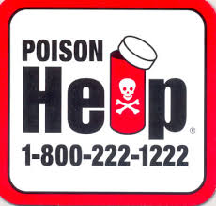
Medications: Reducing Access
Overdose is usually not fatal. But because there are hundreds of thousands of overdose attempts, it is the 3rd-leading method of suicide death.
If you prescribe meds or work with prescribers, minimize overdose risk for at-risk patients:
  Use lower toxicity medications where possible
  Limit quantities to non-lethal doses, even if taken all at once
  Take into account drug interactions & substance use/misuse
  For help on safe quantities, ask a pharmacist or the Poison Control Hotline 1-800-222-1222
(Spicer, 2000)
Notes:
Source: Spicer, R. S., & Miller, T. R. (2000). Suicide acts in 8 states: Incidence and case fatality rates by demographics and method. American Journal of Public Health, 90(12), 1885.

Slide 76

Medications: Reducing Access
Advise the following steps:
  Properly dispose of unneeded/expired medications.
  Keep only non-lethal quantities on hand.
  Lock up abuse-prone and dangerous drugs (e.g., opioids, anti-anxiety medications, amphetamines, sedatives/tranquilizers).
  Local health departments may distribute lockboxes
  Pharmacists can advise on safe quantities. A support person—not the patient—should talk with them.
Notes:
There’s a website in the resource materials that lists drug drop-off locations in Missouri - https://opioids.mo.gov/drug-take-back-locations
In St. Louis area: http://ncada-stl.org/get-involved/safe-use-storage-and-disposal-of-prescriptions/prescription-drug-drop-off-locations/
Some other notes on the bullet points in the slide:
The drugs that are abuse-prone are important to lock up both because they can lead to addiction and because they tend to be more toxic than the typical meds one finds in the medicine cabinet (like vitamins, diarrhea medicine, laxatives, which are not a cause for overdose concern).
A word of caution on medication lockboxes: many of them are designed to keep toddlers out, not teenagers or adults. Test a lockbox to ensure that it isn’t easily defeated.
Source: CALM Developers

Slide 77
Speaking with Patients about Medication
Which of the following is the safest strategy for speaking with a patient about psychiatric medication?
“We will continue with the prescription because it seems to be helping, but if you take it all at once it could kill you, so let’s revisit your safety plan.”
“We will continue with the prescription because it seems to be helping, and, even if taken all at once, it won’t hurt you.”
“We will continue with the prescription because it seems to be helping, but I’m going to write it for weekly refills. This will mean you’ll have fewer pills at any one time, which is safer, though taking too many pills can still be harmful. So let’s revisit your safety plan.”
Notes:
The first option is telling the patient that you are giving her something that could kill her: a patient could justifiably feel that your are not serious about protecting her.
The second option in essence is telling the patient to use a different method if she wants to attempt suicide. Almost any method she would substitute is likely to be more lethal than her meds. Also, because so many factors go into toxicity—the medication itself, the dose, the patient’s size/age/metabolism/health, whether the patient would combine with other meds and alcohol – it is nearly impossible to assure that the meds will do no harm.
The third option strikes a balance: it lets the patient know you are taking steps to protect her and you are not over-promising safety or inadvertently suggesting she substitute a different method.
Weekly refills can be extremely inconvenient, however. For some very low-toxicity meds, monthly refills may be safe. Other options are to do monthly refills but have a family member or support person lock up all but one-week’s worth at a time.
You are not expected to be an expert on this. Pharmacists are the people with the most training in this area and can be asked to advise families.
Source: CALM Developers

Slide 78

Chan
Chan is a 15 year-old male in his sophomore year who
  identifies as gay, does not feel accepted by his parents, and goes home only to sleep.
  reports feeling depressed for the past year and tried to overdose on his prescribed insulin last night but was stopped by his older brother.
  While no suicidal intent today, he is afraid that the urge may return.
  He identifies his insulin as possible means, and he has access to a lethal dose.
Notes:
Cut down on words

Slide 79
Chan (cont.)
As his caregiver:
  You inform Chan that because you are concerned about his immediate safety, you want to talk with his parents about his suicide risk.
  He is upset but understands.
  You talk with the parents and learn they are resentful toward him, aren’t involved in his diabetes management, and seem unreliable.
What’s your next move?
Notes:
This is a very challenging case. It involves information that for the most part mental health clinicians will be unfamiliar with, like how toxic is insulin (very, if multiple doses are taken), are there single dose units (yes). Because you are unlikely to know these answers, and Chan’s parents are not a source of help, the point of this case is to emphasize the importance of reaching out for technical help (e.g., from Chan’s doctor and/or pharmacist for technical information) and to think outside the box for potential social supports (perhaps Chan’s brother can keep most of the insulin doses in a lockbox in the fridge and keep only a safe number of individual doses unlocked).

Slide 80
Other Methods
If the patient/client’s ideation focuses on a method other than medications or firearms, work with them to reduce access to that method in addition to guns and meds, particularly if that method is highly lethal.
  For example, if ideation focuses on motor vehicle crash, MV exhaust, or driving to a jump site, it may be unwise for the patient to have independent access to the car keys for now.
Notes:
80

Slide 81
Other Methods
It’s impossible to reduce access to all methods, especially tools for hanging and/or cutting.
If there are specific objects that the person has identified they would use (e.g., dog leash, carpet cutting blade), reduce access to those.
Otherwise, focus on support, supervision, and other parts of the Safety Plan
Notes:
In 2017, there were 1,151 suicides in Missouri. 58 of these were with sharp instruments. Limiting access to sharps at home is nearly impossible (smash a window and you have a sharp instrument), it is a major disruption to daily life, and it would almost never actually save a life. It is therefore not a promising avenue for means reduction.
While many more of those 1,151 suicides were suffocations (254), that method too is nearly impossible to control at home. Clothing, wire, cords, sheets, plastic bags, belts -- all can bring about death. Fortunately, according to the ICARIS-2 study, which asked people who seriously considered suicide what method they would use, suffocation and hanging ranked low on the list, which is a good thing since it is a relatively high-lethality method. Another saving grace to suffocation and partial-suspension hanging, there is a small window of opportunity for the attempter to change their mind or be rescued.
Data source: Missouri Department of Health and Senior Services, MICA - https://healthapps.dhss.mo.gov/MoPhims/QueryBuilder?qbc=DM&q=1&m=1
Source: Healthapps.dhss.mo.gov. (2019). MOPHIMS - Death MICA. [online] Available at: https://healthapps.dhss.mo.gov/MoPhims/QueryBuilder?qbc=DM&q=1&m=1 [Accessed 30 Sep. 2019].
(Healthapps.dhss.mo.gov, 2019)

Slide 82
Means Reduction for Self-Injury
In some cases, means reduction strategies are useful for preventing Non-Suicidal Self-Injury (NSSI)
Assess preferences and logistics for means reduction
  Be sure to identify replacement behaviors
Implements adolescents often prefer for cutting:
  Disassembled disposable razors
  Blades from pencil sharpeners
  X-acto blades
Notes:
[Note to speakers: CALM trainings do not typically cover this topic. It does, however, sometimes come up in discussion. We therefore have provided an optional slide in these cases.]
Often a patient uses non-suicidal self-injury as a means of calming themselves when they are feeling suicidal. In these cases, access to their preferred method should not be impeded until you and they have identified other protective strategies that they can successfully substitute to regulate their emotions and avoid a suicide attempt.
There are times – particularly during periods of dissociation—that NSSI in and of itself can be medically dangerous because the patient is unaware of the tissue damage they are inflicting. Means reduction for people who fall into this category should be considered.
For patients whose self-injuries are minor, the purpose of reducing their access to their preferred implements is not for their physical protection so much as to help them substitute pro-social techniques that in the long run will do a better job of helping them feel better.

Slide 83
Documentation and Follow-up
Once you’ve agreed on a specific plan, document
agreed upon roles and timelines:
Father will hold onto the keys to the gun locks tonight; tomorrow he’ll arrange to have his sister pick up the guns, and he’ll email me when the guns are gone.
Follow up within 24 hours (or the next school day)
and at the next appointment to ensure the plan is
being followed.
Notes:
83
Often Safety Plans are very vague (e.g. “Family will safeguard the guns at home”) and it is unclear who’s responsible for what and by when.
Making a plan specific, realistic, and actionable increases the odds that it will be enacted. Identifying specific behaviors that will be completed by specific individuals to avoid diffusion of responsibility.
Regarding follow-up, CALM is not a “one and done” technique. Unless you follow up, you are communicating that you weren’t actually serious about this aspect of their care and are willing to leave things to chance.
That said, there are cases where follow-up is not acutely time-sensitive (e.g., the patient is not in high distress and has disclosed no SI) and cases where it is critical (e.g., the patient is being released from the hospital following a suicide attempt). Discuss a follow-up time frame that is feasible for the family and reasonable for you and that underscores the importance of this strategy.
Source: CALM developers

Slide 84
Module 2 Summary
In this module you have learned how to:
Raise the issue that you are concerned about suicide.
Explain how reducing access reduces risk.
Discuss reducing access to firearms, medications, and, if indicated, other methods.
Enlist the help of a loved one or support person when possible.
Document the plan to reduce access, including roles and a timeframe.
Follow up within 24 hours and at the next visit or sooner.
Notes:
84

Slide 85
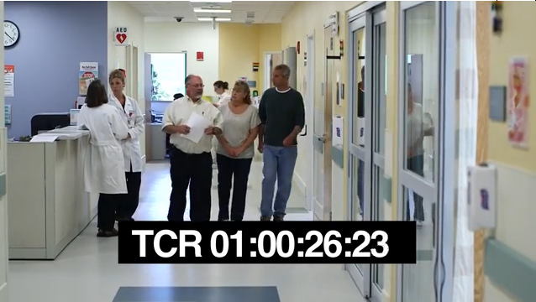
Module 3
Sample Counseling Session
www.youtube.com/watch?v=XiQbZUsCBlU

Slide 86
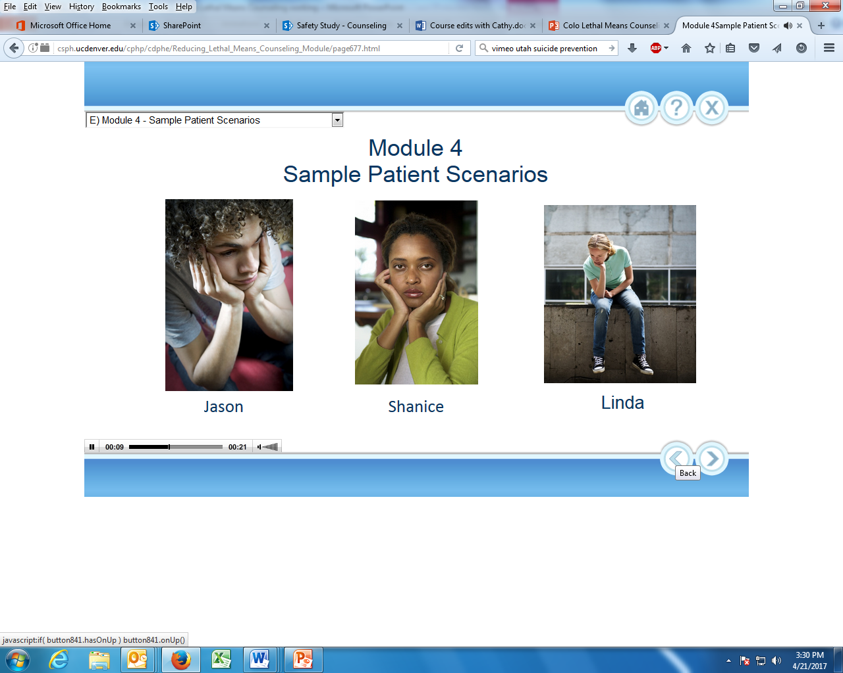



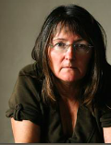
Module 4
Scenarios

Slide 87
Shanice is a 15 year-old who has been living with a foster family for two years. Recently, her school performance has declined, she is spending less time with her friends, and has withdrawn from activities she used to enjoy. When her friend noticed cut marks on Shanice’s arms, she urged her to set up an appointment with you at the school health clinic.
When you meet with Shanice, she says cutting is no longer relieving her emotional pain, and she has thought about taking all the pills in the medicine cabinet.
You assess Shanice for depression and for suicide risk. You determine that there is some risk, though it is not severe at this time.
You discuss a Cognitive Behavioral
Therapy Group that is just starting up.
Shanice agrees to try that and to have
her foster mom come in to meet with you.
Role play that conversation, focusing on
lethal means reduction.
Notes:
87
Fewer words

Slide 88
Luis, 18, has been angry and not sleeping for several nights. This evening, he took two of his mother’s sleeping pills thinking these might help him sleep. When he was still restless, he drank two beers.
His uncle, with whom Luis and his mother live, called the Poison Control Center to see if that might be a lethal combination. The PCC specialist found no acute poisoning risk but suggested that they set up an appointment for Luis at a behavioral health center.
Your assessment finds that Luis had no suicidal intent and has never considered suicide; his aim was to relieve
his emotional pain so he could sleep.
The uncle asks to speak with you, and
you receive Luis’s
permission.
You share that Luis says this was not
a suicide attempt.
How do you raise the issue of suicide risk
and home safety?

Slide 89
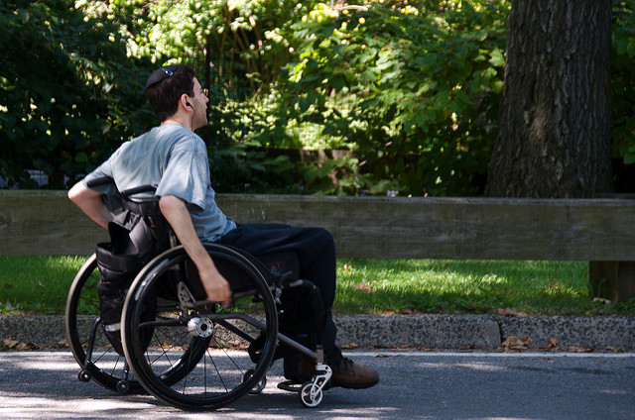
Tom is a 24 year old veteran who has recently returned from Afghanistan where he was in a motor vehicle crash, with significant injuries to his spinal cord.
After spending time in both acute care and rehab facilities, he has moved back home with his parents and is now receiving in-home physical therapy services. He has been making excellent progress and has regained most of the function in his upper body though there is still marked disability in both his legs.
Today, during therapy, he is not cooperative with you.
When you ask what is going on, he says,
“What’s the point? I’m going to be
stuck in this chair for the rest of my life.
I think I should make things easier
for everyone and just shoot myself.
I used to be a hunter and still have
a loaded shotgun in my closet.”
This Photo by Unknown Author is licensed under CC BY-SA-NC
Notes:
Ask directly about suicidal thoughts and actions and access to the loaded shotgun.
Listen carefully
Do not leave him alone with access
Who to engage/inform? Get his permission or acknowledgement.
Follow up to be sure that a treatment plan has been developed
Maintain connection

Slide 90

James is a 27 year old Army veteran. He completed one tour in Afghanistan. He struggles with PTSD and major depression. His wife called you and reported that he had locked himself in the bathroom last night and wouldn’t respond to her. He eventually came out and was quite calm though his wife was clearly shaken.
Today he says that he isn’t sleeping and is plagued by hypervigilance, and feelings of being useless. But he insists that he’s not suicidal and that he wouldn’t put his family through that. He wants to “get better” for his wife and kids.
When you ask about whether he has any firearms,
he says that he has to have a loaded
firearm at his bedside at night and
worries that without it his anxiety
will get worse.
What can be done to increase
James’ safety?
This Photo by Unknown Author is licensed under CC BY-NC-ND
Notes:
Focus on SAFETY – his, his wife’s and his kids
Ask him what would make him feel safer.
Engage him in discussion about reducing access to increase everyone’s safety
Involve others in support for him and his family – family and friends, VA, peer support, work, etc
Develop a comprehensive safety plan and follow up

Slide 91

MaryAnn has recently given birth to her second son in less than two years. You are making the second new baby home visit. This time, MaryAnn seems somewhat disinterested in both boys, the house is really dirty with stinky diapers on the coffee table and she has trouble making eye contact.
You know that she had been taking anti-depressants before this pregnancy but discontinued them while pregnant. Her PCP suggested that she go back on them and she resumed taking them two weeks ago.
When you ask her whether she is seeing any improvement from them, she replies, “I think the only way they’ll do me
any good is if I take the whole three month supply
at once and never wake up again.”
hen she starts to cry.
Notes:
Be direct in asking about thoughts of suicide and of making an attempt
Ask about other meds in the home
Ask about options for reducing her access to these quantities while she is feeling like this.
Try to get someone else involved – husband, other family, friend, neighbor. If husband, make sure she is comfortable with this.
Document this info. Share with your supervisor and with PCP and others re: duty to report.
Ask about firearms in the home and other methods
Do not leave her alone with children and meds

Slide 92

Stan is a 56 year-old, married man with two daughters in college. He lost his job at a high-tech firm eighteen months ago due to downsizing. Though he has been actively searching, he has yet to find anything, but he has been able to do some small consulting jobs.
Stan has had problems with sleep over the past two to three months, and he has seen Dr. Johnson, his primary care provider for complaints of chronic back pain and headaches. Today, when his wife accompanies him to the doctor, she reports that Stan has been very moody, and he has said more than once, “You know that if something happens to me, you’ll have all the life insurance money. That’s better than I can do for you and the girls right now.”
This Photo by Unknown Author is licensed under CC BY-SA
Notes:
Make a specific plan for reducing access to all lethal means
Create a comprehensive safety plan
Provide support for both Stan and his wife
Utilize wife to confront about the last part of his statement

Slide 93

Harold is 72 years old. Betty, his wife of 47 years died a year ago after a long fight with cancer. A devoted caregiver, Harold gave up his previous activities to care for his wife.
In the past six months, he has seen you, his PCP, a number of times for a variety of physical complaints. In the past three weeks, he has made and broken two appointments which is totally out of character.
During today’s appointment, when you ask, “What brings you here today?”, Harold says, “Same old thing. I just don’t feel myself.” When you say, “What do you think would make you feel better?”, Harold replies, “Probably just a shot in the head from my trusty old .22”
This Photo by Unknown Author is licensed under CC BY-SA
Notes:
Be direct in asking about suicidal thoughts – Have you been having thoughts of suicide?
Listen carefully and follow up.
Probe about depression, “not feeling himself” and concerns you have – withdrawn, missing appointments, etc.
Discuss options for reducing access to guns. Is there someone you would trust to hold on to your guns while you are feeling this way? Continue to probe until a solution is found.
Try to involve a family member or friend.
Develop a treatment plan including safety planning and follow up
Maintain connection
You may be the first or the only person he shares these feelings with!

Slide 94
Objectives
Explain that reducing access to lethal means is an evidence-based strategy that can suicide prevention.
Recognize that lethal means counseling is appropriate when concerns for suicide are present.
Demonstrate strategies to bring-up the topic of lethal means with comfort and competence.
Discuss specific off-site and in-home secure storage options for firearms as a strategy that increase time and distance between a person at risk and lethal means.
Work collaboratively with clients and their families on safety planning and follow-up for reducing access to lethal means.
Notes:
94

Slide 95
Final Thoughts
Questions?
Discussion Points?
Check Parking Lot

Slide 96
Congratulations!
You have completed
Counseling on Access to Lethal Means
workshop
To receive your continuing education credit, please complete the post-test evaluation.
If you have questions about CALM, you can contact
  Elizabeth Makulec (elizabeth.Makulec@kuto.org) or
  Rick Strait (rickstrait777@gmail.com)

Slide 97
Research Supporting CALM
Community Mental Health J. 2018 Apr; 54(3):293-301. doi: 10.1007/s10597-017-0190-z. Epub 2017 Nov 28. Counseling on Access to Lethal Means (CALM): An Evaluation of a Suicide Prevention Means Restriction Training Program for Mental Health Providers. https://www.ncbi.nlm.nih.gov/pubmed/29185154
J Emerg Nurs. 2018 Sep; 44(5):499-504. doi: 10.1016/j.jen.2018.03.012. Epub 2018 Apr 25. Counseling Suicidal Patients About Access to Lethal Means: Attitudes of Emergency Nurse Leaders. https://www.ncbi.nlm.nih.gov/pubmed/29704978
J Gerontol Soc Work. 2019 Jan; 62(1):48-66. doi: 10.1080/01634372.2018.1522410. Epub 2018 Sep 24. An Evaluation of the Counseling on Access to Lethal Means (CALM) Training with an Area Agency on Aging. https://www.ncbi.nlm.nih.gov/pubmed/30247989

Slide 98
References
Baxley F, Miller M. Parental Misperceptions About Children and Firearms. Arch Pediatr Adolesc Med. 2006;160(5):542–547. doi:10.1001/archpedi.160.5.542
Berman, A. L., Shepherd, G., & Silverman, M. M. (2003). The LSARS-II: Lethality of suicide attempt rating scale updated. Suicide and Life-Threatening Behavior 33(3), 261–276.
Borges, G., Angst, J., Nock, M. K., Ruscio, A. M., Walters, E. E., & Kessler, R. C. (2006). A risk index for 12-month suicide attempts in the National Comorbidity Survey Replication (NCSR). Psychological Medicine, 36(12), 1747–1757.
Britton, P., Bryan, C., & Valenstein, M. (2016). Motivational interviewing for means restriction counseling with patients at risk for suicide. Cognitive and Behavioral Practice 23, 51–61.
Canner, J. K., Giuliano, K., Selvarajah, S., Hammond, E. R, & Schneider, E. B. (2018). Emergency department visits for attempted suicide and self-harm in the USA: 2006–2013. Epidemiology and Psychiatric Sciences, 27(1), 94–102.
Carroll, R., Metcalfe, C., & Gunnell, D. (2014). Hospital Presenting Self-Harm and Risk of Fatal and Non-Fatal Repetition: Systematic Review and Meta-Analysis. PLoS ONE, 9(2).
Centers for Disease Control and Prevention, National Center for Injury Prevention and Control. Web-based Injury Statistics Query and Reporting System (WISQARS) [online]. (2017) [cit2019]. Available from URL: www.cdc.gov/injury/wisqars
Deisenhammer, E. A., Ing, C.-M., Strauss, R., Kemmler, G., Hinterhuber, H., & Weiss, E. M. (2009). The Duration of the Suicidal Process. The Journal of Clinical Psychiatry, 70(1), 19–24.

Slide 99
References
Drum, D. J., Brownson, C., Denmark, A. B., & Smith, S. E. (2009). New Data on the Nature of Suicidal Crises in College Students: Shifting the Paradigm. Professional Psychology: Research and Practice, 40(3), 213-222. https://doi.org/10.1037/a0014465
Fatal Injury Data | WISQARS | Injury Center | CDC.
Friend, T. (2003). Many other survivors of lethal attempts have said similar things. The New Yorker .
Gunnell, D., Fernando, R., Hewagama, M., Priyangika, W. D., Konradsen, F., & Eddleston, M. (2007). The impact of pesticide regulations on suicide in Sri Lanka. International journal of epidemiology, 36(6), 1235–1242. doi:10.1093/ije/dym164
Healthapps.dhss.mo.gov. (2019). MOPHIMS - Death MICA. [online] Available at: https://healthapps.dhss.mo.gov/MoPhims/QueryBuilder?qbc=DM&q=1&m=1 [Accessed 30 Sep. 2019].
Joiner, Thomas & Kalafat, John & Draper, John & Stokes, Heather & Knudson, Marshall & Berman, Alan & Mckeon, Richard. (2007). Establishing Standards for the Assessment of Suicide Risk Among Callers to the National Suicide Prevention Lifeline. Suicide & life-threatening behavior. 37. 353-65. 10.1521/suli.2007.37.3.353.
Lubin, G., Werbeloff, N., Halperin, D., Shmushkevitch, M., Weiser, M. and Knobler, H. (2010). Decrease in Suicide Rates After a Change of Policy Reducing Access to Firearms in Adolescents: A Naturalistic Epidemiological Study. Suicide and Life-Threatening Behavior, [online] 40(5), pp.421-424. Available at: https://onlinelibrary.wiley.com/doi/abs/10.1521/suli.2010.40.5.421 [Accessed 24 Sep. 2019].

Slide 100
References
Means Matter. (2019). Firearm Access is a Risk Factor for Suicide. [online] Available at: https://www.hsph.harvard.edu/means-matter/means-matter/risk/ [Accessed 30 Sep. 2019].
Means Matter. (2019). Means Matter. [online] Available at: https://www.hsph.harvard.edu/means-matter/ [Accessed 24 Sep. 2019].
O'Donnell, I, Arthur, A. J., & Farmer, R. D. (1994). A follow-up study of attempted railway suicides. Social Science & Medicine 38(3), 437–42.
Shelef, L., Laur, L., Raviv, G., & Fruchter, E. (2015). A military suicide prevention program in the Israeli Defense Force: a review of an important military medical procedure. Disaster and military medicine, 1, 16. doi:10.1186/s40696-015-0007-y
Spicer, R. S., & Miller, T. R. (2000). Suicide acts in 8 states: Incidence and case fatality rates by demographics and method. American Journal of Public Health, 90(12), 1885.
Stanley, B., & Brown, G. K. (2012). Safety planning intervention: A brief intervention to mitigate suicide risk. Cognitive and Behavioral Practice, 19(2), 256-264.
Suicide and Firearm Injury in Utah Linking Data to Save Lives, October 2018 Harvard T. H. Chan School of Public Health https://dsamh.utah.gov/pdf/suicide/Suicide%20and%20Firearm%20Injury%20in%20Utah%20-%20Final%20Report.pdf
UT Suicide Prevention Coalition. (2016). UT Suicide Prevention-Gun Range- [Video File]. Retrieved from URL: https://vimeo.com/175761640

Slide 101
Congratulations!
You have completed the Counseling on Access to Lethal Means Instructor Training.
To receive your continuing education credit, please complete the post-test evaluation.
Support materials are available in the online portal
  https://www.saferhomescollaborative.org/CALM
  PW = CALM2019-MIMH
If you have questions about CALM, you can contact
  Elizabeth Makulec (elizabeth.Makulec@kuto.org) or
  Rick Strait (rickstrait777@gmail.com)

