Slide 1

Conversations for Suicide Safer Homes
Training Evaluation

Slide 2
Safer Homes Collaborative Overview
Joint effort between the firearm-owning community and suicide prevention community.
Raise awareness of preventing suicide through safe firearm storage.
  Community Outreach
    Service members, veterans, and their families
    High-risk industry workers
    Faith-based organizations
    First responders
  Trainings
    Conversations for Suicides Safer Homes (CSSH)
    Question, Persuade, Refer (QPR)
    Vital Cog: Suicide Prevention in Construction
  Safe Storage Mapping
  Governor’s Challenge
Notes:
The Safer Homes Collaborative was first established in 2018 to implement a suicide prevention education program for owners and staff at gun shops, shooting ranges, and other organizations in frequent contact with firearm owners.
Field Coordinator Outreach--- Suicide prevention trained field coordinators who are also part of the firearm-owning community are employed to establish relationships and engage these populations in firearm suicide prevention.
and promote the message of lethal means safety.
2) They spread the mission and message by providing our materials (11 Commandment fliers, 988 wallet cards, and 988 magnets) to the target audiences.
3) Participate by offering the training Conversations for Suicide Safer Homes (CSSH) to the respective audience.
Conduct trainings to guide the general public in having the difficult conversation around suicide plans and access to lethal means.
We have added a page to the Safer Homes Collaborative website that directs visitors to FFL partners who offer firearm storage.
The Safer Homes Collaborative is responsible for the third strategy in the Governor's Challenge mission to prevent suicide: lethal means and safety planning for SMVF. The Safer Homes Collaborative continues to provide subject matter expertise to the Governor's Challenge for Suicide Prevention among SMVF. We completed the adaption of CSSH for military communities and have trained instructors from the SMVF population to deliver the training to the population

Slide 3
Conversations for Suicide Safer Homes
Adapted from Counseling on Access to Lethal Means (CALM) by the Safer Homes Collaborative.
Developed to train all audiences on how to prevent suicide through firearm-safe storage.
SHC has increased the capacity of CSSH instructors throughout the state.
  Held three CSSH instructor trainings
  Over seventy CSSH instructors in Missouri

Slide 4
CSSH Instructor Portal
  Login: https://saferhomescollaborative.org/CSSH
    Password: CSSH@MIMH2022
    Hints & Tips
      Instructor Portal link is not visible on the SHC webpage
      Save the URL to the web browser favorites
      Use the "save password" option

Slide 5
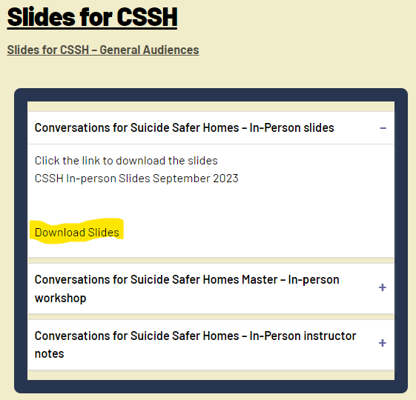
CSSH Instructor Portal
  Download the PowerPoint slides

Slide 6
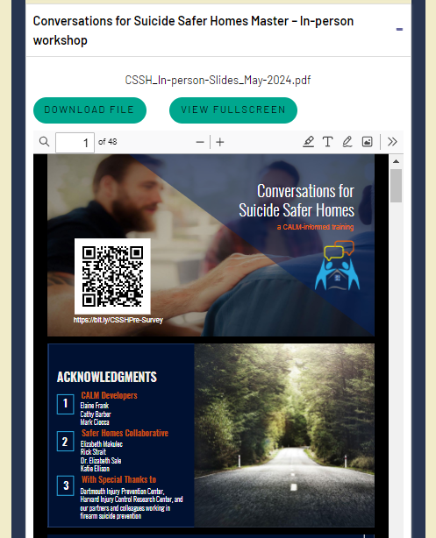
CSSH Instructor Portal
  Download a PDF copy of the slides

Slide 7
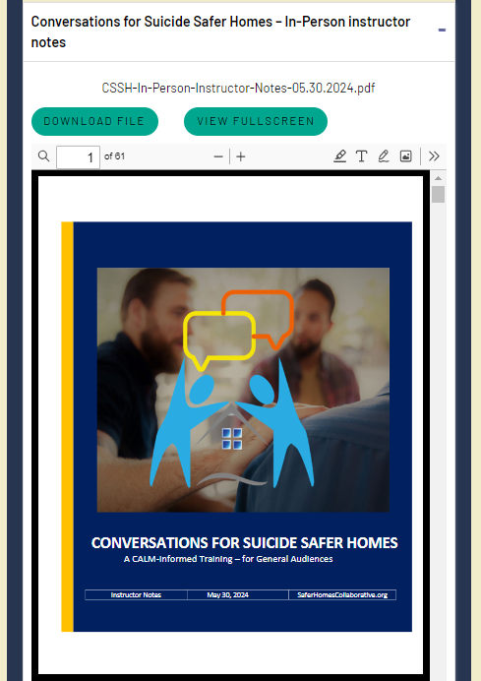
CSSH Instructor Portal
  Download the Instructor Manual

Slide 8
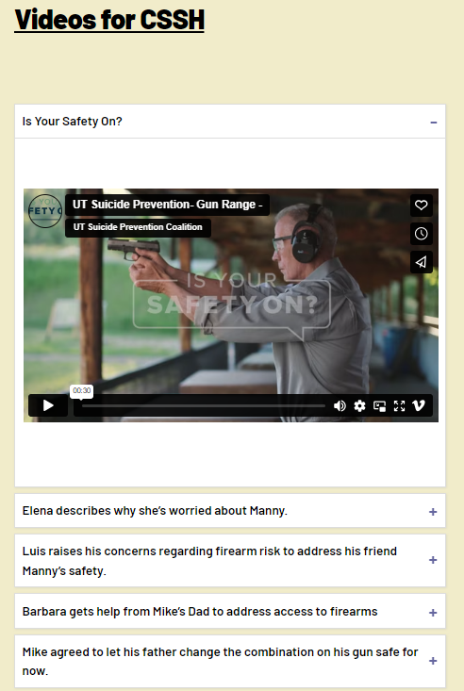
CSSH Instructor Portal
  Access the Videos

Slide 9
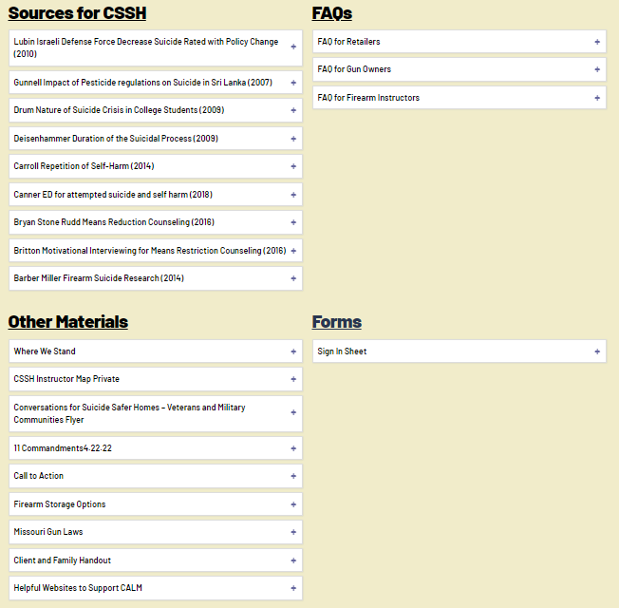
CSSH Instructor Portal
  Access some of the evidence-based research for CSSH
  Access additional Materials that support CSSH
  Access FAQs for firearm retailers, owners and instructors.
  Sign-in sheet

Slide 10
CSSH Evaluation
  What do we want to learn?
    Does CSSH increase knowledge, comfort, and confidence in those trained to be able to talk to and help someone at risk for suicide?
  Why is this important?
    To provide empirical evidence to validate the effectiveness of the CSSH training.
  How are we finding out?
    Collecting pre-, post, and three-month follow-up surveys from CSSH training participants.

Slide 11
CSSH Evaluation
CSSH instructors trained through SHC are asked to:
  Conduct two CSSH trainings
  Register each CSSH training online before the training is held.
  Collect and send in a sign-in sheet for each CSSH training.
  Collect pre- and posttest surveys from participants in each CSSH training.

Slide 12
CSSH Training Registration
Let’s do this together:
  Go to: https://saferhomescollaborative.org/CSSH
    Enter Password: CSSH@MIMH2022
  Click on CSSH Registration Form
      Complete the form and submit
  Once submitted, an email will be sent with confirmation.

Slide 13
Sign-In Sheet
Download and print sign-in sheet before training.
  Located on the website
The sign-in sheet is required at every training. This ensures accurate attendance numbers
  Not everyone who is registered attends
  Walk-ins happen
  Some will opt-out of pre and posttest surveys
Scan and email sign-in sheet as soon as training is completed.

Slide 14
Collecting Surveys
There are two ways to collect the pre- and posttest survey:
QR Codes (the easier and more efficient way)
  Embedded in the slides at the beginning (pre) and end (post)
  Instructor can strongly encourage completion of the surveys in person.
Email registration link (not so easy and less efficient)
  An email link is sent to the instructor after training is registered.
  This link is used to register participants who will be attending trainings.
  Once a participant is registered, the pretest will be emailed prior to the training and posttest will be emailed after the training.
  Participants are on their own complete surveys.

Slide 15
Collecting Surveys
Participants who complete the pre- and posttest surveys will be eligible for the 3-month follow-up survey and a $25 Amazon electronic gift card.
  Use this incentive to encourage survey completion.
  Participants MUST complete the pretest survey before the training begins.
  Remind participants if they complete the 3-month follow-up survey they will receive a $25 Amazon gift card.
  Instructors can request to receive participant feedback from their courses to learn from and improve the quality of training.

Slide 16
CSSH Instructor Incentive
As a thank you for conducting and evaluating CSSH Trainings, you will receive a $25 Amazon electronic gift card.
To receive the gift card:
  Register CSSH training online BEFORE training is conducted.
  Collect and send in sign-in sheet.
  Collect pre- and posttest surveys.

Slide 17
CEUs and POST credit
Participants can receive a certificate of attendance with FREE Missouri Institute of Mental Health (MIMH) CEUs or Peace Officer Standards and Training (POST) credit.
    MIMH awards 1 clock hour or 1.2 contact hours (.12) CEUS for this program
    Missouri POST Program has approved this course for 1 hour of continuing law enforcement education training in the area of Interpersonal Study.
To generate a Certificate, participants must access the Post-Survey by scanning the QR code or typing https://bit.ly/CSSHPost-Survey into a web browser.
  Participants must provide their email address so that the certificate can be sent back to them.
    Some organization's firewalls block our emails. For best results, we recommend participants provide a personal email address to receive the certificate.
  Participants can advance through the post-survey questions without answering them, if they have decided to opt out.
  Participants must advance through the questions until they get to the page that asks them to select whether they want MIMH CEUs or POST Credit. They can only choose one.

Slide 18
CEUs and POST credit
  If the participant opts to receive POST credit, the participant must provide their POST License Number. (Instructors will not have this number, but most will know their number.)
  Remind participants to continue advancing through the pages of the survey until they receive they read, "We thank you for your time spent taking this survey.
  Your response has been recorded."
  A certificate with MIMH CEUs or POST Credit will be generated and emailed to the email address they provided.
    Certificates are good for three (3) years from the date of the training.
    MIMH Professional Training retains certificate records for at least three years.
    The cost associated with MIMH & POST credit is paid for by the SHC grant.
    Some organization's firewalls block our emails. For best results, we recommend participants provide a personal email address to receive the certificate.

Slide 19
Questions?
Julie Matthews Project Director - Evaluation Julie.Matthews@MIMH.edu | Katie Ellison Project Director - Firearm Suicide Prevention Programs Katie.Ellison@MIMH.edu | Safer Homes Collaborative www.saferhomescollaborative.org Info@saferhomescollaborative.org

