Slide 1


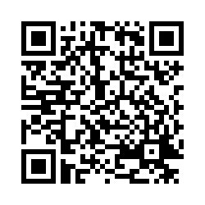

Conversations for ​
Suicide Safer Schools​
https://bit.ly/CSSS_Pre
Notes:
Instructor Notes: Pre-Survey, and Opening Remarks
Encourage Pre-Survey Participation
Ask participants to scan the QR code or enter the URL to complete the pre-survey.
Explain that their feedback helps improve future trainings and ensures the content remains relevant and impactful.
The Safer Homes Collaborative is seeking participants’ help in validating the effectiveness of this training.
Participants who complete both the pre- and post-surveys and provide contact information will receive a $25 Amazon gift card.
Participation is completely voluntary, and participants may opt out at any time.
Surveys take approximately 5–7 minutes and are available digitally only.
MIMH CEUs and Certificate of Attendance
Participants can receive MIMH CEUs for completing the training.
To receive a certificate of attendance, they must complete the post-survey and provide their name and email address.
Encourage the use of a personal email address (not a school district email) to avoid issues with firewalls or spam filters.
If participants choose to opt out, they may leave all other post-survey questions blank.
Welcome and Acknowledgment
Begin by warmly welcoming participants and thanking the host school or district for supporting this important training. Acknowledge the time and commitment of everyone present.
Emotional Safety and Support
Let participants know that this training covers sensitive topics, including suicide and crisis response. Many individuals have been personally impacted, either through the loss of someone to suicide or through their own lived experience as attempt survivors.
Acknowledge that emotional responses are valid and expected.
Encourage participants to take care of themselves during the session. If anyone needs to step out, take a break, or opt out of an activity, they are welcome to do so at any time. Emphasize that your goal is to create a safe, respectful, and supportive learning environment where participants feel comfortable asking questions and practicing new skills.
Purpose and Scope of the Training
Explain that the Conversations for Suicide Safer Schools training is one component of a comprehensive suicide prevention strategy. It is designed to support both prevention and intervention efforts in school settings.
Clarify that this training is not a commentary on Second Amendment rights or gun ownership. Rather, the focus is on increasing our comfort, confidence, and willingness to talk with caregivers about reducing access to any potentially lethal means, especially when a student is at increased or imminent risk for suicide.
Framing the Learning Experience
Let participants know that the training will provide them with practical tools and strategies to:
Recognize warning signs and risk factors
Respond appropriately in a school setting
Engage in direct, compassionate conversations
Promote safer environments at school and at home

Slide 2
OBJECTIVES
Participants will
  Review the prevalence, suicide risk, and warning signs.
  Understand their role in response to a crisis in the school setting.
  Ask direct questions to determine the risk for suicide.
  Recognize lethal means used in suicide attempts and differentiate lethal means safety strategies to make the environment suicide safer from suicide.
  Develop skills to help parents create suicide-safer environments to prevent, delay, or deter a suicide attempt.
Missouri Institute of Mental Health (MIMH)
The University of Missouri – St. Louis, Missouri Institute of Mental Health will be responsible for this program and maintain a record of your continuing education credits earned. MIMH awards 2 clock hour(s) or 2.4 contact hour(s) (0.24 CEUs) for this program, including 0 clock hour(s) towards ethics, 2 clock hour(s) towards suicide prevention, and 0 clock hour(s) towards cultural competence.
Notes:
Instructor Notes: Objectives Slide
Use this slide to set the tone for the session by briefly walking participants through the five key learning objectives:
Recognize Risk and Warning Signs
Ground the session in data and awareness—what to look for and why it matters.
Clarify Your Role in a Crisis
Define what school staff can do during a crisis, and how to act within their scope and protocols.
Ask Direct Questions About Suicide
Dispel myths and model how to ask clearly and compassionately about suicide risk.
Promote Lethal Means Safety
Introduce practical strategies to reduce access to lethal means, especially firearms.
Support Caregivers in Creating Safer Environments
Equip participants with tools to engage families in prevention and safety planning.
Wrap-Up Talking Point:
These objectives are about building confidence and practical skills. Encourage questions and active participation throughout the session.

Slide 3
MISSOURI DATA
2nd In 2023, suicide was the 2nd leading cause of death among 10 – 14- and 20 - 24-year-olds and the 3rd leading cause of death for 15 – 19-year-olds in Missouri. (CDC WISQARS, 2024*) | 11.7% In 2024, 11.7 percent of Missouri high school students and 22 % of Missouri college students reported having seriously considered suicide in the last 12 months. (MSS, 2024**; MOPIP, 2023**) | 74.5% 74.5% of 10 – 24-year-olds in Missouri who died by suicide in 2023 used a firearm (CDC WISQARS, 2024⁺) | 2022 Guns were the leading cause of death among children and teens for the third year in a row - accounting for more deaths than car crashes, overdoses, or cancers. (Johns Hopkins, 2024⁺⁺)
Notes:
Use this slide to highlight why suicide prevention and lethal means safety are urgent priorities in Missouri:
Suicide is a Leading Cause of Death
Suicide ranks among the top causes of death for youth in Missouri, especially ages 10–24.
High Rates of Suicidal Ideation
Over 1 in 10 high school students and 1 in 5 college students have seriously considered suicide in the last 12 months.
Firearms Are the Most Common Method
Nearly 75% of youth suicides in Missouri involve a firearm, compared to 55% of youth suicides nationally—emphasizing the need for safe storage.
Firearms Are the Leading Cause of Death
For the third year in a row, firearms have surpassed all other causes of death for children and teens.
Closing Talking Point:
These statistics show that suicide is not rare—and it’s preventable. As educators, you are often the first to notice when something is wrong. By recognizing the signs and understanding the data, you can help save lives.
Citations:
Roberts, B., Nofi, C., Cornell, E., Kapoor, S., Harrison, L., & Chethan Sathya. (2023). Trends and Disparities in Firearm Deaths Among Children. Pediatrics. https://doi.org/10.1542/peds.2023-061296
‌
* Centers for Disease Control and Prevention. (2023). Leading causes of death. CDC. https://wisqars.cdc.gov
**Missouri Department of Mental Health. (2024). Missouri Student Survey: 2024 final report. https://dmh.mo.gov/sites/dmh/files/media/pdf/2024/08/mss-2024-report-final_0.pdf
**Partners in Prevention. (2023). Help seeking behaviors and warning signs of suicidality and mental health crises in Missouri college students. Missouri's higher education substance misuse consortium. https://www.mopip.org/docs/briefs/PIP_13_03.pdf
+Centers for Disease Control and Prevention. (2023). Explore mortality data. CDC. https://wisqars.cdc.gov/explore
++Villarreal, S., Kim, R., Wagner, E., Somayaji, N., Davis, A., & Crifasi, C. K. (2024). Gun violence in the United States 2022: Examining the burden among children and teens. Johns Hopkins Center for Gun Violence Solutions. Johns Hopkins Bloomberg School of Public Health. https://publichealth.jhu.edu/sites/default/files/2024-09/2022-cgvs-gun-violence-in-the-united-states.pdf

Slide 4
YOUTH SUICIDE RISK FACTORS
Individual | Relationship | Community | Societal
Previous attempts History of depression or other mental illnesses Serious illness/chronic pain Criminal/legal problems Impulsive or aggressive tendencies Substance use/misuse Current or prior history of adverse childhood experiences Sense of hopelessness Violence victimization or perpetration | Adverse childhood experiences History of being bullied Family or peer conflict Family/loved one’s history of suicide Loss of relationships (breakup, divorce, death) High conflict or violent relationships Social isolation | Recent suicide of a friend/relative/ celebrity or anniversary of that suicide Lack of access to healthcare Suicide cluster in the community Stress of acculturation Community violence Systemic trauma, or marginalizing experiences based on sex/gender/race/ ethnicity | Easy access to lethal means Cultural, religious, or moral acceptance of suicide, or considered an honorable act Increased access to social media and negative online material Stigma associated with mental health or help-seeking Unsafe media portrayals of suicide
Notes:
Instructor Notes: Youth Suicide Risk Factors
Use this slide to help participants think beyond surface-level causes of suicide risk:
Risk is Complex and Interconnected
Suicide is rarely caused by a single issue—consider individual, relational, and environmental factors together.
Risk Isn’t Always Visible
Even attentive adults may miss signs. Familiarity with risk factors helps educators notice subtle changes.
Multiple Risk Factors Raise Concern
One factor may not signal danger, but several together—especially with warning signs—should prompt action.
Tip: Encourage participants to think holistically and stay curious about what might be going on beneath the surface.

Slide 5
WARNING SIGNS
FOUR out of FIVE individuals planning suicide communicate or demonstrate observable warning signs
Talking about being a burden Talking about feeling trapped or in unbearable pain Expressing hopelessness Expressing on social media feelings of isolation and depression Talking or posting about wanting to die Talking or posting about plans for suicide Looking for a way to access lethal means | Being isolated or self-isolating from friends and family Increased anxiety Increased substance use Neglect of personal appearance Inadequate self-care Lack of response to praise Increased anger or rage Extreme mood swings Atypical irritability | Self-injury or indications of an attempt Sadness or crying spells Sleeping/eating too little or too much Giving away personal possessions Engaging in reckless, dangerous, or life-threatening activities or behaviors. Declining academic performance
Notes:
Instructor Notes: Recognizing Warning Signs
Use this slide to emphasize the importance of early recognition and awareness:
Warning Signs Are Often Present but Missed
People often say, “There were no signs,” but many signs are subtle or misunderstood.
Most Individuals Show Signs
Research shows most people who die by suicide exhibit behavioral, verbal, or emotional cues—training helps us recognize them.
This Is About Awareness, Not Blame
The goal is not to assign blame, but to build confidence in noticing and responding to signs when they appear.
Tip: Encourage participants to stay observant and trust their instincts when something feels off.

Slide 6
YOUTH PROTECTIVE FACTORS
Individual | Relationship | Community | Societal
Reasons for living (family, pets, friends) Effective coping & problem-solving skills Hope for the future Impulse control Sense of purpose or self-esteem Strong beliefs about the meaning & value of life Sobriety | Positive relationship with a caring adult Caregiver(s) who foster respectful & safe communication Support from partners, friends, family, and caring adults Feeling connected to others (trusted adults, teachers, mentors, coaches) | Feeling connected to school, community & social institutions Positive school supports (GSA, LGBTQ+ inclusive curriculum & school policies) Availability of high-quality and consistent behavioral health care | Limited access to lethal means Cultural, religious, or moral objections to suicide Cultural or religious beliefs that encourage help-seeking Access to mental health care and support for seeking help
Notes:
Instructor Notes: Youth Protective Factors
This slide highlights the protective factors that can reduce the risk of suicide among youth. These are strengths, supports, and conditions that help buffer against stress and adversity.
Protective factors exist across multiple levels
Just like risk factors, protective factors operate at the individual, relationship, community, and societal levels.
Strengthening these factors can help youth build resilience and reduce the likelihood of suicidal thoughts or behaviors.
2. Relationships Matter Most
Strong connections with caregivers, peers, and mentors are among the most powerful protective factors.
Connection and support can strengthen a young person’s sense of hope and belonging.
3. Schools and communities play a vital role
Inclusive environments, access to care, and supportive policies help build resilience.
Schools can actively foster these supports through policies, programs, and inclusive practices.
4. Cultural and societal influences matter
Beliefs that promote life and limit access to lethal means can significantly reduce risk.
Reducing access to lethal means—especially during times of crisis—is also a critical strategy for suicide prevention.

Slide 7

Notes:
Instructor Notes: DESE Suicide Prevention Policy
Use this slide to connect the training to state policy and reinforce the importance of a comprehensive approach:
Statewide Requirement
All Missouri school districts must have a suicide prevention policy—this ensures consistency and accountability across schools.
Three Core Components
Prevention: Staff training, student education, and community resources
Intervention: Identifying and responding to students at risk
Postvention: Supporting the school community after a suicide or attempt
Training Alignment
This training supports the prevention and intervention components of the DESE Model Policy.
Emphasize that this is about more than compliance—it’s about creating safer, more responsive school environments.

Slide 8

PREPAREDNESS
District-Level Planning
  Develop a comprehensive crisis plan with consistency across all buildings.
  Ensure alignment with state and DESE requirements.
School-Level Planning
  Each school should have a customized crisis plan based on the district’s framework.
  Include specific protocols for responding to a suicidal student.
Crisis Team Composition
  Administrators should designate a multidisciplinary team, which may include:
Administrators
School counselors
    School nurse
    Student support personnel
    School resource officers
Administrative Assistants
    Teachers
    Custodians
    Transportation
    Parents
Notes:
Instructor Notes: Preparedness and Crisis Planning
This slide emphasizes the importance of proactive planning and coordinated crisis response at both district and school levels:
District-Level Planning
Every district must have a comprehensive crisis response plan aligned with DESE guidelines, covering prevention, intervention, and postvention.
School-Level Customization
Each school should adapt the district plan to its unique needs, with clear procedures for responding to suicidal behavior and engaging families.
Multidisciplinary Crisis Teams
Schools should form diverse crisis teams (e.g., admin, counselors, teachers, support staff, parents) to implement and maintain the plan.
Education as Prevention
Include suicide prevention education for staff, students, and families to reduce stigma, build awareness, and increase readiness to respond across the school community.

Slide 9

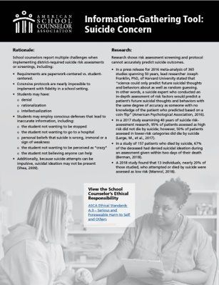
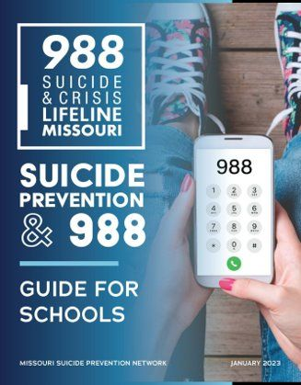
DEVELOPING A SCHOOL CRISIS PLAN
Crisis Manual (2022)
Notes:
Instructor Notes: Developing a School Crisis Plan
This slide introduces key tools to help schools strengthen their suicide prevention and crisis response plans:
Missouri School Counselor Association Crisis Manual
Offers templates and protocols for school-based crisis response, including suicide-related incidents.
DESE Model Policy
Provides a state-aligned framework for prevention, intervention, and postvention planning.
ASCA Suicide Concern Tool
Helps staff consistently gather and document information when a student may be at risk.
988 Guide for Schools (Missouri Suicide Prevention Network)
Offers strategies for integrating the 988 Lifeline into school protocols and educating the school community.
Closing Talking Point:
Encourage participants to explore these tools and integrate them into their school’s crisis plan. These are not just checklists—they’re practical supports for effective, compassionate response.

Slide 10
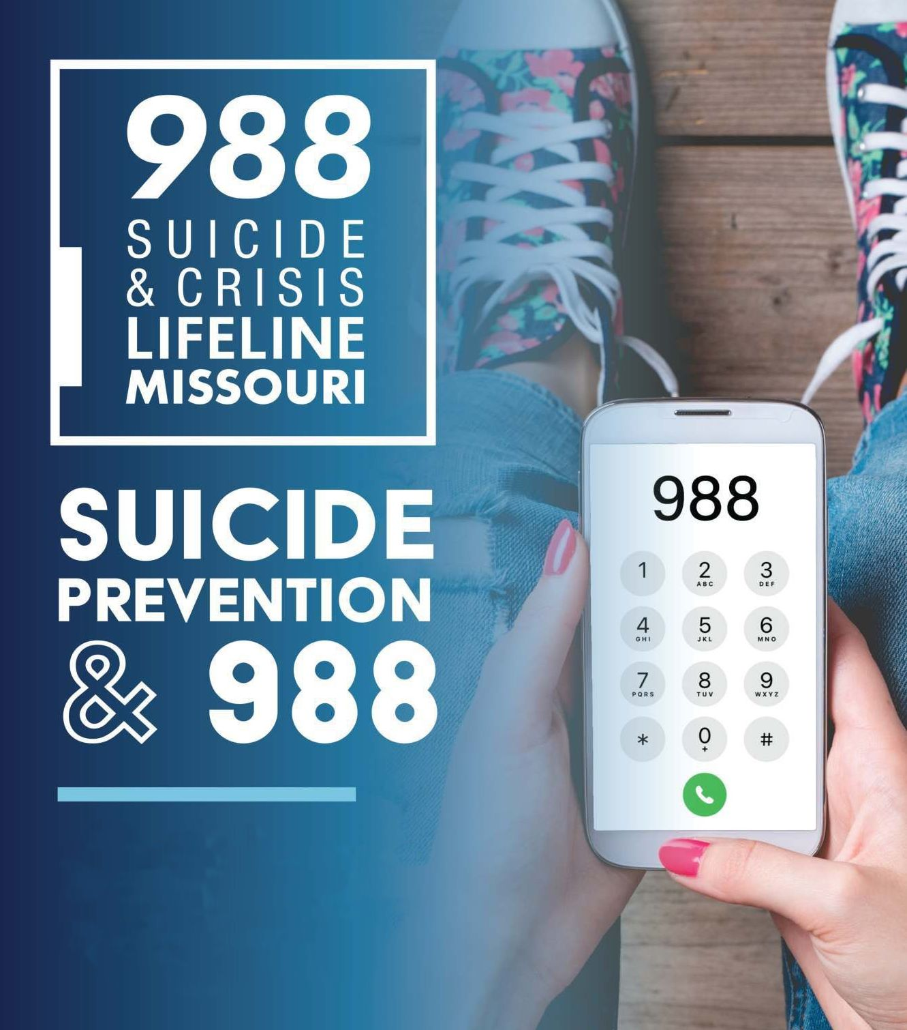
Free
Confidential
Available 24/7
Staffed with trained professionals
Missouri Regional Crisis Centers
Geo-location call routing available for Verizon, T-Mobile & AT&T users
Call by dialing 988
SMS Text 988
Chat online at 988lifeline.org/chat
Translation services are available, including deaf & hard-of-hearing TTY users.
Notes:
Instructor Notes: 988 Suicide & Crisis Lifeline and Student ID Requirements
Use this slide to highlight the importance of 988 as part of a comprehensive school-based suicide prevention strategy:
Immediate, 24/7 Support
988 offers free, confidential help via call, text, or chat—ideal for students in crisis or emotional distress.
Accessible and Student-Friendly
Multiple contact options reduce barriers for students who may be hesitant to seek help in person.
Crisis and Postvention Resource
988 can be used during or after a crisis to connect students and families with trained counselors and local services.
Promotes a Help-Seeking Culture
Displaying and discussing 988 normalizes mental health conversations and reinforces that help is always available.
Policy-Aligned
Missouri law requires schools to include 988 on student ID cards and educate students about its use.
Closing Talking Point:
988 is a vital, life-saving tool. Make sure students and staff know how to access it—and feel empowered to use it when needed.
.

Slide 11

Notes:
Instructor Notes: The Puzzle of Suicide Risk
Use this slide to emphasize that identifying suicide risk is a shared responsibility—no one person sees the full picture.
Everyone Sees Different Pieces
Teachers, bus drivers, paraprofessionals, and others may each notice different signs. All observations matter.
It is important that all staff, including support staff and contract personnel, are trained to recognize warning signs and know how to respond appropriately.
Know and Follow Your School’s Protocol
Staff should know who to report to, how to report, and what details to include.
Report Promptly and Clearly
Trust your instincts. Be specific, objective, and timely in your reports.
Use the Right Channels
Avoid informal conversations. Use designated systems or staff.
Follow Up and Maintain Confidentiality
It’s okay to check that your concern was received. Share only with those who need to know.
Empower All Staff
Remind everyone they are part of the safety net. Provide training and support to build confidence in reporting.
Closing Message:
When we share what we see and follow protocols, we strengthen the safety net and increase the chance of early intervention.

Slide 12
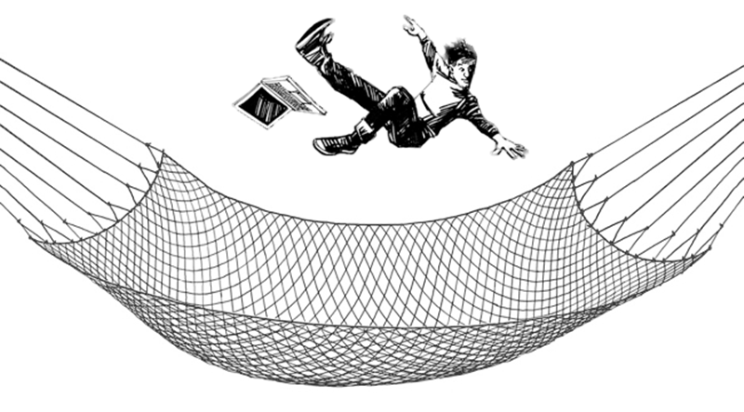
Notes:
Instructor Notes: Weaving a Tighter Safety Net
This slide uses a powerful visual metaphor—a person falling into a net—to represent the importance of building strong, interconnected systems of support within schools to prevent youth suicide.
Everyone Plays a Role in the Safety Net
Just like the net in the image, a school’s safety net is made up of many interconnected individuals—teachers, counselors, bus drivers, custodians, cafeteria staff, office personnel, and more.
Each person may notice different changes in a student’s behavior, mood, or appearance. These observations are critical in identifying students who may be at risk.
Structured and Unstructured Moments Matter
Emphasize that opportunities to notice warning signs don’t just happen in counseling sessions or classrooms.
They happen in the hallway, on the playground, at the bus stop, or in the lunch line. These everyday interactions can be the first sign that something is wrong.
Extend the Net Beyond School Walls
If your district works with outside providers or after-school programs, providers (e.g., transportation, custodial services, YMCA, Boys & Girls Clubs), include them in suicide prevention training and ensure they understand the crisis response plan.
Partner with community agencies to offer suicide prevention training for parents. To accommodate busy schedules, provide information in multiple formats—such as in-person sessions, newsletters with 988 info, inserts in activity programs, email blasts during awareness months, and regular updates from school counselors.
Closing Talking Point:
The stronger and more connected our safety net, the more likely we are to catch students before they fall too far. Suicide prevention is not the responsibility of one person or one department—it’s a shared responsibility across the entire school community.

Slide 13

Notes:
Instructor Notes: Special Considerations – “Attention Seeking” vs. Connection Seeking
This slide addresses a common and critical misconception in suicide prevention: the idea that students who talk about suicide “just want attention.” Use this moment to reframe that thinking and emphasize the importance of taking all disclosures seriously.
Reframe “Attention Seeking” as “Connection Seeking”
Students expressing suicidal thoughts are signaling distress—not manipulating. Instead of dismissing it, treat every disclosure as a call for help and an invitation for connection and support.
Never Assume There’s No Risk
Even repeated or vague statements can indicate real risk. Never assume a student isn’t serious.
Act Immediately—Don’t Delay
Report concerns to the crisis team right away—don’t wait.
Do not wait until lunch, your planning period, or the end of the day.
Delays can increase risk, especially if the student goes home to an unsafe environment.
Closing Talking Point:
Our job is not to determine intent—it’s to respond with care, urgency, and consistency. When in doubt, report. It’s always better to over-respond than to miss a cry for help.

Slide 14

Notes:
Instructor Notes: Special Considerations – Young Children (Ages 5–10)
This slide highlights the importance of recognizing and responding to suicide risk in young children, even though it’s less common.
Take All Expressions Seriously
Talk, drawings, or writings about death or suicide should never be dismissed as imagination.
Exposure Is Often a Factor
Children may mimic what they’ve seen or heard—at home, in media, or from others.
Limited Emotional Vocabulary
Young children may express distress through behavior or art rather than words.
Use Simple, Supportive Language
Ask open-ended questions like:
“Can you tell me more about this drawing?”
“Have you ever felt really upset like that?”
Respond with Care and Urgency
Stay calm, validate feelings, and refer immediately to a mental health professional or crisis team—don’t delay.
Closing Message:
Early intervention is critical. When in doubt, report. It’s always better to over-respond than miss a child in distress.

Slide 15

Notes:
Instructor Notes: Special Considerations: Impact of Systemic Racism on Student Mental Health
This slide highlights how systemic racism affects BIPOC students’ mental health and access to care.
Acknowledge Disparities
BIPOC students face higher mental health challenges and more barriers to care—rooted in systemic inequities, not individual failings.
Plan with Equity in Mind
Crisis plans should reflect diverse student needs through cultural competence, representation, and trauma-informed practices.
Inclusion Requires Intention
Ask: Who’s at the table when we design safety plans? Whose voices are missing?
Take Action
Partner with culturally specific organizations
Diversify crisis teams
Train staff on racial trauma and bias
Review policies for equity
Closing Message:
Equity isn’t optional—it’s essential to creating safe, supportive environments for all students.

Slide 16

Notes:
Instructor Notes: Special Considerations: Understanding Risk and Assessment in Students with IDD
This slide highlights that students with intellectual and developmental disabilities (IDD) are at risk for suicide, often facing additional vulnerabilities. It also outlines key considerations for sensitive and effective assessment.
Acknowledge the Risk
Individuals with IDD are not immune to suicide risk and may face higher exposure to factors like social isolation, trauma, and limited mental health access.
They can form intent and act on it—countering a common misconception.
Assessment Considerations
Cognitive Processing: Students may struggle with abstract thinking and process information slowly. Use clear, concrete language.
Communication: Expression of needs may be limited. Use alternative communication methods or visual supports.
Emotional Regulation: Don’t assume behavioral issues are solely disability-related—they may signal emotional distress or unmet mental health needs.
Facilitation Tips
Ask: “Have you seen a student’s behavior or communication mask deeper emotional needs?”
Encourage sharing of effective strategies.
Reinforce collaboration with specialists (e.g., school psychologists, speech-language pathologists).

Slide 17
SMALL
GROUP
DISCUSSION
Evaluating Inclusivity and Equity in Crisis Response Plans
Who is currently on the crisis response team?
Do we have diverse representation on our team?
Whose voices are missing from our team?
How do we ensure cultural competence in our crisis response?
What training have we provided on trauma and implicit bias?
Notes:
Instructor Notes: Reflection & Small Group Discussion
This slide encourages participants to reflect on key concepts and engage in peer discussion to deepen understanding.
Instructions to Deliver
Set the Stage (1 min)
Say: “Let’s take a few minutes to reflect and discuss. This will help reinforce your understanding and hear others’ perspectives.”
Form Groups (1 min)
Ask participants to form groups of 3–4. Ensure everyone is included.
Explain the Task (1 min)
Say: “Discuss the questions on the slide for about 7–8 minutes. Focus on key takeaways, surprises, and how this applies to your work.”
Monitor & Support (7–8 min)
Circulate, listen in, and offer prompts if needed.
Group Sharing (5–7 min)
Invite volunteers to share highlights. Aim for a variety of voices.
Facilitation Tips
If no one volunteers right away, gently call on a group you observed having a good discussion.
Affirm all contributions and connect them back to the session’s key themes.
Use responses to segue into the next section of your presentation.

Slide 18
Notes:
Instructor Notes: Recognizing Risk Factors
This slide uses a puzzle metaphor to emphasize the complexity of identifying suicide risk and the importance of collaboration among school staff.
Acknowledge that recognizing suicide risk can be challenging
Say, “Identifying suicide risk can feel like assembling a puzzle without the final image. Each of us may hold different pieces—observations, conversations, or concerns.
Reinforce that every adult in the school plays a role.
Say: “That’s why it’s critical that all staff are trained to recognize warning signs and know how to respond.”
Transition to Next Point.
Say: “This brings us to a key takeaway: When you see warning signs or risk factors, don’t hesitate—always ask about suicidal ideation.”

Slide 19

Notes:
Instructor Notes: Scenario – Joe in Mrs. Johnson’s Class
This scenario is designed to help participants recognize warning signs of suicide risk in adolescents and explore the appropriate role of a school staff member in responding to concerning behavior.
Introduce the Scenario (Read or Summarize):
Let’s look at a student scenario. This is Joe, a freshman in Mrs. Johnson’s English class. He’s typically an average, friendly student, but lately, his behavior and academic performance have changed.
Briefly walk through the key observations:
Lately, Mrs. Johnson has had to get after him about staying on task and missing assignments. The assignments he has turned in have been below his ability. His writing has been more edgy and a little morose, with themes of sadness, despair, and death. Some days, he's sullen and withdrawn. Some days, he’s irritable. On other days, he seems fine. Like today, Mrs. Johnson observed him cracking it up with the girls in the library. He was smiling and seemed to be doing okay. Mrs. Johnson is worried about Joe.
Mrs. Johnson asks Joe to hang back at the end of class and says,
"Joe, I want to visit with you about some things I’ve noticed that concern me. I've noticed lately that you've been writing about themes of sadness, despair, and death."
Joe stands there, staring blankly at Mrs. Johnson.
She continues.
"Joe, it's not just your writing. I've noticed changes in you lately. Some days, you come into class in what seems like slow motion, and you're unprepared, and you have missing assignments. I’ve visited with you several times about staying on task in the last several weeks. I’ve noticed some days you’re irritable. On other days, you’re withdrawn. That’s not like you. Can you tell me what's changed? Is there anything I can do to help? I'm just worried about you."
Joe drops his shoulders, rolls his eyes, runs his hand through his hair, and huffs,
"No, I can't tell you what's changed. No, there isn't anything you can do to help me. I don't want to be here."
Highlight the Dilemma:
Mrs. Johnson is concerned. She’s noticed a pattern of changes and has taken the step to talk to Joe. But now she’s unsure—should she ask about suicide? Is it her role?
Use these to guide discussion or small group reflection:
What warning signs is Joe showing that might indicate he’s at risk?
Decline in academic performance
Morose and dark writing themes
Mood fluctuations: sullen, irritable, withdrawn, but sometimes appears fine
Direct quote: “I don’t want to be here.”
What do you think about Mrs. Johnson’s approach to the conversation? What did she do well?
How would you respond to Joe’s statement: ‘I don’t want to be here’?
Should Mrs. Johnson ask Joe directly about suicide? Why or why not?
What school protocols or supports should be activated at this point?
Key Takeaways to Emphasize
Behavioral changes, especially when they involve mood, academic performance, and expressions of despair, should never be ignored.
Trust your instincts—if something feels off, it probably is.
It is appropriate for school staff to ask directly about suicide when they observe warning signs.
Asking about suicide does not plant the idea—it opens the door for help.
Immediate referral to a school mental health professional or crisis team is essential.

Slide 20

HOW SHOULD MRS. JOHNSON RESPOND?
ASK THE QUESTION
  Are you thinking of suicide?
  Have you had thoughts of killing yourself?
  Have you ever wished you could go to sleep and never wake up?
“NO”
Notes:
Instructor Notes: Responding to Suicide Warning Signs – Joe’s Scenario
This slide guides participants through the critical next step in the scenario with Joe—how to respond when a student shows warning signs of suicide. It emphasizes the importance of asking direct, specific questions about suicide and preparing educators to do so with confidence.
Affirm the Need to Ask
Mrs. Johnson is concerned after Joe says, “I don’t want to be here.”
This is the moment to ask directly about suicide—avoid vague or softened language.
Model Effective Questions
Advance the slide to display the three evidence-based questions for asking about suicide risk.
Read or display the three examples on the slide:
“Joe, are you thinking of suicide?”
“Joe, have you had thoughts of killing yourself?”
“Joe, have you ever wished you could go to sleep and never wake up?”
These are clear, compassionate, and invite honesty.
Notice these questions do not include the words harm or hurt yourself. Harm and hurt yourself is recoverable. Suicide is not.
Discuss Possible Responses: When the answer is NO
Advance the slide to display the word “NO” and Joe.
Explain that even if Joe says “No,” that doesn’t mean he “No”. There are many reasons a student might not disclose suicidal thoughts right away.
Ask the group, “What are some reasons Joe may say ‘No’?”
Fear, past experiences, lack of trust, discomfort with how the question was asked.
Emphasize: Tone matters—be calm, confident, and caring.
Practice Activity Introduction
To build participants’ confidence, introduce the opportunity to practice asking the questions.
Normalize that it can be uncomfortable asking this question for the very first time.
Discomfort can depend on the relationship with the person you are asking.
Participants can opt out of this activity, but reassure them that this is a safe place to practice saying the words, knowing that Joe’s response is going to be “No.”
Instructions:
Pair up or form triads. Take turns being Mrs. Johnson and Joe.
Prompt participants to envision that they are asking Joe the questions on the slide.
Take turns practicing asking the questions aloud.
Focus on tone: calm, caring, and direct.
Joe’s response will be “No.”
Facilitation Tips
Say: “It’s okay to feel. That’s why we practice.”
Encourage participants to practice asking the question out loud when they are looking in the mirror or driving alone in their car.
Reinforce: “Asking directly can save a life. It shows students that we’re not afraid to talk about hard things—and that we’re here to help.”

Slide 21

"NO" Does NOT Mean
There is No Risk
REINFORCE your care and concern.
NORMALIZE the possibility for thoughts of suicide.
REASSURE them they are NOT in trouble.
EMPOWER them to ask for help if they have thoughts of suicide in the future.
GATHER information from other sources, including parents/ guardians.
REFER to the school counselor or crisis team member for further assessment.
Notes:
Instructor Notes: Even Though Joe Said “No”
This slide reinforces that a student’s denial of suicidal thoughts does not eliminate concern. It guides educators on how to continue offering support, gather additional context, and take appropriate next steps, without delay.
No doesn’t always mean no risk
Even though Joe said ‘No’ when asked about suicide, that doesn’t mean there’s no risk. Mrs. Johnson has still observed significant changes in his mood, behavior, and academic performance.
Continue the conversation while expressing care and concern.
Normalize that high school is a time of big changes and that it’s not uncommon for students to feel overwhelmed or have thoughts of suicide
Reassure Joe that he is not in trouble.
Empower them to ask for help if thoughts of suicide ever return.
Mention available supports: school mental health staff and the 988 Suicide & Crisis Lifeline, a trusted adult/coach or mentor.
Encourage Information Gathering :
Mrs. Johnson can also check in with other teachers or Joe’s parents to gather a fuller picture.
Do not delay the referral to the school counselor or crisis team while gathering information.
If there’s a concern, act immediately. A student going home to an empty house without support can be a serious risk.
Facilitation Tips
Reinforce that trust and consistency are key—students may open up over time.
Remind participants that early action is always better than regret.

Slide 22
RESPONDING
TO
SUICIDE
RISK
ASK THE QUESTION
  Are you thinking of suicide?
  Have you had thoughts of killing yourself?
  Have you ever wished you could go to sleep and never wake up?
“YES”
Notes:
Instructor Notes: Responding to Suicide Risk When Joe Said “Yes”
This slide is meant to allow participants a second opportunity to practice asking the evidence-based questions about suicide. This time, Joe is going to say yes. Yes, he has thought of suicide. He has thought of killing himself.
Practice Activity Introduction
To build participants’ confidence, introduce the opportunity to practice asking the questions when the response will be “Yes.”
Participants can opt out of this activity but reassure them that this is a safe place to practice saying the words, knowing that Joe’s response is going to be “Yes.”
Instructions:
Pair up or form triads. Take turns being Mrs. Johnson and Joe.
Prompt participants playing the role of Mrs. Johnson to envision that they are asking Joe the questions on the slide.
Take turns practicing asking the questions out loud.
Focus on tone: calm, caring, and direct.
The person playing the role of Joe will say “Yes” to the question(s).
Facilitation Tips
Normalize discomfort:
“It’s okay to feel nervous. That’s why we practice.”
Encourage feedback:
“What did it feel like to ask or hear the question?
“What did it feel like anticipating the answer was Yes?”
“Did it hit differently this time?”
Reinforce the use of direct questions:
“Asking about suicide directly can save a life. It shows students that we’re not afraid to talk about hard things—and that we’re here to help.”

Slide 23

Confidentiality
Employees are required to share with the crisis response team and administrators or their designees any information that may be relevant in determining whether a student is at risk of suicide, is having a suicide crisis, or is otherwise at risk of harm.
Employees are prohibited from promising students that information shared by the student will be kept secret when the information is relevant to the student's safety or the safety of another person.
DESE Youth Suicide Awareness And Prevention Model Policy (2022)
Notes:
Instructor Notes: A Note About Confidentiality
This slide addresses how to handle student disclosures about suicide with care, clarity, and responsibility. It emphasizes the importance of maintaining trust while also fulfilling the legal and ethical duty to report and protect the student.
Acknowledge Concerns
Students may fear getting in trouble. Reassure them they’re not in trouble—you’re here to help.
Clarify Your Role
Explain that you must involve the crisis team or a guardian for their safety—not as punishment, but to ensure they are safe.
Normalize the Experience
Disclosure often means the student wants help, even if they’re scared or unsure.
Be Transparent
Clearly explain next steps (e.g., “I’ll stay with you until the counselor arrives”).
If you don’t know the next steps, acknowledge that you are unsure but that you will be there to support them.
Ensure Supervision
Never leave the student alone.
Only trained staff should assist with transitions. Never delegate this task to another student.
If they need to use the restroom, a staff member must accompany them.
Closing Talking Point:
All employees are mandatory reporters when it comes to a suicide crisis or risk of harm. Being clear, calm, and compassionate helps students feel safe. They likely disclosed to you because you 1) asked the questions, 2) they trust you, and 3) they want help.

Slide 24


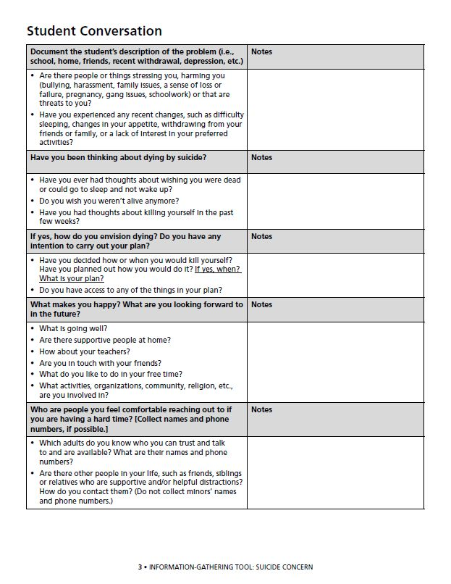
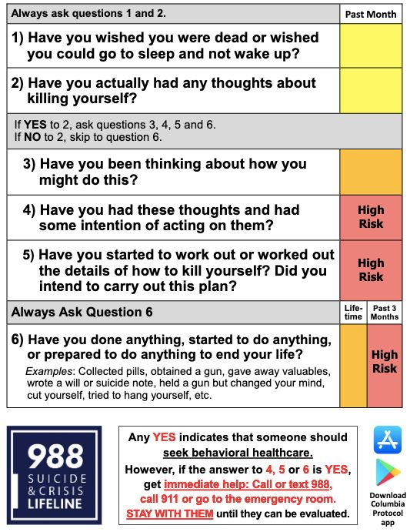
CRISIS
TEAM
ASSESSMENT
TOOLS
The Columbia- Suicide Severity Rating Scale
Notes:
Instructor Notes: Suicide Risk Assessment Tools
This slide introduces two evidence-based tools that school crisis teams may use to assess suicide risk: the Columbia Suicide Severity Rating Scale (C-SSRS) and the ASCA Information-Gathering Tool for Suicide Concern. It also clarifies the purpose of these tools and how to communicate findings appropriately.
Introduce the Tools
When a student like Joe shows signs of suicide risk, your school’s crisis team should use a structured tool to guide the assessment. Two commonly used frameworks are the Columbia Suicide Severity Rating Scale and the ASCA Information-Gathering Tool.
Both tools are available online for free and guide the conversation with evidence-based questions to assess for suicide.
These tools are not designed to label a student as ‘low,’ ‘medium,’ or ‘high’ risk. That language can be misleading and may create a false sense of security or urgency.
The tools are meant to provide clear, objective information that can be shared with administrators, caregivers, 988 crisis counselors, EMS, or emergency room professionals.
Share findings with caregivers:
When sharing concerns with families, focus on what you’ve observed and what the student has shared, not a risk label.
This helps families understand the seriousness without feeling confused or alarmed by vague terminology.
Caregivers may deny or reject that the student has disclosed suicide risk. It is not uncommon for caregivers to be irritated or make statements that their student “says it all the time” and has never attempted before. Some replies to this could include:
“When I asked the student about thoughts of suicide, they shared… (intent, plan, access to lethal means).”
“Sometimes a student will say, ‘I’m going to kill myself,’ because they are frustrated and have big emotions. They may not be aware of the significance of what they are saying. But maybe they do mean it. That is why we take it seriously when a student says they have thoughts or plans for suicide.”
Closing Talking Point:
There are many assessment tools available. These are just two of many. No matter which tool your team uses, there are three essential questions that should always be asked.
Advance to the next slide.

Slide 25
ASSESSMENT:
ALWAYS
ASK
  Direct questions about suicide ideation.
  About a plan for suicide.
  About access to lethal means (even if they don’t have a plan.)
Notes:
Instructor Notes: Assessment Tools Should Always Include These Questions
This slide reinforces the importance of asking clear, direct questions when assessing suicide risk. It also highlights the need to explore both suicidal thoughts, plans, and access to lethal means, even in the absence of a specific plan.
Reinforce the Importance of Directness:
Whichever assessment tool you or your district decides to use, it’s essential that you ask three key questions
“Are you thinking about suicide?”
“Do you have a plan?”
“Do you have access to anything that could be used to end your life?”
Again, avoid terms like hurt or harm yourself. Hurting or harming oneself has different meanings and is recoverable. Suicide is not.
Asking about access to lethal means is critical
Ask about access to lethal means even if the student doesn’t have a plan. Many youth act impulsively, and access to lethal means, particularly unsecured firearms, can increase risk.
Closing Talking Point:
Asking about access to means is not invasive—it’s protective. The school crisis counselor and the student’s caregiver will use this information to determine the best course of action to keep the student safe.

Slide 26

EXPLORE THE PLAN
Have you thought about how you would kill yourself?
Do you have access to the (insert method) you would use to end your life? – helps determine the immediacy of risk
How quickly could you have access to (insert method) you would use to end your life? – establishes a potential timeline
Notes:
Instructor Notes: Explore the Suicide Plan:
Ask Directly About the Plan
When Joe has affirmed he has had suicidal thoughts, always ask if there is a plan for suicide. Again, be direct.
“Have you thought about how you would kill yourself?”
“When?”
“Where?”
Always assume there is access to lethal means
Poisons, medications, ropes, knives, belts, plastic bags, knives, and likely, firearms.
Ask:
“Do you have access to [method]?”
“How quickly could you get access?”
Even if Joe denies having access to the lethal, this does not mean he is low or no risk. It only means that it could/would take time to acquire or access.
In a suicide crisis, thoughts can turn to action in under 10 minutes. If Joe is alone at home with access to lethal means, his risk increases significantly.
Firearm access in Missouri
Nearly 50% of Missouri households have access to firearm(s).
No law prohibits educators from asking about access when there is concern for suicide.
Asking about access is part of best practice and due diligence.
Important Reminders
Never assume kids couldn't or wouldn't find keys to the gun safe or know the combination. They know where things are hidden.
Hunter safety or firearm safety training is not a protective factor for someone with suicidal intent, a plan, and access. Familiarity with the firearm reduces inhibitions in a suicide crisis.

Slide 27

NOTIFY A PARENT OR GUARDIAN
Empower the student’s voice
Frame the conversation with the caregiver(s) as a partnership
Provide a clear summary
Explain relevant protocols
Request a release of information
Notes:
Instructor Notes: Notifying a Parent or Guardian
This slide covers best practices for informing caregivers about student mental health or safety concerns—emphasizing student voice, caregiver collaboration, and adherence to district protocols with empathy.
Empower Student Voice
Students often fear caregiver reactions. Involving them in how the conversation happens can ease anxiety and build trust. Ask how they’d like their caregiver to be informed.
“What would be helpful for me to know about your caregiver(s) before I talk with them? “
“Who do you consider the most supportive adult in your household?”
“Do you want to lead the conversation?”
“Do you want to be on the call when I talk with them so you can hear what I say?”
Frame the Conversation with the caregiver(s) as a Partnership
Caregivers engage more positively when they feel respected and included. Use supportive, non-blaming language that emphasizes shared responsibility.
Avoid labeling suicide risk as “low,” “medium,” or “high,” as it can be misleading.
Provide a Clear Summary
Share a clear, respectful summary of your conversation with the student, focusing on facts—not labels (high, medium or low risk) or speculation. Highlight strengths and willingness to seek help, if applicable.
Explain Relevant Protocols
Caregivers may be unfamiliar with school procedures and feel overwhelmed or in denial. Communicate clearly and empathetically. If they’re dismissive, follow up—possibly with a team member or administrator—and be ready to explain required steps, including mandatory reporting.
Request a Release of Information (ROI)
While not always required, a Release of Information (ROI) shows respect for caregiver involvement and supports coordinated care. Frame it as a tool for collaboration, allowing schools to share relevant info with outside providers.
Closing Talking Points:
Involve the student in how the caregiver is notified to support their sense of control. Treat caregivers as partners, share a clear summary without labeling risk levels, and explain next steps if they’re resistant. A Release of Information can help build trust, though it’s not required.

Slide 28
ADDRESSING LETHAL MEANS WITH CAREGIVERS
Focus on access to lethal means at home—especially firearms, medications, and poisons.
Recommend steps to make the environment suicide-safer, not suicide-proof.
Emphasize creating time and distance between the student and lethal means.
Assume there are firearms (most deadly) and poisons/medications (most used) in the home.
Notes:
Instructor Notes: Addressing Lethal Means Safety with Caregivers
This slide highlights the importance of discussing access to lethal means with caregivers to reduce suicide risk by increasing time and distance from those items.
Normalize the Conversation
Use inclusive language: “When there are firearms or medications in the home, we recommend…” to avoid defensiveness.
Focus on Safety, Not Judgment
Emphasize making the home safer, not suicide-proof.
Address a Range of Means
Mention firearms, medications, poisons, sharp objects, and cords. Recommend secure storage or temporary removal.
Use Empathetic Language
Frame it as protecting their child, not criticizing parenting.
Example: “Even a few extra minutes can save a life—that’s why we talk about safety at home.”

Slide 29
STRATEGIES FOR A SUICIDE-SAFER HOME
 | FIREARMS | POISONS/ MEDICATIONS | SUFFOCATION | OTHER
 | Most Lethal | Most often used | 2nd most lethal method | Accessible or potentially lethal
Safest | Removal from home | Removal from home | Removal from home | Removal from home
Safer | Make harder to access | Make harder to access | Make harder to access | Make harder to access
Safe | Render inoperable | Reduce quantity | - | -
Other | Distract or remind of reasons for living | Distract or remind of reasons for living | Distract or remind of reasons for living | Distract or remind of reasons for living
And | 988 Keep physical & emotional contact | 988 Keep physical & emotional contact | 988 Keep physical & emotional contact | 988 Keep physical & emotional contact
Notes:
Instructor Notes: Strategies for a Suicide-Safer Home
This slide introduces a practical framework for reducing access to lethal means in the home. It is especially useful when a student has disclosed a suicide plan or when caregivers are seeking guidance on how to make the home environment safer.
Use the “Safest, Safer, Safe” Framework
Safest: Complete removal of lethal means from the home.
Safer: Make access more difficult (e.g., locked storage, separate ammunition).
Safe: Reduce harm potential (e.g., rendering firearms inoperable, reducing medication quantities).
This tiered approach allows caregivers to take incremental steps based on what is feasible for them.
Tailor Strategies to the Method Identified
Firearms: Emphasize that they are the most lethal method. Encourage removal or secure storage with locks and separate ammunition.
Medications/Poisons: These are the most used methods. Recommend locking them up or removing excess/unnecessary medications.
Suffocation Means: Items like ropes, cords, or plastic bags should be removed or made less accessible.
Other Means: Include sharp objects, tools, or anything that could be used impulsively.
Encourage Emotional and Physical Support
Highlight the importance of keeping physical and emotional contact with the student.
Promote the use of 988, the Suicide & Crisis Lifeline, as a resource for both students and caregivers.
Normalize the Conversation
Reassure caregivers that making a home suicide-safer is a preventive and caring action, not a sign of failure or blame.
Use language that is non-judgmental and collaborative.
Remind: No Home Can Be Suicide-Proof
The goal is to increase time and distance between the person and the means, which can significantly reduce the risk of a fatal attempt.

Slide 30

"When firearms are in the home, out-of-home storage is the safest way to make a suicide-safer living environment. Is there someone outside the home whom you trust to temporarily and safely store your firearms?"​
FIREARMS​
Safest​ | Removal from home​ | Trusted friend or relative | Gun range or retailer
 |  | Self-storage facility | Pawn Shop
Safer​ | Make harder to access​ | Remove ALL ammunition from the home | Store ALL ammunition separately and locked up
 |  | Store ALL guns unloaded & in a secured safe or lock box | Install a trigger, clam or cable lock on ALL firearms.
 |  | Change combination to the safe or store keys away from home
Safe​ | Render inoperable​ | Remove a key component such as the firing pin, slide, bolt, or cylinder
Other​ | Distract or remind of reasons for living​ | Adhere a 988 sticker to gun safe | Leave photos of loved ones or ​ reasons for living in the safe​
 |  | Freeze keys to the safe in ice | Store keys in a safety deposit box at bank​
And​ | 988​ Keep physical & emotional contact​ | Program 988 – Suicide & Crisis Lifeline into phone so they can reach out for help. Keep bedroom doors open to maintain eyes and ears on them
Notes:
Instructor Notes: Firearm Storage for a Suicide-Safer Home
This slide outlines a tiered approach to firearm safety in the home, emphasizing strategies that reduce suicide risk by increasing time and distance between a person in crisis and a lethal means.
Start with the Quote
Use the quote at the top to frame the conversation: “Out-of-home storage is the safest way…”
Use Practical Language
Suggested phrasing:
“We know that even a few minutes of delay can save a life.”
“Let’s talk about what safe storage could look like in your home.”
“Who might be a trusted person or place for temporary firearm storage?”
Explain the Tiered Safety Table
Safest: Complete removal from the home—trusted friend, gun range, pawn shop, or storage facility.
Acknowledge that there are circumstances or barriers to out-of-home storage of firearms. Avoid getting sucked into a power struggle if there is an objection to out-of-home storage by suggesting safer storage options.
Safer: Secure storage within the home—unloaded, locked, separate from ammunition, with access codes or keys stored offsite.
Safe: Render firearms inoperable by removing key components.
Reinforce that any step toward safer storage is progress.
Discuss “Other” and “And” Actions
Other: Emotional deterrents—photos, 988 stickers, or freezing keys to create time and distance.
And: Maintain physical and emotional connection—keep doors open, check in often, and ensure 988 is programmed into phones.
Normalize and Empower
Emphasize that these strategies are not about judgment but about protecting life during a vulnerable time.
Encourage caregivers to choose the level of safety that feels doable and to revisit the conversation as needed.
Additional Talking Points:
“We know that in moments of crisis, even a few extra minutes can save a life.”
“Let’s talk about ways to make your home safer—not perfect, but safer—for your child.”
“What feels doable for your family right now?”

Slide 31
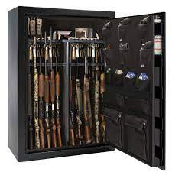



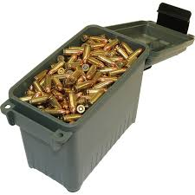

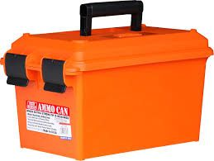
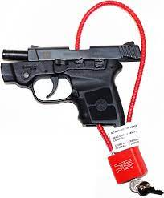
Gun Safe
Gun case/lock box
Biometric Gun Safe
Safe Firearm Storage Video
Community Partnership of the Ozarks
https://youtu.be/mj7yJ8i9XH4?si=eJ0W75-PAIBXFEhV
Cable Lock
Trigger Lock
Clam Shell
Ammunition Can
Notes:
Instructor Notes: Safe Firearm Storage Examples - This slide is optional to share.
This slide visually introduces a range of firearm storage options to help caregivers and community members understand how to reduce access to lethal means in the home. It supports the broader goal of creating suicide-safer environments.
Key Teaching Points:
Normalize the Conversation
Frame safe storage as a responsible and caring action, not a judgment.
Use inclusive language: “Many families have firearms. Let’s talk about how to store them safely.”
Introduce Storage Options Shown
Gun Safe: Best for long-term, secure storage of multiple firearms.
Biometric Safe: Offers quick access for authorized users while keeping others out.
Lock Box / Gun Case: Portable and secure for handguns.
Cable Lock: Threads through the firearm to prevent it from being fired.
Trigger Lock / Clam Shell: Prevents trigger access; useful for households with children.
Ammunition Can: Store ammunition separately from firearms to increase safety.
Encourage Layered Safety
Recommend using multiple methods (e.g., a lock box + separate ammo storage).
Reinforce that removal from the home is the safest option when someone is at risk.
Use the Video as a Resource
Direct participants to the linked video for a demonstration of each method: Safe Firearm Storage Video – Community Partnership of the Ozarks

Slide 32

"Many homes have medications that could be dangerous in a crisis. Let’s talk about how to make them safer."
​POISONS/MEDICATIONS
Safest​ | Removal from home​ | Do not flush or pour down the sink or toilets | Purchase a drug deactivation kit from local pharmacy
 |  | Law enforcement medication drop box or drug take back events
Safer​ | Make harder to access​ | Store large quantities & infrequently used medications in a pill safe or lock box | Keep daily or weekly doses in a pill organizer
 |  |  | Switch to blister packs
Safe​ | Render inoperable​ | Talk to the pharmacist about dispensing prescriptions in non-lethal quantities | Contact Poison Control to determine safe quantities
Other​ | Distract or remind of reasons for living​ | Identify ways to distract from suicidal thoughts (art, movement, hold on to ice cubes, take a shower, journal, call a friend) | Leave photos of loved ones, pets, or ​ reasons for living in common places
And​ | 988​ Keep physical & emotional contact​ | Program 988 – Suicide & Crisis Lifeline into phone so they can reach out for help. Keep bedroom doors open to maintain eyes and ears on them
Notes:
Instructor Notes: Safe Storage and Disposal of Medications and Poisons
This slide provides a structured approach to reducing the risk of suicide by limiting access to potentially lethal medications and household poisons. It complements firearm safety strategies and is especially relevant for youth, older adults, and individuals with chronic health conditions.
Start with the Message at the Top
“Many homes have medications that could be dangerous in a crisis. Let’s talk about how to make them safer.”
Emphasize the importance of disposing of unused, expired, or excess medications and toxins.
Reinforce that flushing or pouring down the drain is not safe—environmentally or for safety.
Explain the Tiered Safety Table
Safest: Complete removal from the home via:
Drug deactivation kits (available at pharmacies)
Law enforcement drop boxes or take-back events
Safer: Secure storage of necessary medications:
Use a pill safe or lock box for bulk medications
Use pill organizers for daily/weekly doses
Safe: Reduce harm potential:
Ask pharmacists to dispense in non-lethal quantities
Consult Poison Control for safe storage and dosage guidance
Discuss “Other” and “And” Actions
Other: Emotional and cognitive strategies to reduce impulsivity:
Distraction techniques (e.g., art, journaling, cold exposure)
Visual reminders of reasons for living (photos, pets, affirmations)
And: Maintain physical and emotional presence:
Keep bedroom doors open.
Program 988 into phones for immediate support.
Normalize and Empower
Frame these actions as preventive care, not punishment or overreaction.
Encourage caregivers to start with one small step—even organizing medications can make a difference.

Slide 33

"Even though you didn't identify suffocation or hanging, we should consider implements in the home that could be used: ropes, belts, garbage can liners, plastic bags, extension cords, blind cords, curtain rods, or clothes rods in closets."
​SUFFOCATION
Safest​ | Removal from home​ | Almost impossible to remove all implements for suffocation or hanging
Safer​ | Make harder to access​ | When not in use, secure, lock up implements in the home that could be used for suffocation or hanging | Avoid storing implements for suffocation or hanging in the person's bedroom
Safe​ | Render inoperable​ | Almost impossible to render implements for suffocation or hanging inoperable
Other​ | Distract or remind of reasons for living​ | Identify ways to distract from suicidal thoughts (art, movement, hold on to ice cubes, take a shower, journal, call a friend) | Leave photos of loved ones, pets, or reasons for living in common places
And​ | 988​ Keep physical & emotional contact​ | Program 988 – Suicide & Crisis Lifeline into phone so they can reach out for help. Keep bedroom doors open to maintain eyes and ears on them
Notes:
Instructor Notes: Reducing the Risk of Suffocation or Hanging
This slide addresses the challenges and strategies for reducing access to means of suffocation or hanging in the home, methods that are often impulsive and highly lethal.
Acknowledge the Complexity
Begin by validating that suffocation methods are difficult to fully eliminate from a home.
“We can’t remove everything, but we can reduce access and increase support.”
Use the quote at the top to frame the conversation for the implements that may not have been mentioned in a suicide plan:
“Even though you didn’t identify suffocation or hanging, we should consider implements in the home that could be used…”
Review the Tiered Safety Table
Safest: Total removal is nearly impossible, but awareness is key.
Safer: Lock up or secure items like ropes, belts, cords, plastic bags, and curtain rods when not in use.
Avoid storing these items in the person’s bedroom or private spaces.
Safe: Rendering these items inoperable is not feasible, so focus on access control instead.
Discuss “Other” and “And” Actions
Other: Emotional and behavioral strategies:
Encourage distraction techniques (e.g., art, movement, cold exposure, journaling).
Place photos or reminders of reasons for living in visible areas.
And: Maintain connection and supervision:
Keep bedroom doors open.
Program 988 into phones and encourage its use.
Normalize and Empower
Emphasize that perfection isn’t the goal—progress is.
Encourage caregivers to focus on what they can control and to revisit safety strategies regularly.

Slide 34

"Since your student identified another method (knife, jumping from a height, stepping into traffic, drowning, driving their car off the road, etc.) how can you create a buffer of time and distance between that method and your student in the event of a crisis?"
​OTHER
Safest​ | Removal from home​ | Almost impossible to mitigate for all other methods of suicide, but removal should be considered when possible.
Safer​ | Make harder to access​ | Secure implements that can be locked up, (i.e., scissors, knives, razor blades, car keys, etc.) | Use under supervision
Safe​ | Render inoperable​ | Almost impossible to render all other implements inoperable
Other​ | Distract or remind of reasons for living​ | Identify ways to distract from suicidal thoughts (art, movement, hold on to ice cubes, take a shower, journal, call a friend) | Leave photos of loved ones, pets, or reasons for living in common places
And​ | 988​ Keep physical & emotional contact​ | Program 988 – Suicide & Crisis Lifeline into phone so they can reach out for help. Keep bedroom doors open to maintain eyes and ears on them
Notes:
Instructor Notes: Addressing Other Suicide Methods
This slide focuses on strategies for reducing risk when a student identifies a suicide method that doesn’t fall into the categories of firearms, medications, or suffocation, such as knives, jumping, traffic, drowning, or car crashes.
Acknowledge the Challenge
Begin by validating that not all methods can be fully controlled, but time and distance can still be powerful protective factors.
Use the guiding question at the top to frame the discussion:
“How can you create a buffer of time and distance between that method and your student in the event of a crisis?”
Review the Tiered Safety Table
Safest: Removal from the home is ideal, but not always possible.
Examples: temporarily removing car keys, storing sharp objects offsite.
Safer: Make access more difficult.
Lock up or supervise access to items like knives, scissors, razors, car keys.
Safe: Rendering inoperable is rarely feasible for these methods, so focus on supervision and access control.
Discuss “Other” and “And” Actions
Other: Emotional and behavioral strategies:
Encourage distraction techniques (e.g., art, movement, cold exposure, journaling).
Place visual reminders of reasons for living in common areas.
And: Maintain physical and emotional presence:
Keep bedroom doors open.
Program 988 into phones and encourage its use.
Normalize and Empower
Emphasize that caregivers are not expected to eliminate all risk, but they can take meaningful steps to reduce it.
Encourage them to focus on what’s within their control and to revisit safety strategies regularly.

Slide 35
STRATEGIES FOR A SUICIDE-SAFER HOME
 | FIREARMS | POISONS/ MEDICATIONS | SUFFOCATION | OTHER
 | Most Lethal | Most often used | 2nd most lethal method | Accessible or potentially lethal
Safest | Removal from home | Removal from home | Removal from home | Removal from home
Safer | Make harder to access | Make harder to access | Make harder to access | Make harder to access
Safe | Render inoperable | Reduce quantity | - | -
Other | Distract or remind of reasons for living | Distract or remind of reasons for living | Distract or remind of reasons for living | Distract or remind of reasons for living
And | 988 Keep physical & emotional contact | 988 Keep physical & emotional contact | 988 Keep physical & emotional contact | 988 Keep physical & emotional contact
Notes:
Instructor Notes: Bringing It All Together
As we wrap up this section, this slide serves as a summary and integration of all the strategies we've discussed for making homes suicide-safer. It reinforces the idea that while we cannot eliminate all risk, we can take meaningful steps to reduce it.
Understand the Risk Landscape
Firearms are the most lethal.
Medications and poisons are the most commonly used.
Suffocation is the second most lethal.
Other methods (e.g., sharp objects, jumping, traffic) are accessible and impulsive.
Apply the “Safest, Safer, Safe” Framework
Safest: Remove lethal means from the home when possible.
Safer: Make access more difficult—lock up, separate, supervise.
Safe: Render items inoperable or reduce their quantity.
Support Emotional Safety
Other: Use distraction techniques and visible reminders of reasons for living (photos, affirmations, pets).
And: Maintain physical and emotional connection—keep doors open, check in often, and ensure 988 is programmed into phones.
Empower, Don’t Overwhelm
Encourage caregivers and staff to start with one step.
Remind them that progress is more important than perfection.
End with Encouragement
“You don’t have to do everything at once. Even one small change can make a big difference.”
“Thank you for showing up for this conversation. Your awareness and action can save lives.”

Slide 36
REMEMBER
Know the risk factors and warning signs.
Understand your role in response to a suicide crisis.
Ask direct questions to determine risk for suicide.
Identify lethal means safety strategies to make an environment suicide safer.
Skills to help parents create suicide-safer environments to prevent, delay, or deter a suicide attempt.
Notes:
Instructor Notes: Remember the Learning Objectives
This slide serves as a powerful recap of the course’s essential messages. Use it to reinforce participants’ confidence in what they’ve learned and to encourage continued application of these skills in real-world settings.
Know the risk factors and warning signs.
Reaffirm the importance of recognizing behavioral, emotional, and situational indicators of suicide risk.
Encourage participants to stay alert and trust their instincts when something feels off.
Understand your role in response to a suicide crisis.
Emphasize that everyone has a role—whether as an educator, caregiver, peer, or community member.
Clarify that their role is not to diagnose or fix, but to listen, support, and connect to help.
Ask direct questions to determine risk for suicide.
Remind participants that asking about suicide does not increase risk—it opens the door to help.
Encourage the use of clear, compassionate language:
“Are you thinking about killing yourself?”
Identify lethal means safety strategies to make an environment suicide safer.
Utilize the Safest, Safer, Safe framework.
Reinforce that time and distance between a person and a lethal method can save lives.
Skills to help parents create suicide-safer environments to prevent, delay, or deter a suicide attempt.
Highlight the importance of partnering with caregivers.
Encourage participants to share what they’ve learned and to normalize conversations about safety at home.
Suggested Closing Script:
“You now have the tools to recognize risk, respond with care, and help create safer environments. Whether you’re supporting a student, a friend, or a family member, your actions can make a life-saving difference. Thank you for being part of this important work.”

Slide 37

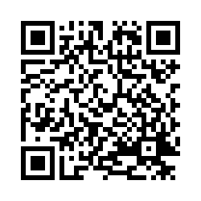
Post-Survey
[Instructor Name]
[Title]
[Organization]
Phone: [xxx-xxx-xxxx]
Email: [yourname@yourorganization.com]
Web: saferhomescollaborative.org
https://bit.ly/CSSS_POST
The University of Missouri – St. Louis, Missouri Institute of Mental Health will be responsible for this program and maintain a record of your continuing education credits earned. MIMH awards 2 clock hour(s) or 2.4 contact hour(s) (0.24 CEUs) for this program, including 0 clock hour(s) towards ethics, 2 clock hour(s) towards suicide prevention, and 0 clock hour(s) towards cultural competence.
Notes:
Instructor Notes: Post-Survey and Closing Remarks
This slide marks the official close of the training session. It provides participants with a clear call to action, access to ongoing support, and a way to stay connected after the course.
Encourage Post-Survey Participation
Ask participants to scan the QR code or enter the URL to complete the post-survey.
Explain that their feedback helps improve future trainings and ensures the content remains relevant and impactful.
The Safer Homes Collaborative is seeking participants’ help in validating the effectiveness of this training.
Participants who complete both the pre- and post-surveys and provide contact information will receive a $25 Amazon gift card.
Participation is completely voluntary, and participants may opt out at any time.
Surveys take approximately 5–7 minutes and are available digitally only.
MIMH CEUs and Certificate of Attendance
Participants can receive MIMH CEUs for completing the training.
To receive a certificate of attendance, they must access the post-survey and provide their name and email address. If participants choose to opt out, they may leave all other post-survey questions blank.
Encourage the use of a personal email address (not a school district email) to avoid issues with firewalls or spam filters.
988 Suicide & Crisis Lifeline
Remind participants that 988 is a free, confidential, 24/7 resource for anyone in emotional distress or experiencing a mental health crisis.
Encourage them to program 988 into their phones and share it with students, families, and colleagues.
Share Instructor Contact Info
If applicable, personalize this section with your name, title, organization, phone number, and email address.
Let participants know they can reach out with questions, concerns, or requests for additional resources.
Direct to Additional Resources
Highlight the website: saferhomescollaborative.org
Encourage participants to explore the site for more tools, handouts, and training opportunities.
Suggested Closing Script:
“Thank you for your time, your attention, and your commitment to creating suicide-safer homes and schools. Please take a moment to complete the post-survey—it helps us improve and supports your continued learning. Don’t forget to claim your Amazon gift card and CEUs by completing the post-survey with your name and contact information. And remember, 988 is always there. Together, we can save lives.”
Missouri Institute of Mental Health (MIMH)
The University of Missouri – St. Louis, Missouri Institute of Mental Health will be responsible for this program and maintain a record of your continuing education credits earned. MIMH awards 2 clock hour(s) or 2.4 contact hour(s) (0.24 CEUs) for this program, including 0 clock hour(s) towards ethics, 2 clock hour(s) towards suicide prevention, and 0 clock hour(s) towards cultural competence.

