Slide 1


Conversations for Suicide Safer Homes
a CALM-informed training
Notes:
This course can only be presented by those who have completed the Instructor Training Workshop facilitated by the Safer Homes Collaborative. If you have any questions or concerns about the slide deck, contact Project Director Katie Ellison @ katie.Ellison@mimh.edu. Any significant alterations must be approved the Safer Homes Collaborative prior to being presented. Additional slides that show local data or suicide prevention resources may be added with the approval of a Master Trainer to ensure that they are accurate and in keeping with the CALM approach to suicide prevention.
Course description - This course reviews public health data regarding suicide and access to lethal means. It highlights the importance of reducing access to highly lethal means, discusses the most lethal means, and describes how to have a culturally competent conversation regarding securing lethal means and firearms.
Note to Instructors:
Introductions may include the sponsoring organization, the instructors(s), and/or the participants.
Welcome gun owners’ and non-gun owners’ participation in this training.
Safe messaging practices recommend avoiding focusing on the method used in suicide deaths. We must focus on the most lethal method(s) for training purposes.
There is a high probability that a survivor of suicide loss and/or attempt survivor is a participant. Acknowledge the likelihood that loss survivors are in attendance and that the material may be emotionally difficult for some people.

Slide 2

ACKNOWLEDGMENTS
CALM Developers
1
Elaine Frank
Cathy Barber
Mark Ciocca
Safer Homes Collaborative
2
Elizabeth Makulec
Rick Strait
Dr. Elizabeth Sale
Katie Ellison
With Special Thanks to
3
Dartmouth Injury Prevention Center,
Harvard Injury Control Research Center, and our partners and colleagues working in firearm suicide prevention
Notes:
Instructor Note: Historical Background of CSSH and CALM
This slide provides important context for the development of Conversations for Suicide Safer Homes (CSSH) and its roots in the Counseling on Access to Lethal Means (CALM) framework.
In 2017, the Missouri Institute for Mental Health (MIMH) was invited by the Missouri Foundation for Health (MFH) to propose a project aimed at reducing firearm suicides. A key component was adapting CALM—originally developed by Elaine Frank, Dr. Frank Ciocca, and Cathy Barber—for use with gun retailers.
In 2018, MFH awarded MIMH a three-year grant, leading to the creation of the Safer Homes Collaborative (SHC). MIMH partnered with Elaine Frank, Rick Strait, and Elizabeth Makulec to adapt CALM into two versions:
Clinical CALM (CALM.3) for healthcare providers
Conversations on Access to Lethal Means (CALM.1) for gun retailers
Initially, CALM.1 was delivered in-person to gun shops, but participation was limited. SHC expanded outreach to include gun owners and community members who could engage in conversations about suicide risk and firearm access.
Evaluation of CALM workshops—delivered at conferences and community events—showed increased comfort, confidence, and willingness among participants to talk about suicide and lethal means safety. Over 800 Missourians were trained.
In 2022, SHC received continued funding to broaden its impact. CALM.1 was adapted into Conversations for Suicide Safer Homes (CSSH)—a more flexible, audience-specific training. CSSH is now tailored for groups such as:
First responders
Service members and Veterans
Faith-based communities
High-risk occupations
This evolution reflects a growing commitment to lethal means safety and community-based suicide prevention.

Slide 3
ABOUT THIS WORKSHOP
1
2
3
BASED ON COUNSELING ON ACCESS TO LETHAL MEANS
ONE PART OF SUICIDE PREVENTION
FOCUS ON CREATING SUICIDE SAFER ENVIRONMENTS
CALM is an evidence-based prevention resource by the Suicide Resource Center (SPRC)
Developed in 2006 in partnership with Dartmouth Injury Prevention Center
Not THE answer but should always be included
Anyone can do it – not just clinicians/ professionals
Anti-suicide
Not anti-gun, not even
anti-drugs.
Notes:
Instructor Note:
This slide introduces the foundational principles of the Conversations for Suicide Safer Homes (CSSH) workshop. Use it to set the tone and clarify the purpose of the training:
Based on Counseling on Access to Lethal Means (CALM):
Emphasize that this workshop is grounded in evidence-based practices.
CALM was developed in 2006 by the Dartmouth Injury Prevention Center.
It provides a structured approach to discussing access to lethal means with individuals at risk for suicide.
One Part of Suicide Prevention:
Reinforce that this training is not a standalone solution, but a critical component of a broader suicide prevention strategy.
Highlight that anyone can use these tools, not just mental health professionals. This empowers participants to take action in their own communities.
Focus on Creating Suicide-Safer Environments:
Clarify that the workshop is anti-suicide, not anti-gun or anti-medication.
The goal is to reduce access to lethal means during times of crisis, not to promote political or ideological positions.

Slide 4


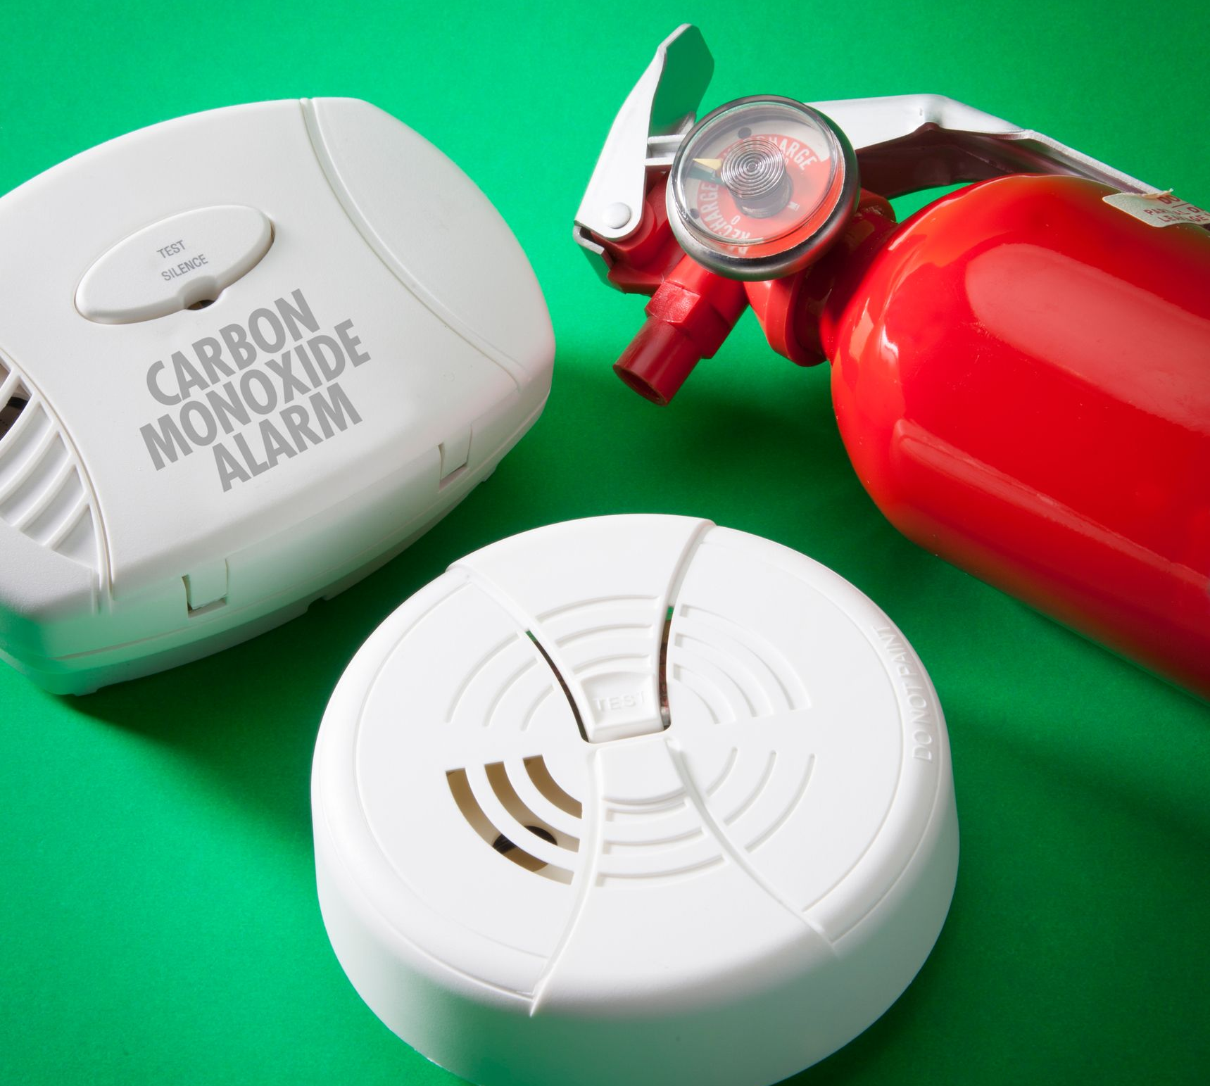

Standard Home
Safety Practices
Install safety gates & window guards
Keep an eye on children around water
Develop & practice a fire escape plan
Smoke alarms and carbon monoxide detectors
Keep floor surfaces free of trip hazards
Store medications safely
Safe storage of household cleaners/toxic products
Secure TVs, dressers, & appliances to the wall to prevent tipping hazard
Notes:
Instructor Note: Standard Home Safety Practices
This slide highlights common home safety practices that many families already implement to protect against everyday risks. Use this as a bridge to introduce the idea that lethal means safety is a natural extension of these familiar precautions.
Key points to emphasize:
These practices—like installing safety gates, securing furniture, and storing medications safely—are widely accepted and non-controversial.
They reflect a shared value: keeping loved ones safe, especially children and vulnerable individuals.
Just as we take steps to prevent accidental injuries, we can also take steps to reduce access to lethal means during times of crisis.
This framing helps normalize conversations about suicide prevention by placing them within the broader context of home safety.
Encourage participants to reflect on how they already practice safety at home and how they might extend those efforts to include suicide prevention strategies.

Slide 5
Why should we talk about firearms and suicide?
Suicide is a leading cause of death.
Home is the primary setting where young people obtain firearms used in suicide.
Talking about suicide is a research-informed best practice for preventing suicide.
Gun owners have a role in preventing firearm suicide.
Suicide is generally preventable.
Notes:
Instructor Note: Why Should We Talk About Firearms and Suicide?
This slide sets the stage for why conversations about firearms and suicide are both necessary and impactful. Use it to frame the importance of the workshop and to engage participants in thinking about their role in prevention.
Key points to emphasize:
Suicide is a leading cause of death in the U.S., particularly among youth and middle-aged adults. It’s a public health issue that affects individuals, families, and communities.
Firearms used in youth suicides are most often obtained from the home. This highlights the importance of safe storage and proactive conversations within households.
Talking about suicide saves lives. Research shows that asking about suicide does not increase risk—it opens the door to support and intervention.
Gun owners play a critical role in suicide prevention. This is not about politics—it’s about safety, responsibility, and protecting loved ones.
Suicide is generally preventable. With the right tools, awareness, and support, we can reduce risk and save lives.
Encourage participants to view this conversation as part of a broader commitment to community safety and care.
Citations
CDC WISQARS. (n.d.). WISQARS Data Visualization. Centers for Disease Control and Prevention. Retrieved May 12, 2022, from https://wisqars.cdc.gov
Goldstick, J., Cunningham, R., & Carter, P. (2022, May 19). Current Causes of Death in Children and Adolescents in the United States. https://www.nejm.org/doi/full/10.1056/NEJMc2201761
Harvard T.H. Chan School of Public Health (Ed.). (2016, March 29). National Violent Injury Statistics System. Retrieved from https://web.sph.harvard.edu/mch-data- connect/results/national-violent-injury-statistics-system/
Johnson, R. M., Barber, C., Azrael, D., Clark, D. E., & Hemenway, D. (2010). Who are the owners of firearms used in adolescent suicides? Suicide and Life-Threatening Behavior, 40(6), 609–611. https://doi.org/10.1521/suli.2010.40.6.609
Polihronis, C., Cloutier, P., Kaur, J., Skinner, R., & Cappelli, M. (2022). What’s the harm in asking? A systematic review and meta-analysis on the risks of asking about suicide-related behaviors and self-harm with quality appraisal. Archives of Suicide Research, 26(2), 325–347. https://doi.org/10.1080/13811118.2020.1793857

Slide 6
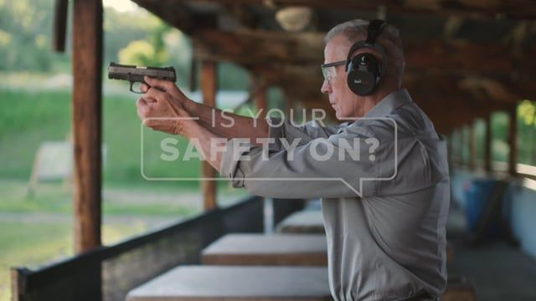
Warning – viewers will hear two gunshots at the beginning of the video
Courtesy - Utah Suicide Prevention Coalition
Notes:
Instructor Note:
Participants will now view a public service announcement (PSA) created by the Utah Suicide Prevention Coalition. This video emphasizes that suicidal crises are often temporary and that with time and support, individuals, especially gun owners, can return to the activities they value, such as shooting sports.
⚠️ Content Warning:
Let participants know in advance that the video includes the sound of two gunshots—at the beginning and at the end of the video. Encourage anyone who may be sensitive to this content to take care of themselves as needed (e.g., stepping out briefly or muting the audio).
This PSA is a powerful tool for illustrating the message that temporary steps to increase safety can lead to long-term recovery and reconnection.
Utah PSA –https://vimeo.com/175761640

Slide 7

Commandments of firearm safety
Treat every firearm as if it were loaded.
Always point the muzzle in the safest direction.
Keep your finger off the trigger until you are ready to shoot.
Be sure of your target – and what’s beyond.
Know how to safely operate and maintain your firearm before shooting.
Be sure that your firearm is safe to operate.
Be sure your firearm and ammunition are compatible.
Wear eye and ear protection when shooting.
Never use alcohol or other drugs when operating or cleaning firearms.
Safely store all guns to prevent theft and unauthorized access.
Consider temporary off-site storage or use safe storage strategies if someone in the home may be suicidal or is going through a rough time.
Notes:
Instructor Note (General Audience):
This slide presents the core principles of responsible firearm ownership—rules that many participants will already know and practice. Use this familiarity to build trust and introduce the idea that suicide prevention is a natural extension of gun safety.
Key points to highlight:
The first ten commandments reflect standard firearm safety—treating every gun as loaded, keeping the muzzle pointed in a safe direction, and using proper maintenance and protective gear.
These rules are about protecting yourself and others from unintentional harm.
The 11th commandment introduces a new layer of responsibility:
If someone in the home is going through a tough time or showing signs of suicidal thoughts, consider temporary off-site storage or enhanced safe storage practices.
This is not about taking away rights—it’s about protecting life during a vulnerable moment.
Reinforce that responsible gun ownership includes being proactive about safety, especially when it comes to mental health.
------------------------------------------------------------------------------------------------------------------------------------------------------------------------------------------------------------
Instructor Note (Law Enforcement Audience):
This slide reviews the core firearm safety principles that law enforcement professionals are trained to follow. Use this as a foundation to introduce how these same principles can be extended to suicide prevention efforts, both on and off duty.
Key points to highlight:
The first ten commandments reflect standard law enforcement firearm protocols—safe handling, situational awareness, and operational readiness.
These rules are second nature to officers and reinforce the importance of discipline and responsibility in firearm use.
The 11th commandment introduces a proactive approach to mental health and suicide prevention:
If a colleague, family member, or community member is experiencing a mental health crisis, consider temporary off-site storage or enhanced safe storage practices.
This is especially relevant in law enforcement, where access to firearms is routine and stress levels can be high.
Emphasize that this is not about questioning fitness for duty—it’s about protecting lives during moments of vulnerability.
Encourage officers to see this as an extension of their duty to serve and protect, including protecting their own well-being and that of their peers and families.

Slide 8

Consider temporary off-site storage or safe storage strategies
for firearms and any other lethal methods if you or a family member may be going through a rough time or having suicidal thoughts and feelings
Notes:
Instructor Note: (General Audience)
The Safer Homes Collaborative encourages participants to view the responsible, safe, and legal storage of firearms as a standard part of home safety, just like locking up medications or securing cleaning products. This practice is especially important in preventing the tragedy of firearm suicide.
Most individuals who attempt or die by suicide show observable warning signs beforehand. However, many loss survivors report that they didn’t recognize these signs until it was too late.
When a firearm is easily accessible and not stored securely, the risk of a suicide attempt becoming fatal increases significantly.
Encourage participants to be proactive:
Layer safe storage practices before someone is in crisis.
Consider voluntary, temporary off-site storage if someone in the home is struggling or at risk.
Framing these actions as part of everyday safety, not just crisis response, can help normalize and encourage life-saving decisions.
--------------------------------------------------------------------------------------------------------------------------------------------------------------------------------------------------------------------
Instructor Note (Firearm Instructors):
As trusted educators in firearm safety, you play a vital role in promoting not only responsible handling but also responsible storage—especially when it comes to preventing firearm suicide.
The Safer Homes Collaborative encourages firearm instructors to include safe, legal, and responsible storage practices as part of their standard safety curriculum.
Most individuals who attempt or die by suicide show warning signs, but these signs are often missed or misunderstood. When firearms are readily accessible and not securely stored, the risk of a fatal suicide attempt increases dramatically.
As instructors, you can help normalize the idea that safe storage is a proactive safety measure, not a restriction of rights.
Encourage your students to:
Layer safe storage practices before a crisis occurs.
Consider temporary off-site storage if someone in the home is struggling with mental health or going through a difficult time.
Framing this as part of comprehensive firearm safety helps reinforce that responsible ownership includes protecting loved ones—not just from accidents, but also from preventable tragedies like suicide.
------------------------------------------------------------------------------------------------------------------------------------------------------------------------------------------------------------------
Instructor Note (Healthcare Workers):
As healthcare professionals, you are often in a unique position to recognize and respond to suicide risk. This slide emphasizes the importance of integrating safe firearm storage into your conversations about home safety and mental health.
The Safer Homes Collaborative encourages you to include responsible, legal, and secure firearm storage as part of routine safety planning—just like discussing medication safety or fall prevention.
While most individuals who attempt or die by suicide show warning signs, these signs are not always recognized in time. When a firearm is easily accessible and not securely stored, the risk of a fatal suicide attempt increases significantly.
Encourage patients and families to:
Implement safe storage practices before a crisis occurs.
Consider temporary off-site storage if someone in the home is experiencing a mental health crisis or showing signs of suicide risk.
Framing this as a preventive health measure—rather than a judgment or restriction—can help reduce stigma and increase acceptance. Your role in initiating these conversations can be life-saving.

Slide 9
Risks for suicide
COMMUNITY & SOCIETAL RISK
Barriers to health care
Cultural and religious beliefs that suicide is noble
Suicide cluster in the community
Stigma associated with mental illness or help-seeking
Easy access to lethal means among people at risk
Unsafe media portrayals of suicide
INDIVIDUAL RISKS:
Mental health challenges such as depression
Social isolation
Criminal or legal problems
Financial problems
Impulsive or aggressive tendencies
Job problems or loss
Serious illness
Substance use disorder
RELATIONSHIP RISKS:
Childhood abuse and neglect
Bullying
Family history of suicide
Relationship problems – break-up, violence, or loss
Sexual violence
CDC, 2021
Notes:
Instructor Note: (General Audience)
Begin by defining risk factors as characteristics or conditions that increase the likelihood of someone developing suicidal thoughts or behaviors. These can be grouped into individual, relationship, community, or societal categories.
Engage participants by asking them to brainstorm known risk factors for suicide. After the discussion, reveal the CDC-defined risk factors and highlight any that weren’t mentioned to expand their understanding.
Emphasize that suicide is complex—no single risk factor predicts behavior. However, the presence of multiple risk factors increases the likelihood of suicidal thoughts or actions.
Reinforce the importance of early recognition and intervention. The sooner we identify risk, the better the chance of preventing suicidal behavior.
Remind participants that while we can’t always predict who will attempt suicide, training everyone to recognize risk factors and warning signs increases the chances of timely support and intervention.
-------------------------------------------------------------------------------------------------------------------------------------------------------------------------------------------------------------
Instructor Note (Healthcare Workers):
Begin by defining risk factors as characteristics or conditions that increase the likelihood of someone developing suicidal thoughts or behaviors. These can be categorized into individual, relationship, and community or societal factors.
Invite participants to brainstorm known risk factors for suicide. After discussion, present the CDC-defined risk factors, highlighting any that were not mentioned to expand their clinical awareness.
Emphasize that suicide is multifactorial—no single risk factor alone predicts behavior. However, the accumulation of multiple risk factors increases the likelihood of suicidal ideation or attempts.
Reinforce the importance of early identification and intervention. As healthcare providers, you are often in a position to notice subtle changes in behavior, mood, or functioning. The earlier you act, the greater the chance of preventing escalation.
Remind participants that while we cannot always predict who will attempt suicide, training to recognize risk factors and warning signs equips providers to respond with empathy, skill, and urgency.
This discussion supports the broader goal of integrating suicide prevention into routine clinical care.

Slide 10
Observe warning signs – a change from what is typical or expected
Mood – depressed, angry, impulsive, lethargic
Major life change – facing a breakup, legal/money challenges, or another personal setback that represents a loss
Substance use or misuse – increase in prescription or recreational drugs or alcohol
Behaviors – withdrawing from usual activities, writing or drawing about suicide/death, absenteeism or presenteeism, reckless behaviors, giving things away, acquiring or having access to lethal means
Affect/Emotion – hopeless, sense of burden, trapped or stuck with no way out of the circumstances, unexplained euphoric shift like the weight has lifted off their shoulders
CDC, 2021
Notes:
Instructor Note: Recognizing Suicide Warning Signs (General Audience)
Begin by defining warning signs as observable changes in a person’s thoughts, feelings, or behaviors that may indicate they are considering or planning suicide.
Invite participants to brainstorm warning signs they’re familiar with. Then, reveal the CDC-defined warning signs and highlight any that weren’t mentioned to broaden awareness.
Emphasize that the most important indicator is a change from what’s typical for that individual. Warning signs vary from person to person and may not be recognized by everyone around them.
Reinforce that most people show warning signs to someone before a suicide attempt, but not always to those closest to them. This helps explain why survivors often say they didn’t see any signs.
Stress the importance of taking action: If you notice warning signs, ask directly if the person is thinking about suicide or ending their life. This simple step can be life-saving.
-------------------------------------------------------------------------------------------------------------------------------------------------------------------------------------------------------------
Instructor Note: Recognizing Suicide Warning Signs (Clinicians and Healthcare Context)
Definition:
Warning signs are observable changes in a person’s thoughts, feelings, or behaviors that may indicate they are considering or planning suicide.
Training Guidance:
Engage participants by asking them to list warning signs they’ve encountered in clinical practice. After discussion, present the CDC-defined warning signs and highlight any that were not mentioned to expand clinical awareness.
Emphasize that the key indicator is a change from baseline behavior. Warning signs are highly individualized and may not be recognized by everyone, especially those closest to the individual.
Reinforce that most people exhibit warning signs to someone before a suicide attempt. However, these signs may be subtle or misinterpreted, which is why healthcare workers must remain observant and proactive.
Encourage providers to ask directly if they suspect someone may be thinking about suicide. Phrasing such as “Are you thinking about ending your life?” is appropriate and supported by research as a best practice.
Clinical Takeaway:
Early recognition and direct inquiry can lead to timely intervention and save lives. Integrating this awareness into routine assessments—especially during mental health screenings or crisis evaluations—is essential for comprehensive patient care.

Slide 11




REDUCING ACCESS TO LETHAL MEANS IS EFFECTIVE SUICIDE PREVENTION
1
2
3
Automobile Exhaust
Heights
Firearms
Notes:
Instructor Note: Means Restriction and Suicide Prevention – Historical Examples
This section highlights how changes in access to lethal means have influenced suicide rates over time. Use these examples to illustrate the effectiveness of means restriction as a public health strategy.
1. Automobile Exhaust:
From the 1940s to 1970s, suicide by carbon monoxide poisoning from car exhaust became more common as enclosed garages became widespread.
In 1975, the introduction of catalytic converters—mandated by the U.S. Environmental Protection Agency—significantly reduced the toxicity of vehicle emissions.
This technological change led to a notable decline in suicide deaths by automobile exhaust.
2. Heights – Bloor Viaduct, Toronto:
The Bloor Viaduct was once the second most common suicide bridge in North America, after the Golden Gate Bridge.
Before barriers were installed in 2003, an average of 9 suicides per year occurred at the site.
A 2017 report showed that in the 14 years following the barrier installation, only one person died by suicide at the bridge, demonstrating the effectiveness of physical barriers in preventing suicide.
3. Firearms – Switzerland:
Switzerland’s militia system required male citizens to keep military-issued firearms and ammunition at home.
In 2003, the Army XXI reform halved the number of active soldiers and changed firearm policies:
Soldiers had to purchase their firearms upon discharge instead of keeping them automatically.
Ammunition storage was moved from homes to military bases.
Gun licensure became mandatory for all owners.
A 2013 analysis of suicide data (1995–2009) found:
A 4.09% overall reduction in firearm suicides.
A 9% reduction among men.
No significant change in non-firearm suicide rates, indicating the impact was specific to firearm access.
Key Takeaway for Participants: These examples show that limiting access to lethal means—whether through policy, technology, or environmental design—can reduce suicide rates without necessarily increasing other methods. This reinforces the importance of safe storage, temporary removal, and proactive planning in suicide prevention efforts.
Citations:
Hampson, Neil & Holm, James. (2015). Suicidal carbon monoxide poisoning has decreased with controls on automobile emissions. Undersea Hyperb Med. 42. 159-64.
Sinyor M, Schaffer A, Redelmeier DA, et al, Did the suicide barrier work after all? Revisiting the Bloor Viaduct natural experiment and its impact on suicide rates in Toronto, BMJ Open, 2017;7:e015299. doi: 10.1136/bmjopen-2016-015299
Reisch, T., Steffen, T., Habenstein, A., & Tschacher, W. (2013). Change in suicide rates in Switzerland before and after firearm restriction resulting from the 2003 “Army XXI” reform. The American Journal of Psychiatry, 170(9), 977–
984. https://doi.org/10.1176/appi.ajp.2013.12091256

Slide 12
REDUCING ACCESS TO LETHAL MEANS IS EFFECTIVE SUICIDE PREVENTION
1
Ambivalence
2
Transient/Temporary
3
Urgency
4
Lethality
Notes:
Instructor Note: (General Audience)
This slide introduces four key concepts that explain why reducing access to lethal means is a powerful and evidence-based suicide prevention strategy. Use this slide to help participants understand the psychological and behavioral dynamics of suicidal crises:
Ambivalence – Many individuals experiencing suicidal thoughts feel conflicted. They may not want to die, but they want their pain to end. This ambivalence creates a critical window for intervention.
Transient/Temporary – Suicidal crises are often short-lived. If access to lethal means is delayed or restricted during this period, the risk of a fatal outcome can be significantly reduced.
Urgency – Suicidal thoughts can escalate quickly. The decision to act is often made impulsively, within minutes or hours. Slowing down access to lethal means can interrupt this urgency.
Lethality – Some methods, like firearms, are far more lethal than others. Reducing access to highly lethal means increases the chance of survival and the opportunity for recovery.
Key Message:
Reducing access to lethal means doesn’t eliminate risk, but it buys time, increases safety, and saves lives. This is a practical, nonjudgmental approach that anyone can support, regardless of their background or beliefs.
------------------------------------------------------------------------------------------------------------------------------------------------------------------------------------------------------------------
Instructor Note (Clinicians and Healthcare workers):
This slide outlines four key psychological and behavioral factors that explain why reducing access to lethal means is a clinically effective suicide prevention strategy. Use this to reinforce the importance of incorporating means safety into your patient assessments and safety planning.
Ambivalence – Many patients experiencing suicidal ideation are conflicted. They may not want to die but feel overwhelmed by emotional pain. This ambivalence creates a critical opportunity for intervention.
Transient/Temporary – Suicidal crises are often short-lived. If access to lethal means is restricted during this window, the likelihood of survival increases significantly.
Urgency – Suicidal thoughts can escalate rapidly. The decision to act is often impulsive, occurring within minutes or hours. Delaying access to lethal means can interrupt this urgency and allow time for de-escalation and support.
Lethality – Some methods, particularly firearms, have a much higher fatality rate. Reducing access to highly lethal means increases the chance of survival and the opportunity for therapeutic intervention.
Clinical Application:
Incorporate discussions about lethal means safety into routine suicide risk assessments. Normalize these conversations as part of comprehensive care, and collaborate with patients and families to develop realistic, respectful, and effective safety plans.

Slide 13

AMBIVALENCE
Notes:
Instructor Note: 1. Ambivalence
Ambivalence means feeling torn—most people who think about suicide don’t fully want to die. They’re often struggling between wanting to escape their pain and still wanting to live.
Why It Matters:
Recognizing this inner conflict is important. It shows that there’s still a part of the person who wants help and hopes things can get better. That’s the part we can connect with—whether we’re a friend, family member, coworker, or community member.
Key Message:
If someone opens up about suicidal thoughts, it doesn’t mean they’ve made up their mind. It means they’re in pain and may be looking for a reason to hold on. Listening, showing you care, and helping them feel supported can make a life-saving difference.
---------------------------------------------------------------------------------------------------------------------------------------------------------------------------------------------------------------------
Instructor Note: 1. Ambivalence (Clinicians and Healthcare workers)
Ambivalence refers to the internal conflict many individuals experience when having suicidal thoughts—feeling torn between wanting to die and wanting to live.
Why It Matters:
Recognizing ambivalence is critical because it signals that part of the person still wants help and hopes for change. This is the part that clinicians, caregivers, and loved ones can connect with to offer support and intervention.
Clinical Application:
When engaging with someone at risk, listen for signs of ambivalence (e.g., expressions of doubt, hesitation, or conflicting feelings).
Use this as an opening to explore their reasons for living and to collaboratively build a safety plan.
Reinforce that ambivalence is normal and treatable, and that support is available to help them move through the crisis.
This concept is foundational to motivational interviewing and other therapeutic approaches that aim to strengthen a person’s desire to live.

Slide 14
THOUGHTS OF SUICIDE CAN BE TRANSIENT/TEMPORARY- suicidal thoughts often come and go; they are frequently momentary.
Owens, Horrocks & House, 2002
Notes:
Instructor Note: 2. Transient/Temporary
Suicidal crises are often short-term, even when the underlying issues are long-standing. The intense emotional pain that drives suicidal thoughts can lessen with time, support, and intervention.
Why It Matters:
Helping someone understand that their crisis is temporary can encourage them to hold on through the most difficult moments and seek help.
Key Data to Share:
Fewer than 10% of people who attempt suicide will go on to die by suicide.
That means if we can prevent a suicide today, we have a strong chance of saving that life long-term.
However, those who survive a suicide attempt are at significantly higher risk—about 750 times the suicide rate of the general population (13 per 100,000 vs. 10 per 100 attempt survivors).
This is why a previous suicide attempt is one of the strongest predictors of future risk.
Takeaway:
Creating suicide-safer environments and intervening early, especially after a prior attempt, can be life-saving. Emphasize that delaying access to lethal means during a temporary crisis can make all the difference.
-------------------------------------------------------------------------------------------------------------------------------------------------------------------------------------------------------------------
Instructor Note (Clinicians & Healthcare Workers): 2. Transient/Temporary
Suicidal crises are often acute and short-term, even when the underlying mental health or life challenges are chronic. The intense emotional pain that drives suicidal ideation can diminish with time, support, and appropriate intervention.
Why It Matters:
Helping patients understand that their crisis is temporary can be a powerful motivator for them to seek help and stay safe through the most difficult moments.
Key Data to Share:
Fewer than 10% of individuals who attempt suicide will eventually die by suicide.
This means that timely intervention can be life-saving—preventing a suicide today often means saving a life long-term.
However, individuals who survive a suicide attempt are at significantly elevated risk—approximately 750 times higher than the general population (13 per 100,000 vs. 10 per 100 attempt survivors).
A previous suicide attempt is one of the strongest predictors of future suicide risk.
Clinical Takeaway:
Emphasize the temporary nature of suicidal crises during safety planning and patient education.
Promote lethal means safety as a critical, evidence-based strategy to reduce immediate risk.
Encourage collaborative planning that includes removing or securing access to lethal means, especially following a recent attempt or during periods of acute distress.

Slide 15
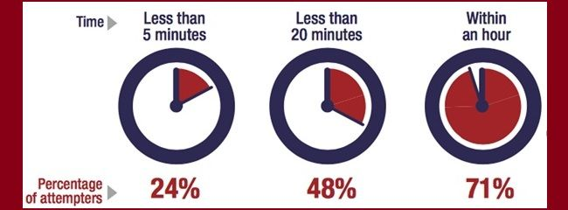
URGENCY- to end despair or pain, the decision to act on suicidal thoughts is reached quickly, particularly among young people.
The time between suicide as an option and an attempt
Putting time and distance between a suicidal person
and lethal means MAY save a life
Notes:
3. Urgency
Definition: This refers to how immediate the risk is. A person may feel an overwhelming need to act quickly, often driven by intense emotional distress or a triggering event.
Why it matters: High urgency increases the risk of impulsive actions. It’s a key factor in determining the need for immediate intervention.
In a study with near-lethal suicide attempt survivors in 2005, survivors were asked how much time transpired between the decision to end their life and the suicide attempt.
48% percent said less than twenty minutes, while 24% said it was less than five minutes. According to another survey, most attempt survivors said it was less than 10 minutes. The transition from thoughts about suicide to engaging in suicide behaviors can be urgent, or seemingly impulsive. Most gun owners underestimate their unique risk of dying in a firearm suicide attempt when firearms in the home are not stored unloaded and locked up or temporarily removed from the home when there is a person at risk. Because the time between making the decision to engage in the act of suicide is quite brief, it’s important that gun owners be proactive about safely, responsibly, and legally storing their firearms.
Citations:
Simon, T.R., Swann, A.C., Powell, K.E., Potter, L.B., Kresnow, M., and O’Carroll,
P.W. Characteristics of Impulsive Suicide Attempts and Attempters. SLTB. 2001; 32(supp):49-59.

Slide 16
LEADING LETHAL METHODS OF SUICIDE IN MISSOURI
CDC WISQARS, 2021
Notes:
Instructor Note: 4. Lethality (General Audience)
Lethality refers to how likely a method of suicide is to result in death. Some methods, like firearms, are far more lethal than others.
Why It Matters:
The more lethal the method, the higher the risk that a suicide attempt will be fatal. That’s why reducing access to highly lethal means—especially during a crisis—can save lives.
Key Talking Points:
Mental health professionals assess lethality to help determine how urgent a situation is and what kind of safety planning is needed.
In states with stronger firearm safety laws—such as safe storage requirements, licensing, and training—suicide rates tend to be lower.
For example, a 2020 study found that after Missouri repealed its “Permit to Carry” law, firearm suicide rates among young adults rose by 21.8%, while non-firearm suicide rates declined by 8.1%.
This shows that access to firearms matters, especially when someone is in crisis.
Takeaway:
Encourage participants to think of safe firearm storage as part of everyday home safety, just like locking up medications or cleaning supplies. Reducing access to lethal means doesn’t take away rights—it protects lives.
---------------------------------------------------------------------------------------------------------------------------------------------------------------------------------------------------------------
Instructor Note: 4. Lethality (Clinical Context)
Lethality refers to the likelihood that a specific method of suicide will result in death. Methods such as firearms are significantly more lethal compared to others like overdose or superficial cutting.
Clinical Relevance:
Understanding the lethality of different methods is essential for risk assessment and safety planning. When a patient is in crisis, access to highly lethal means can dramatically increase the risk of a fatal outcome. Clinicians play a critical role in identifying and mitigating these risks.
Key Clinical Points:
Risk Assessment: Evaluating the lethality of a patient’s chosen or considered method is a core component of suicide risk assessment. It informs the level of intervention required and the immediacy of safety planning.
Means Restriction: Evidence supports that reducing access to highly lethal means—especially firearms—can prevent suicide. This is particularly important during periods of acute risk.
Policy and Outcomes: Research shows that firearm legislation impacts suicide rates. For instance, after Missouri repealed its “Permit to Carry” law, firearm suicide rates among young adults increased by 21.8%, while non-firearm suicide rates declined by 8.1% (Kaufman et al., 2020). This underscores the importance of access control in suicide prevention.
Counseling on Access to Lethal Means (CALM): Clinicians should incorporate discussions about safe firearm storage and other means restriction into routine care, especially when working with at-risk individuals.
Takeaway for Practice:
Encourage patients and families to treat safe firearm storage as a standard safety measure—akin to locking up medications or household chemicals. Framing means restriction as a temporary, protective step rather than a permanent loss of rights can improve receptivity and compliance.
Citation:
Bhatt, Apurva, et al. “Association of Changes in Missouri Firearm Laws with Adolescent and Young Adult Suicides by Firearms.” JAMA Network Open, U.S. National Library of Medicine, 2 Nov. 2020, www.ncbi.nlm.nih.gov/pmc/articles/PMC7643031/#:~:text=Firearm%2Drelated%2 0suicide%20rates%20after,were%208.1%25%20lower%20in%20Missouri.

Slide 17

LETHALITY
90% fatal
1-2% fatal
Firearms
Sharps & Overdose
Spicer & Miller (2000)
Notes:
Instructor Note: Talking About Lethality – Use with Care
Important Reminder:
If you're presenting this information to a group that may include people who are struggling or at risk, please be especially careful. We never want to unintentionally suggest that some methods of suicide are “more effective” than others. The goal is always to prevent harm and save lives.
About This Slide:
This slide shares findings from a 2000 study by Spicer and Miller, which looked at how likely different suicide methods are to result in death. They found that:
About 90% of suicide attempts with a firearm are fatal.
In contrast, only 1–2% of attempts involving overdose or self-injury result in death.
This surprises many people. Most assume that methods like overdose are much more deadly than they actually are, often guessing around 30%. That overestimation may actually help save lives, which is why we don’t recommend sharing exact numbers in public or media settings.
Why This Matters:
The key takeaway is that access to lethal means matters. If someone in crisis doesn’t have access to a firearm—because it’s stored safely, legally, or temporarily removed—they are more likely to survive. And survival gives people a chance to get help and recover.
Final Thought:
When talking about suicide prevention, focus on hope, help, and safety. Encourage safe storage of firearms and medications as part of everyday home safety. And always remind people that help is available and recovery is possible.
--------------------------------------------------------------------------------------------------------------------------------------------------------------------------------------------------------------------
Instructor Note: (Clinical Settings) Lethality by Method – Use with Caution in At-Risk Settings
Purpose of This Slide:
This slide presents findings from a 2000 study by Spicer and Miller, which examined the lethality of various suicide attempt methods among individuals presenting to emergency departments. It highlights the stark contrast in fatality rates—approximately 90% for firearm attempts versus 1–2% for overdose or self-injury.
Instructor Guidance:
Use Clinical Discretion:
This content is intended for professional education and should be used with caution when presenting to audiences that may include individuals at risk for suicide. Avoid sharing specific lethality statistics with patients or the general public, as this information could unintentionally influence method selection.
Key Clinical Insight:
Many people—including clinicians—overestimate the lethality of less fatal methods, often assuming a 30% fatality rate for overdose or cutting. This misperception may actually serve a protective function. Clarifying this data is important for clinical understanding but should be handled sensitively.
Framing the Message:
The goal is not to highlight which methods are more or less lethal, but to underscore the life-saving potential of means safety. For example, if a person in crisis cannot access a firearm due to safe storage or temporary removal, they are more likely to survive an attempt using a less lethal method.
Contextualizing ED Data:
Not all emergency department visits for overdose or self-injury represent suicide attempts—some may be non-suicidal self-injury or gestures. Even accounting for this, the case fatality rate remains significantly lower than for firearms.
Takeaway for Practice:
When discussing means safety with patients or families, focus on reducing access to lethal methods rather than comparing lethality. Emphasize that safe storage is a protective measure, not a restriction of rights. Avoid discussing low lethality statistics directly with patients, as this could have unintended consequences.

Slide 18
WHY FOCUS ON FIREARMS?
Frequency: +60% of suicides in Missouri are with a firearm
Lethality: almost always fatal
Impulsivity: <10 minutes between thoughts and action
Availability: 52% of Missourians have access to a firearm in the home
Cultural Acceptability: ‘shall issue/open carry’ state
Notes:
Instructor Note: Understanding Gun Ownership Rates in Missouri and the Relation to Suicide Risk
Purpose of This Slide:
This slide helps set the stage for understanding how common firearm access is in Missouri and why that matters for public health and safety discussions, especially around suicide prevention.
We focus on firearms in this training because it is the leading method for suicide, and an attempt with a firearm is almost always fatal. Consider access in Missouri. The number of people who own or have access to a gun is surprisingly hard to pin down. There’s no national registry that captures every firearm, and many guns are passed down or sold privately without being officially recorded.
In 2020, the Missouri Foundation for Health partnered with IPSOS to conduct a statewide poll. They found that 52% of Missourians surveyed said they had access to a firearm in the home. That’s half of all households.
A 2015 national study estimated the national average for gun ownership at about 29.1%. Some states, like Delaware, were much lower, just over 5%.
Missouri, on the other hand, is well above the national average. And that makes sense when you consider the state’s laws. Missouri is a ‘shall issue’ state for concealed carry, meaning permits must be issued if the applicant meets the legal requirements. Since 2017, Missouri has also allowed permit-less carry, and open carry is legal in most places.
Why it Matters:
Understanding how common firearm access is helps us think about safety strategies, especially when it comes to preventing suicide or unintentional injuries. It’s not about politics—it’s about public health and protecting lives.

Slide 19
ACCESS TO FIREARMS INCREASES SUICIDE RISK
Suicide rates vary with rates of firearm ownership.
82% of youth who die by suicide used a firearm owned by a family member, usually a parent.
Parents underestimate the likelihood that their children have or could obtain their firearms.
Three out of five firearm-related deaths in the U.S. are a suicide.
Notes:
Instructor Note: Access to Firearms and Suicide Risk
Purpose of This Slide:
This slide highlights the strong connection between firearm access and suicide risk, especially among youth. It’s designed to raise awareness and encourage safe storage practices as a key part of suicide prevention.
Key Talking Points:
Firearm Access and Suicide Rates:
Research consistently shows that suicide rates are higher in areas with higher rates of firearm ownership. Access to a firearm during a crisis can turn a temporary situation into a fatal one.
Youth and Family-Owned Firearms:
A striking statistic: 82% of youth who die by suicide with a firearm used one that belonged to a family member, most often a parent. This underscores the importance of secure storage in homes with children or teens.
Parental Awareness Gap:
Many parents underestimate their children’s ability to access firearms in the home. Even if a gun is hidden, it may not be secure. Safe storage means locked and unloaded, with ammunition stored separately.
Suicide and Firearm Deaths:
It’s important to note that 3 out of 5 firearm-related deaths in the U.S. are suicides, not homicides. This fact often surprises people and shifts the conversation toward prevention through means safety.
Framing for the Audience:
This slide is not about taking away rights—it’s about protecting lives. Encourage the audience to think of safe firearm storage as part of everyday home safety, just like locking up medications or cleaning supplies.
----------------------------------------------------------------------------------------------------------------------------------------------------------------------------
Citations:
Curtin SC. State suicide rates among adolescents and young adults aged 10–24: United States, 2000–2018. National Vital Statistics Reports; vol 69 no 11. Hyattsville, MD: National Center for Health Statistics. 2020.
Duff-Brown, B. (2020, June 3). Handgun ownership is associated with a much higher suicide risk. Stanford Medicine News Center. Retrieved from https://med.stanford.edu/news/all-news/2020/06/handgun-ownership-associated-with- much-higher-suicide-risk.html
Miller M, Azrael D, Barber C. Suicide mortality in the United States: The importance of attending to method in understanding population-level disparities in the burden of suicide. Annual Review of Public Health. 2012; 33:393-408.

Slide 20
MAYBE IT’S NOT THE GUNS
Are people who live in homes with guns more likely to have…
… a mental health problem? | Yes | No
… seriously consider suicide? | Yes | No
… attempt suicide? | Yes | No
Gun owners aren’t likely to be more suicidal, just more likely to die if they make an attempt.
Notes:
Instructor Note: Understanding Risk – It’s About Access, Not Intent
Purpose of This Slide:
This slide is designed to challenge assumptions about the link between gun ownership and mental health or suicidal behavior. It emphasizes that the presence of a firearm doesn’t make someone more suicidal, but it does make a suicide attempt more likely to be fatal.
Key Talking Points:
Mental Health is Common:
About 1 in 4 adults will experience a mental health condition at some point in their lives. This is true regardless of whether they own a firearm.
Gun Ownership ≠ Suicidality:
Research shows that gun owners are no more likely than non-gun owners to experience suicidal thoughts or attempt suicide. The difference lies in the outcome of an attempt.
Lethality is the Risk Factor:
Firearms are highly lethal—about 9 out of 10 suicide attempts with a gun result in death. In contrast, methods like overdose or cutting are far less likely to be fatal, giving time for medical intervention and a second chance at life.
Why This Matters:
The goal isn’t to stigmatize gun ownership—it’s to highlight that access to a lethal method during a crisis can turn a temporary situation into a permanent tragedy. Safe storage and temporary removal during high-risk periods can save lives.
Framing for the Audience:
This slide helps shift the conversation from “who is at risk” to “what increases the risk of death.” It’s not about blaming individuals—it’s about empowering families and communities to take simple, life-saving steps.

Slide 21

Encourage putting time and distance between a person in emotional crisis and access
ALL/ANY lethal means
to POTENTIALLY save a life
Notes:
Instructor Note: Who Can Benefit from Learning to Have a Conversation About Suicide Safer Homes?
Everyone can benefit from learning how to talk about putting time and distance between a person in emotional crisis and access to lethal means. These conversations are vital because:
Suicidal thoughts often stem from emotional pain—feelings of hopelessness, despair, or being a burden. The desire is typically to end the pain, not necessarily life itself.
Talking about emotional pain can de-escalate a crisis, helping the person feel heard and begin to think more clearly.
Discussing access to lethal means can interrupt the progression from suicidal thoughts to forming a specific plan and may help connect the person to support sooner.
Research and lived experience show that when stressors pile up, it becomes harder to think clearly. A calm, compassionate conversation can make a meaningful difference.

Slide 22

Why have the Conversation?
You recognize the warning signs or have a gut feeling
Mood – depressed, angry, impulsive, lethargic
Major life change – facing a breakup, legal/money challenges, or another personal setback that represents a loss
Substance use or misuse – increase in prescription or recreational drugs or alcohol
Behaviors – withdrawing from usual activities, writing or drawing about suicide/death, absenteeism or presenteeism, reckless behaviors, giving things away, acquiring or having access to lethal means
Affect/Emotion – hopeless, sense of burden, trapped or stuck with no way out of the circumstances, unexplained euphoric shift like the weight has lifted off their shoulders
Notes:
Instructor Note: Recognizing Warning Signs of Suicide Risk
Purpose of This Slide:
This section helps participants identify common warning signs that may indicate someone is at risk for suicide. The focus is on recognizing noticeable changes in a person’s usual behavior, mood, or emotional state.
Key Points to Emphasize:
Look for Changes, Not Just Symptoms:
Warning signs often involve shifts in how someone typically acts or feels. It’s not just about the presence of certain behaviors—it’s about how those behaviors differ from what’s normal for that individual.
Context Matters:
A behavior that might not seem concerning in one person could be a red flag in another if it represents a significant change. Encourage participants to trust their instincts when something feels “off.”
Early Recognition Saves Lives:
Identifying these changes early can create an opportunity for connection, support, and intervention before a crisis escalates.

Slide 23
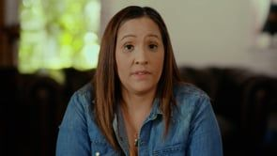
Courtesy of Worried About A Veteran​
Notes:
Instructor Note:
Let’s listen as Elena describes the warning signs she observed in her husband’s behavior, and the steps she took to check whether others were noticing similar concerns.
--------------------------------------------------------------------------------------------------------------------------------------------------------------------------------------------------------------
Debrief Discussion Points:
What warning signs did Elena and Luis notice that raised concern for Manny?
(Examples: a gut feeling of “What if Manny had done something to himself?”, finding empty liquor bottles hidden in the trash, changes in sleep, inconsistent work attendance, noticeable weight loss, and ongoing stress at work and home.)
Discussion Insight:
Sometimes, those closest to a person—like a spouse or family member—may struggle to recognize the severity of changes in behavior, mood, or substance use. They might worry they’re overreacting or be in denial. In these cases, seeking input from trusted others can provide a more objective and complete picture.
Additional Insight:
Conversely, a person at risk may not be receptive to concerns raised by close family members. However, they might be more open to hearing those concerns from a trusted friend, colleague, or community member. This is where involving outside support can be especially helpful.
If the video does not download to your slides, the video can be downloaded
from https://vimeo.com/668732659 or https://worriedaboutaveteran.org/warning-signs/

Slide 24
When & Where to have the Conversation?
ASAP – life vs death
Stress concern for safety
Where it’s convenient, familiar, private, and safe
Notes:
Instructor Note:
Emphasize the primary goal of safety—the focus is on keeping individuals who may be at risk safe and alive.
Encourage participants to have the conversation as soon as possible, choosing a mutually convenient, non-threatening, and private setting where the person feels safe and respected.

Slide 25
Start the Conversation – ask about suicide
Express care and concern for their well-being
“Because of X, Y, Z, I am worried about you.”
“I have noticed lately you’ve been X, Y, and Z. Are you okay?”
Ask directly about suicide
“Are you thinking about suicide?”
“Are you thinking about killing yourself?”
“It’s not uncommon for people to think about suicide when they are going through a hard time like you are. I’m wondering if you have thought about ending your life.”
Notes:
Instructor Note: Starting the Conversation About Suicide Risk
Purpose of This Slide:
This section introduces participants to how they can begin a conversation when they’re concerned someone may be at risk for suicide. The focus is on approaching the person with empathy, clarity, and directness.
Key Points to Emphasize:
Lead with Genuine Concern:
Encourage participants to start from a place of authentic care. It’s important to clearly name the specific behaviors, mood changes, or warning signs that raised concern. This helps the person feel seen and understood.
Awareness Gap:
Many individuals at risk are unaware that others have noticed changes in their mood or behavior. When someone reaches out with compassion, it can bring a sense of relief and open the door to meaningful dialogue.
Consistency Matters:
Even if the person doesn’t open up right away, consistent, nonjudgmental support increases the likelihood that they will eventually share what they’re going through and accept help.
Be Direct About Suicide:
Stress the importance of asking directly about suicide. Avoid vague language like “hurting yourself” or “not wanting to wake up.” These phrases can be misunderstood and may not communicate the seriousness of the concern.
Debunk the Myth:
Reassure participants that asking about suicide does not plant the idea or increase risk. In fact, research shows that direct, respectful questions can reduce distress and show the person that someone is willing to listen and help.

Slide 26
Practice asking the Question – ask about suicide
“Are you thinking about suicide?”
“Are you thinking about killing yourself?”
“NO”​
Notes:
Instructor Note: Practicing the Question
Invite participants to practice asking the question about suicide in a safe and supportive environment. Emphasize that this is a learning space, and practicing now helps ensure that the first time they ask isn’t during a real-life crisis.
--------------------------------------------------------------------------------------------------------------------------------------------------------------------------------------------------------------------------
Purpose of the Exercise:
This activity is designed to help participants hear themselves say the words and become more comfortable with direct language. Encourage them to stretch outside their comfort zone—this is a safe space to practice.
Let participants know:
Participation is encouraged but not required. If the exercise feels too emotionally difficult, it’s okay to opt out.
Pause for reflection. If time allows, invite participants to share how it felt to ask the question. Normalize feelings of discomfort or awkwardness—just like learning CPR, it gets easier with practice.
Introducing the Exercise:
----------------------------------------------------------------------------------------------------------------------------------------------------------------------------------------------------------------------------
Option A: Partner Practice
Ask participants to pair up with someone nearby.
One person will take the role of the helper and ask:
“Are you thinking about suicide?”
“Are you thinking about killing yourself?”
The partner will respond with a simple, “No.”
Then switch roles so both participants have the opportunity to practice asking the questions.
Option B: Group Practice
Invite participants to imagine they are speaking directly to Manny (from the earlier scenario).
As a group, say the questions out loud:
“Are you thinking about suicide?”
“Are you thinking about killing yourself?”
The instructor will role-play Manny and respond with, “No.”
--------------------------------------------------------------------------------------------------------------------------------------------------------------------------------------------------------------------------
Encouragement for Continued Practice:
Suggest that participants continue rehearsing the question on their own—while looking in the mirror, driving, or getting ready for the day. Repetition builds confidence and “muscle memory”, making it easier to respond calmly and clearly if the need ever arises.

Slide 27
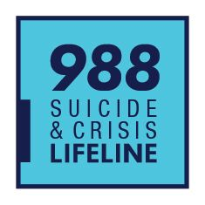
Continue the Conversation – when the answer is “No”
Reinforce your care and concern
“I’m glad to hear that you’re not thinking about suicide, now.”
“I want you to know that I care about you.”
“I want you to know I am here for you if you ever do start to think about suicide.”
“If that should ever change, free and confidential help is available.”
Notes:
Instructor Note:
Even if the person at risk denies having thoughts of suicide, it’s still important to share resources they can turn to if those thoughts arise in the future. Let them know that help is always available.
Encourage them to reach out to the Suicide & Crisis Lifeline by calling, texting, or chatting 988—a free, confidential service available 24/7.
Reinforce that knowing where to turn in a moment of crisis can make a critical difference, even if they don’t need it right now.

Slide 28
Continue the Conversation – when the answer is “No”
When you know there is access to lethal means in the home
“When someone is going through a rough time, like you are, thoughts of suicide are not uncommon. I know you have firearms in the home. I care about you. Can we work together to make sure your firearms are stored safely and responsibly, or even temporarily remove them from the home until things get better?”
Putting time and distance between a suicidal person and highly lethal means MAY save a life
Notes:
Instructor Note:
Even if the person at risk denies having thoughts of suicide, but you know they have access to lethal means—especially firearms—gently invite them to consider how those items are stored in the home.
Encourage a collaborative approach by asking if they’d be willing to work together on a plan to create time and distance between themselves and the most lethal means. Emphasize that this is about safety, not judgment.
Voluntary, temporary out-of-home storage is the safest option, but it may not always be feasible or agreeable.
Explore other realistic and respectful alternatives based on their comfort level.
Reinforce your care and concern for their well-being and your desire to help keep them safe while you support them in getting help.
If they are not ready to make a plan, leave them with resources they can turn to in a moment of crisis. Remind them they can call, text, or chat the Suicide & Crisis Lifeline at 988, available 24/7.

Slide 29
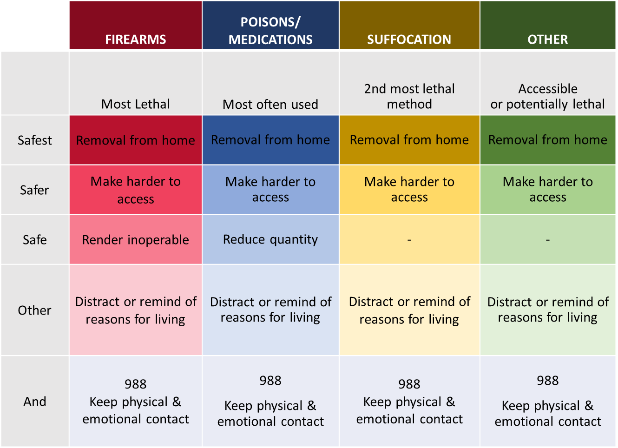
SHIFT THINKING TOWARD SAFETY
Notes:
Instructor Guidance:
Encourage the participants to begin shifting their focus toward safety. Briefly introduce the concept of Strategies for Suicide Safer Homes—this will be explored in greater depth later in the workshop. At this stage, it’s helpful to mention that offering individuals a range of safe storage options empowers them to choose what works best for their situation, which can increase both engagement and follow-through.
Let participants know they’ll soon see this approach in action in the upcoming video, where Luis and Manny discuss Manny’s Glock firearm and demonstrate how field stripping it renders it inoperable.

Slide 30

Courtesy of Worried About A Veteran
Notes:
Instructor Note:
Elena and Luis have noticed significant changes in Manny’s mood, behavior, and substance use, leading them to worry he may be at risk for suicide. Although Manny denied having suicidal thoughts, let’s hear from Luis about how he and Manny worked together to prioritize safety—without removing the firearm from the home.
-------------------------------------------------------------------------------------------------------------------------------------------------------------------------------------------------------------------------
Debrief Discussion Points:
Collaborative Concern: Elena and Luis approached Manny as a team. Elena led with emotional support and care, while Luis offered practical help by addressing the firearm—field stripping it so it could not be fired.
Respecting Boundaries: Some gun owners may not feel comfortable removing firearms from their homes. However, making a firearm temporarily inoperable is still a meaningful and effective step toward safety.
Legal Considerations: Luis expressed discomfort about taking possession of Manny’s firearm, even though he holds a permit. In Missouri, there are no legal restrictions on the voluntary transfer of firearms between individuals. However, if assisting someone in another state, it’s important to review local laws before taking possession of a firearm.
Unified Support: By working together, expressing genuine concern, and framing the action as temporary and safety-focused, Elena and Luis were able to help Manny take a step toward reducing risk during a vulnerable time.
If the video does not download to your slides, the video can be accessed at https://vimeo.com/668731612 or https://worriedaboutaveteran.org/starting-the-conversation/#anchor_page_Watch%20More

Slide 31
Start the Conversation – ask about suicide
Practice asking the question
“Are you thinking about suicide?”
“Are you thinking about killing yourself?”
“YES”​
You are not alone in this conversation. Call the Suicide & Crisis Lifeline if you need help continuing the conversation.
Notes:
Instructor Note: Practicing Hearing “Yes”
Encourage participants to stretch outside their comfort zones by practicing saying the words in this safe and supportive learning environment. Remind them that no one is required to participate if the exercise feels too emotionally difficult or evocative.
---------------------------------------------------------------------------------------------------------------------------------------------------------------------------------------------------------------------------
Introducing the Exercise:
Option A: Partner Practice
Ask participants to pair up with someone nearby.
One person will take the role of the helper and ask:
“Are you thinking about suicide?”
“Are you thinking about killing yourself?”
This time, the partner will respond with: “Yes.”
The person asking the question does not need to respond further—this is simply an opportunity to practice hearing the answer.
Switch roles so both participants have the chance to ask the questions and hear the response.
Option B: Group Practice
Invite participants to imagine they are speaking directly to Manny.
As a group, say the questions out loud:
“Are you thinking about suicide?”
“Are you thinking about killing yourself?”
The instructor will role-play Manny and respond with: “Yes.”
---------------------------------------------------------------------------------------------------------------------------------------------------------------------------------------------------------------------------
Debrief and Reflection:
Pause for a moment of self-reflection.
If time allows, invite participants to share how it felt to hear “Yes.”
Normalize feelings of anxiety, fear, or uncertainty—these are common and valid reactions.
Reassure participants that they are not alone. If they ever feel unsure about what to say next, they can call the Suicide & Crisis Lifeline (988) and ask the crisis counselor for guidance. Encourage them to involve the person at risk in the call so they can hear the conversation and feel included in the process.
------------------------------------------------------------------------------------------------------------------------------------------------------------------------------------------------------------------------------
Encouragement for Continued Practice:
Suggest that participants continue rehearsing the questions on their own—while looking in the mirror, getting ready for the day, or driving alone. Repetition helps build confidence and “muscle memory”, making it easier to respond calmly and clearly if they ever need to ask the question in real life.

Slide 32
Continue the Conversation – when the answer is “Yes”
Thank them for being honest, and express concern for their safety
“Thank you for trusting me with that. How can I help you?”
“You must be feeling really stuck, without options.”
“I’m really worried about you. How long have you been feeling this way?”
“I’m glad you shared it with me. You’re not alone. I want to help keep you safe.”
You are not alone in this conversation. Call the Suicide & Crisis Lifeline
if you need help continuing the conversation.
Notes:
Instructor Note: Responding to a Disclosure of Suicidal Thoughts
When someone discloses that they are having thoughts of suicide, it can bring up a range of emotions for the person hearing it. The important thing to remember is that this disclosure is a positive and courageous step—it means the person is opening up and there is now an opportunity to connect them to help.
Acknowledge their bravery in sharing something that is likely very difficult to admit. Reinforce that they are not alone and that support is available.
In Missouri, the Suicide & Crisis Lifeline (988) is answered by one of seven regionally based organizations staffed with trained professionals. These responders can:
Listen to your concerns and provide resources for help in your community.
Conduct a brief assessment, asking about suicide ideation, specific plans, access to lethal means, to determine the current level of risk and appropriate response.
Connect directly with 911 and request a Crisis Intervention Team (CIT) to be dispatched to the person’s location.
In some areas, such as St. Louis and Kansas City, dispatch a mobile crisis team to the individual’s location to conduct an on-site suicide risk assessment and determine appropriate next steps.
The bottom line: You are not alone when supporting someone in crisis. Help is available for both the person at risk and for you as a helper.

Slide 33
Continue the Conversation – when the answer is “Yes”
Explore access to lethal means
“Have you thought about how you would kill yourself?”
“Do you have access to the (insert method) you would use to end your life?” – helps determine the immediacy of risk
“How quickly could you have access to (insert method) you would use to end your life?” – establishes a potential timeline
You are not alone in this conversation. Call the Suicide & Crisis Lifeline if you need help continuing the conversation.
Notes:
Instructor Note: Clarifying the Role of the Helper
Participants are not expected to act as behavioral health professionals or create treatment plans. However, they are in a trusted position to help reduce access to lethal means until professional support is in place.
Encourage participants to ask exploratory questions such as:
“Have you thought about how you might end your life?”
“Do you have access to that method?”
“How quickly could you access it?”
These questions can deepen the conversation and help assess the person’s proximity to a potential attempt. Any information gathered can be shared with a mental health professional to support the person’s path to recovery.
If participants feel stuck or unsure, remind them they can always call, text or chat with the Suicide & Crisis Lifeline (988) for guidance. Help is available not only for the person at risk—but also for the person offering support.

Slide 34
SHIFT THINKING TOWARD SAFETY
Notes:
Instructor Note: Reducing Access to Lethal Means
This slide presents a framework for reducing access to various lethal methods—including firearms, poisons/medications, suffocation, and other means—by categorizing strategies into levels of safety: Safest, Safer, Safe, Other, and Keeping physical & emotional contact.
Key points to emphasize:
Firearms are the most lethal method; the safest option is removal from the home. If that’s not possible, explore ways to make them harder to access or inoperable.
Medications and poisons are the most commonly used in suicide attempts. Reducing access includes removing them, limiting quantities, or using blister packs.
Suffocation and other methods may be harder to control, but the same principles apply: reduce access where possible and increase supervision and support.
The “Other” and “Additional options” rows remind us that emotional support, distraction, and connection—along with access to resources like 988—are essential parts of any safety plan.
Encourage participants to use this table as a conversation guide when helping someone at risk, tailoring strategies to the individual’s situation and comfort level.
Instructor Note:
This slide is a prompt to help participants consider the various lethal means that may be accessible in the home. You don’t need to review each item in detail—simply emphasize that when someone discloses suicidal thoughts, the next step is to shift the conversation toward safety.
Encourage participants to:
Ask if the person at risk would consider removing the most lethal means, especially firearms.
If removal isn’t possible, explore safe storage strategies that create time and distance between the person and the method.
If participants feel unsure or stuck, remind them they can always reach out for support:
Call, text, or chat 988 (Suicide & Crisis Lifeline)
Or text 741-741 (Crisis Text Line)
Support is available for both the person at risk and the person offering help—they don’t have to do this alone.

Slide 35

Courtesy of Worried About A Veteran
Notes:
Instructor Note:
Quick and easy access to firearms during a time of emotional crisis can significantly increase the risk of suicide or accidental injury. Having open conversations about creating suicide-safer homes helps protect everyone in the household, not just the person at risk.
Sometimes, the person at risk may be resistant to discussing safe firearm storage. In these cases, it can be helpful to involve someone they trust and respect to help initiate the conversation.
Let’s watch how Barbara enlisted her father-in-law’s support to talk with her husband, Mike, about firearm safety.
If the embedded video does not work, instructors can access the video at https://vimeo.com/668733014 or https://worriedaboutaveteran.org/check-in-with-others/

Slide 36
SHIFT THINKING TOWARD SAFETY – off-site storage of firearms
FIREARMS​
Safest​ | Removal from home​ | A trusted friend or relative | Gun range or retailer
 |  | Self-storage facility | Pawn Shop
Safer​ | Make harder to access​ | Remove ALL ammunition from the home | Store ALL ammunition separately and locked up
 |  | Store ALL guns unloaded & in a secured safe or lock box | Install a trigger, clam or cable lock on ALL firearms.
 |  | Change combination to the safe or store keys away from home
Safe​ | Render inoperable​ | Remove a key component such as the firing pin, slide, bolt, or cylinder
Other​ | Distract or remind of reasons for living​ | Adhere a 988 sticker to gun safe | Leave photos of loved ones or ​ reasons for living in the safe​
 |  | Freeze keys to the safe in ice | Store keys in a safety deposit box at bank​
And​ | 988​ Keep physical & emotional contact​ | Program 988 – Suicide & Crisis Lifeline into phone so they can reach out for help. Keep bedroom doors open to maintain eyes and ears on them
Notes:
Instructor Note: Firearm Safety and Suicide Risk
The Safer Homes Collaborative and best practices define safe firearm storage as: unloaded, locked, and stored separately from ammunition.
When someone is at risk for suicide, the safest option is to temporarily remove firearms from the home. This slide introduces strategies for off-site storage, such as entrusting firearms to a trusted individual (e.g., a friend, family member, a Veteran), or using a gun range, retailer, armory, or pawn shop, where legally permitted. Keep in mind that firearm transfer laws vary by state. While Missouri has relatively few restrictions, other states may require background checks, waiting periods, or that transfers be conducted through a licensed dealer. Always check local laws before transferring firearms to someone else’s care.
However, removal isn’t always practical or acceptable to the gun owner, who may also be the person at risk. In such cases, explore safer in-home storage options that increase time and distance between the person and the firearm.
Note that the person initiating the conversation may not be familiar with firearms or may not be the most effective messenger. In these situations, consider involving someone the gun owner trusts and respects to help guide the conversation.
The goal is to find a realistic and respectful solution that prioritizes safety while honoring the individual’s values and concerns.

Slide 37
KEEP THE CONVERSATION GOING
Identify people who could help
“Who do you trust to hold on to your firearms while you/your loved one is at risk and unsafe?”
“Who else can be included in the plan to keep you/your loved one safer?”
The goal is to keep them safe until they get to help, or help is brought to them.
Explore concerns about temporary removal of lethal means
“What are the roadblocks to temporarily removing or increasing the safe storage of firearms in your home ?”
Notes:
Instructor Note: Supporting Conversations About Firearm Safety
This slide is designed to guide participants in having collaborative, nonjudgmental conversations about firearm safety when someone may be at risk for suicide.
Emphasize two key discussion areas:
Identify Trusted Individuals for Support
Encourage participants to help the person at risk think about:
Who they trust to temporarily hold onto their firearms.
Who else can be part of a safety plan (e.g., family, friends, fellow Veterans).
These conversations are about building a support network and ensuring safety until professional help is in place.
Explore Concerns and Barriers
Ask participants to explore any roadblocks the person may have about removing or securely storing firearms.
This opens the door to understanding their perspective and finding realistic, respectful solutions.
Reinforce that these conversations are not about taking something away, but about working together to reduce risk and keep everyone safe.

Slide 38

Courtesy of Worried About A Veteran
Notes:
Instructor Note: Practicing Conversations About Firearm Safety
This video models what a conversation about reducing access to lethal means might sound like. Reassure participants that they don’t need to be perfect—genuine care and concern can go a long way in supporting someone at risk for suicide.
In the video, notice how Mikey’s dad approaches the topic gently:
“I’d feel a whole lot better if you let me babysit these guns.”
Although Mikey wasn’t comfortable removing his firearms from the home due to his collection, he agreed to let his dad:
Change the gun safe combination
Secure all firearms, including those in the bedroom and vehicle
Additional safety layers—like trigger locks or removing ammunition—could further delay access and provide time to reconsider in a moment of crisis.
Remind participants: these steps are about creating time and distance to reduce the risk of impulsive action during emotional distress.
If the embedded video does not work, instructors can access the video at https://vimeo.com/668732342 or https://worriedaboutaveteran.org/storage-options/#anchor_page_fred_video

Slide 39
KEEP THE CONVERSATION GOING
Explore safe storage strategies to store firearms safely in the home
“What are some things that would increase firearm safety in the home?
“What would you feel comfortable doing to increase the safe storage of your firearms?
Putting time and distance between a suicidal person and highly lethal means MAY save a life
Notes:
Instructor Note: Exploring Safe Firearm Storage
This slide encourages participants to continue the conversation about firearm safety by exploring practical, comfortable strategies for secure storage in the home.
Key discussion points:
Ask the person:
“What are some things that would increase firearm safety in your home?”
“What would you feel comfortable doing to improve safe storage?”
Emphasize that the goal is not to remove rights, but to reduce immediate access to lethal means during a crisis.
Reinforce the message: Putting time and distance between a suicidal person and a firearm can save a life.
Encourage open dialogue and respect for individual values while focusing on collaborative, realistic safety planning.

Slide 40
SHIFT THINKING TOWARD SAFETY – on-site storage of firearms
FIREARMS​
Safest​ | Removal from home​ | A trusted friend or relative | Gun range or retailer
 |  | Self-storage facility | Pawn Shop
Safer​ | Make harder to access​ | Remove ALL ammunition from the home | Store ALL ammunition separately and locked up
 |  | Store ALL guns unloaded & in a secured safe or lock box | Install a trigger, clam or cable lock on ALL firearms.
 |  | Change combination to the safe or store keys away from home
Safe​ | Render inoperable​ | Remove a key component such as the firing pin, slide, bolt, or cylinder
Other​ | Distract or remind of reasons for living​ | Adhere a 988 sticker to gun safe | Leave photos of loved ones or ​ reasons for living in the safe​
 |  | Freeze keys to the safe in ice | Store keys in a safety deposit box at bank​
And​ | 988​ Keep physical & emotional contact​ | Program 988 – Suicide & Crisis Lifeline into phone so they can reach out for help. Keep bedroom doors open to maintain eyes and ears on them
Notes:
Instructor Note: Onsite Firearm Storage Strategies
This slide introduces Strategies for Suicide Safer Homes as they apply to on-site firearm storage when removing firearms from the home isn’t possible or preferred.
Guide participants through the “Safer” and “Safe” storage options, emphasizing that while no environment can be completely suicide-proof, increasing barriers to access can reduce risk.
Encourage discussion around realistic, acceptable solutions that the gun owner or person at risk feels comfortable implementing.
Reinforce these key points:
The goal is to create time and distance between the person at risk and a highly lethal method.
Firearms are uniquely lethal, and reducing access, even temporarily, can save lives.
It’s a myth that people will always substitute another method if their primary means is unavailable. Most alternative methods are less lethal, increasing the chance for intervention and recovery.

Slide 41
KEEP THE CONVERSATION GOING
Make a specific plan and follow up
“We agree that to keep you/your loved one safe we need to…”
Don’t leave them alone until you trust they can be safe
Provide them with resources to access help for themselves in the event they need help in the future
Putting time and distance between a suicidal person and highly lethal means MAY save a life
Notes:
Instructor Note: Continuing the Conversation Toward Safety
This slide reinforces the importance of ongoing support and follow-through when someone is at risk for suicide.
Key points to emphasize:
Make a specific safety plan together. Use language like:
“We agree that to keep you/your loved one safe, we need to…”
This helps clarify next steps and builds a shared commitment to safety.
Don’t leave the person alone until you feel confident they are safe. If needed, stay with them or ensure someone else can.
Provide resources they can use if they need help later—such as the 988 Suicide & Crisis Lifeline.
Remind participants that putting time and distance between a suicidal person and lethal means—especially firearms—can save a life.
Encourage participants to approach these conversations with empathy, patience, and a focus on collaborative problem-solving.

Slide 42
Personal Protection Firearms
In the immediate future, suicide is a greater risk than home invasion
3 out of 5 firearm deaths in the U.S. are suicide.
Consider other means of self-defense
Baseball bat, mace or pepper spray, or a home security system
If self-defense is essential urge someone else, not the person at risk, to control the firearm
In a quick-access or biometric gun safe
Holstered and on their person at all times
Stored in a gun safe when not physically in their control
Notes:
Instructor Note: Firearms for Protection and Suicide Risk
Many individuals own firearms for personal protection. However, it's important to note that most firearm-related deaths in the U.S. are suicides. Traditional firearm or hunter safety training does not reduce suicide risk, and in some cases, familiarity with firearms may increase the likelihood of a fatal attempt.
When someone is at risk for suicide, they are often more at risk to themselves than to others. Encourage temporary strategies to increase time and distance between the person and their firearm.
Key talking points:
Reinforce that this is temporary—once the person is no longer at risk, access to firearms for protection can be restored.
If self-defense is a concern, suggest alternative safety measures like a home security system, pepper spray, or a baseball bat.
If a firearm must remain accessible for protection:
Ensure someone else controls access, not the person at risk.
Lock up all other firearms.
Store the protection firearm in a biometric or quick-access safe and keep it on the person or locked away when not in use.
The goal is to balance safety and personal protection while reducing the risk of impulsive harm during a crisis.

Slide 43
Reduce Access to other lethal methods
Notes:
Instructor Note: Applying the Matrix to Other Methods
Remind participants that if the person at risk identifies other methods for suicide beyond firearms, the Strategies for Suicide Safer Homes matrix can still be applied. The same principles—removal, reduce access, and increased time and distance—can be adapted to reduce risk across a variety of means.

Slide 44
Reduce Access to other lethal methods
​POISONS/MEDICATIONS
Safest​ | Removal from home​ | Do not flush or pour down the sink or toilets | Purchase a drug deactivation kit from local pharmacy
 |  | Law enforcement medication drop box or drug take back events
Safer​ | Make harder to access​ | Store large quantities & infrequently used medications in a pill safe or lock box | Keep daily or weekly doses in a pill organizer
 |  |  | Switch to blister packs
Safe​ | Render inoperable​ | Talk to the pharmacist about dispensing prescriptions in non-lethal quantities | Contact Poison Control to determine safe quantities
Other​ | Distract or remind of reasons for living​ | Identify ways to distract from suicidal thoughts (art, movement, hold on to ice cubes, take a shower, journal, call a friend) | Leave photos of loved ones, pets, or ​ reasons for living in common places
And​ | 988​ Keep physical & emotional contact​ | Program 988 – Suicide & Crisis Lifeline into phone so they can reach out for help. Keep bedroom doors open to maintain eyes and ears on them
Notes:
Instructor Note: Poisons & Medications
Collaborate with pharmacists or poison control centers to identify safer quantities of medications to keep at home. When possible, request that medications be dispensed in blister packs, which can reduce risk by limiting immediate access to large doses.
If dispensing larger quantities is necessary, implement harm-reduction strategies such as:
Using pill organizers to provide only small, scheduled doses at a time.
Designating a trusted individual outside the home to hold the bulk supply and dispense as needed.
Storing medications in a locked pill safe to restrict access by individuals at risk.
These strategies help maintain access to essential treatment while creating a safer home environment.

Slide 45
Reduce Access to other lethal methods
​SUFFOCATION
Safest​ | Removal from home​ | Almost impossible to remove all implements for suffocation or hanging
Safer​ | Make harder to access​ | When not in use, secure, lock up implements in the home that could be used for suffocation or hanging | Avoid storing implements for suffocation or hanging in the person's bedroom
Safe​ | Render inoperable​ | Almost impossible to render implements for suffocation or hanging inoperable
Other​ | Distract or remind of reasons for living​ | Identify ways to distract from suicidal thoughts (art, movement, hold on to ice cubes, take a shower, journal, call a friend) | Leave photos of loved ones, pets, or reasons for living in common places
And​ | 988​ Keep physical & emotional contact​ | Program 988 – Suicide & Crisis Lifeline into phone so they can reach out for help. Keep bedroom doors open to maintain eyes and ears on them
Notes:
Instructor Note: Suffocation
While no environment can be made entirely suicide-proof, proactive steps to reduce access to means can significantly lower risk. When an individual identifies suffocation (also referred to as asphyxiation) as a potential method, limiting access to common instruments can help delay, deter, or prevent suicidal behavior. This is a key component of effective safety planning.
Common implements associated with suffocation-related suicide include:
Ropes or cords – Frequently used in hanging, the most prevalent form of suffocation-related suicide.
Plastic bags – Sometimes combined with inert gases (e.g., helium or nitrogen) to induce hypoxia.
Belts, scarves, or clothing – Often used in ligature strangulation, particularly in controlled settings like hospitals or correctional facilities.
Bedding materials – Such as sheets or pillowcases, especially in institutional environments.
Gas inhalation – Though not technically suffocation, it is often grouped with asphyxiation methods in some classifications.
Reducing access to these items, especially in high-risk settings, is a critical part of suicide prevention efforts.

Slide 46
Reduce Access to other lethal methods
​OTHER
Safest​ | Removal from home​ | Almost impossible to mitigate for all other methods of suicide, but removal should be considered when possible.
Safer​ | Make harder to access​ | Secure implements that can be locked up, (i.e., scissors, knives, razor blades, car keys, etc.) | Use under supervision
Safe​ | Render inoperable​ | Almost impossible to render all other implements inoperable
Other​ | Distract or remind of reasons for living​ | Identify ways to distract from suicidal thoughts (art, movement, hold on to ice cubes, take a shower, journal, call a friend) | Leave photos of loved ones, pets, or reasons for living in common places
And​ | 988​ Keep physical & emotional contact​ | Program 988 – Suicide & Crisis Lifeline into phone so they can reach out for help. Keep bedroom doors open to maintain eyes and ears on them
Notes:
Instructor Note: Other methods
This slide outlines a tiered approach to reducing access to non-firearm lethal means of suicide. While it's not always possible to eliminate all risks, taking incremental steps can significantly enhance safety.
"OTHER" Methods:
Begin by considering removal from the home of potentially dangerous items when feasible. If removal isn't possible, focus on making items harder to access (e.g., locking up sharp objects or car keys) and using them only under supervision.
Rendering items inoperable is often impractical, but distraction techniques and reminders of reasons for living (like photos or meaningful objects) can serve as powerful emotional buffers.
"And" Section:
Emphasize the importance of maintaining connection and access to support. Encourage programming the 988 Suicide & Crisis Lifeline into the individual's phone and keeping bedroom doors open to allow for passive monitoring and emotional presence.
These strategies are most effective when tailored to the individual's environment and risk level, and when implemented as part of a broader safety plan.

Slide 47
Remember
Begin with concern and empathy
“I care about you and want you to be safe.”
Ask directly about suicide
“Are you thinking about suicide?”
“Are you thinking about killing yourself?”
Focus on increasing safety
Discuss the temporary nature of both suicidality and limited access to lethal means.
Familiarity with medications or firearms may increase rather than decrease risk
Involve others in preventing suicide
Call the Suicide and Crisis Lifeline by calling 988
Notes:
Instructor Note:
This slide reinforces four essential principles for having effective and compassionate conversations about suicide prevention. These steps are foundational to creating suicide-safe homes and environments:
Begin with concern and empathy
Start the conversation from a place of care. A simple statement like “I care about you and want you to be safe” can open the door to trust and connection.
Ask directly about suicide
It’s important to use clear, direct language. Asking “Are you thinking about suicide?” or “Are you thinking about killing yourself?” does not increase risk—it shows you’re willing to talk about it openly and without judgment.
Focus on increasing safety
Emphasize that suicidal thoughts are often temporary, and that reducing access to lethal means is a temporary, life-saving step. Be aware that familiarity with certain methods (like medications or firearms) may increase risk rather than reduce it.
Involve others in preventing suicide
Encourage connection to support systems. Remind participants that they can call the 988 Suicide & Crisis Lifeline for immediate help and guidance.
This slide is a reminder that compassionate, direct, and safety-focused conversations can save lives.

Slide 48
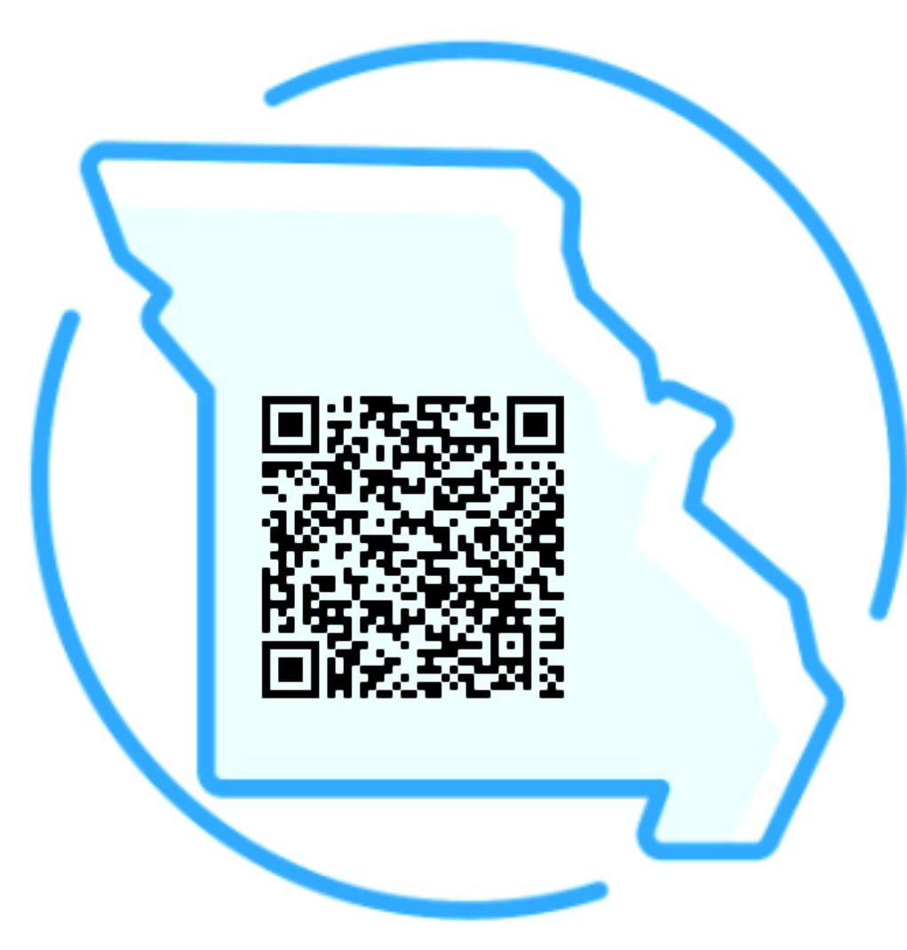
FREE
Confidential
24/7/365
Missouri Firearm Safe Storage Map
SaferHomesCollaborative.org
Notes:
Instructor Note:
There are dedicated resources available to support individuals at risk of suicide, including specialized services for Veterans, members of the LGBTQIA+ community, and non-English speakers through translation assistance.
Veterans Crisis Support:
The 988 Suicide & Crisis Lifeline offers a dedicated option for Veterans. To access it, dial 988, then press 1 to be connected to the Veterans Crisis Line. Support is also available via online chat or text message, providing multiple ways to reach out for help.
Firearm Safe Storage in Missouri:
The Safer Homes Collaborative has developed a firearm safe storage map for Missouri, identifying firearm retailers who offer storage services.
Since terms, conditions, and costs vary by retailer, it’s recommended to contact the retailer directly to ensure their process aligns with your needs.
These resources are valuable tools in creating safer environments and supporting individuals in crisis.

Slide 49
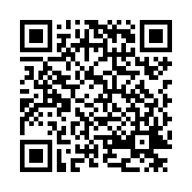
Please complete the confidential post-survey to receive MIMH CEUs or P.O.S.T. credit
[Instructor name(s)]
[Professional Title]
[Organization]
Phone: [Optional]
Email: [yourname@yourorg.com]
[Address 1 – optional]
[Address 2 – optional]
[City, State, Zip Code – optional]
[www.yourorgwebsite.com - Optional]
https://bit.ly/CSSHPost-Survey
Notes:
Instructor Note:
Provide your contact information so participants can follow up with any questions after the session.
Remind participants to complete the confidential post-survey before they leave. They can either:
Scan the QR code using their smartphone camera, or
Enter the URL directly into their web browser.
Completion of the post-survey is required for those seeking:
A certificate of attendance
MIMH Continuing Education Units (CEUs)
P.O.S.T. credit for first responders
Encourage participants to take a moment to complete the survey before exiting the session.

