Slide 1


Conversations for Suicide Safer Homes
a CALM-informed training
for Veterans and military communities
Notes:
This course can only be presented by those who have completed the Instructor Training Workshop facilitated by a CALM Developer or Master Trainer. For additional information on this training, contact Elizabeth Makulec at 314.963.7571 or Rick Strait at 573.915.8911.
Course description - This course reviews public health data regarding suicide and access to lethal means. It highlights the importance of reducing access to highly lethal means, discusses what means are most lethal, and describes how to have a culturally competent conversation regarding securing lethal means and firearms.
Any significant alterations must be approved by a Master Trainer and one of the Developers prior to being presented. Additional slides that show local data or suicide prevention resources may be added with the approval of a Master Trainer to ensure that they are accurate and in keeping with the CALM approach to suicide prevention.
Note to Instructors:
Introductions may include the sponsoring organization, the instructors(s), and/or the participants. This training has been adapted from the clinical version of Counseling on Access to Lethal Means. It has been adapted for general audiences and firearm owners.
Welcome gun owners’ and non-gun owners’ participation in this training.
Explain that suicide is generally preventable - not ALL suicides can be prevented, and many survivors of suicide loss feel stigma and shame when suicide is presented as preventable.
Safe messaging practices recommend avoiding focusing on the method used in suicide deaths. For training purposes, we must focus on the most lethal method(s).
There is a high probability that a survivor of suicide loss and/or attempt survivor is a participant. Acknowledge the likelihood that loss survivors are in attendance and that the material may be emotionally difficult for some people. For virtual presentations, introduce the support person, who is available to provide support to anyone who struggles with the content, and that the virtual hallway and private chat box are available.

Slide 2

ACKNOWLEDGMENTS
CALM Developers
1
Elaine Frank
Cathy Barber
Mark Ciocca
Safer Homes Collaborative
2
Elizabeth Makulec
Rick Strait
Dr. Elizabeth Sale
Katie Ellison
With Special Thanks to
3
Dartmouth Injury Prevention Center,
Harvard Injury Control Research Center, and our partners and colleagues working in firearm suicide prevention

Slide 3

ABOUT THIS WORKSHOP
1
2
3
BASED ON COUNSELING ON ACCESS TO LETHAL MEANS
ONE PART OF SUICIDE PREVENTION
FOCUS ON CREATING SUICIDE-SAFER ENVIRONMENTS
CALM is an evidence-based prevention resource by the Suicide Resource Center (SPRC)
Developed in 2006 in partnership with Dartmouth Injury Prevention Center
Not THE answer but should always be included
Anyone can do it – not just clinicians/ professionals
Anti-suicide
Not anti-gun, not even
anti-drugs.
Notes:
This training is an evidence-informed training and is supported by research in lethal means reduction and firearm suicide prevention. Conversations for Suicide Safer Homes (CSSH) was previously known as Conversations on Access to Lethal Means (CALM), which was developed in 2018 and modeled after the clinical version of Counseling on Access to Lethal Means (CALM). Due to the obvious name confusion, this training has been updated and rebranded as Conversations for Suicide Safer Homes and is affiliated with CALM America.
CSSH is one part of suicide prevention and pairs well with other suicide prevention gatekeeper trainings, such as Question, Persuade, and Refer. You do not have to be a professional to engage in conversations for suicide safer homes.
The focus of this training is to create suicide-safer environments. This training is not anti-gun. In fact, this training was developed in collaboration with gun owners. Rather this training is anti-suicide, believing that gun owners play an important role in preventing firearm suicide.

Slide 4


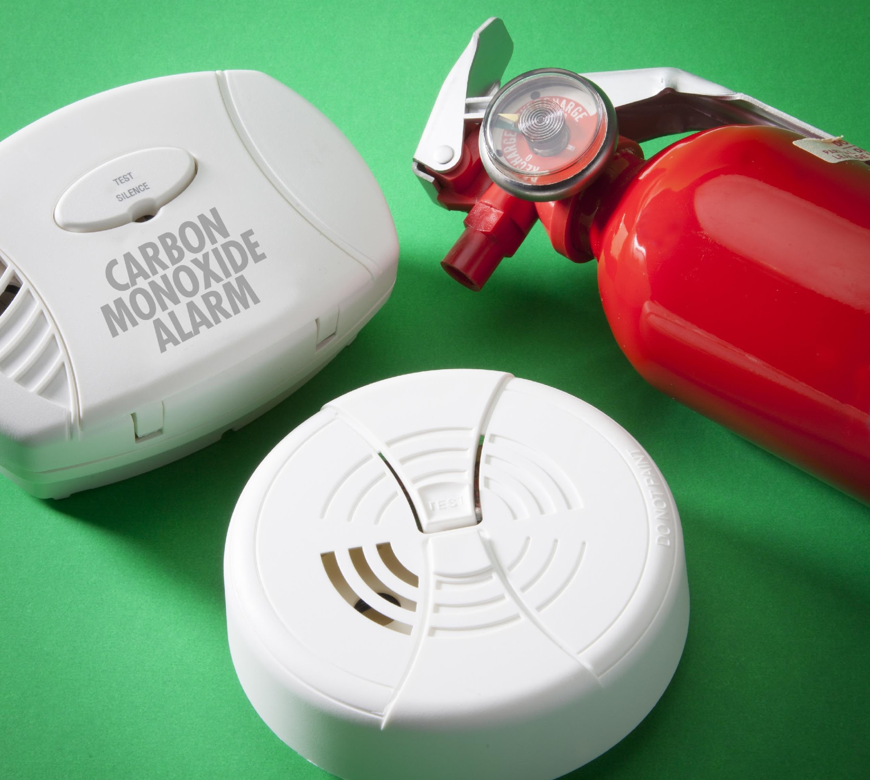

STANDARD HOME
SAFETY PRACTICES
Install safety gates & window guards
Keep an eye on children around water
Develop & practice a fire escape plan
Smoke alarms and carbon monoxide detectors
Keep floor surfaces free of trip hazards
Store medications safely
Safe storage of household cleaners/ toxic products
Secure TVs, dressers, & appliances to the wall to prevent tipping hazard
Notes:
Activity: As a large group, brainstorm home safety practices that are accepted practices to make homes safer. When delivering in a virtual platform, invite participants to submit their answers using the Zoom chat box. For in-person workshops, participants can call out their answers. After a sufficient amount of time for brainstorming ideas, show some of the provided answers that may not have been named.
Note to Instructor: This activity has the potential to take up a lot of time. Avoid engaging participants in a discussion or storytelling. This should be a rapid-fire activity to set the framework that the concepts introduced in this training are no different than other standard home safety practices.

Slide 5
WHY SHOULD VETERANS AND MILITARY FAMILIES TALK ABOUT FIREARMS AND SUICIDE?
Suicide is the second leading cause of death for post-9/11 veterans.
In 2020, 71% of Veterans who died by suicide used a firearm, compared to 50.3% of non-Veteran adults who died by suicide.
Asking someone if they are thinking about suicide is a research-informed best practice for preventing suicide.
A Veteran or military member who is at risk is more likely to engage in safe storage or temporary removal of firearms if a fellow Veteran or military member suggests it.
Suicide is generally preventable
Notes:
Suicide is a leading cause of death: In Missouri (2020)
11th† leading cause of death for all age groups
2nd † leading cause of death for 10-14-year-olds
3rd † leading cause of death for 15-34-year-olds
Youth suicide and firearm access: Home†† is the primary setting where young people obtain firearms used in suicides. 82%††† of youth who used a firearm to complete suicide used a firearm owned by a family member, usually a parent. Parents often underestimate the likelihood that their children have or could obtain their firearms.
Gun owners have a role in preventing firearm suicide by utilizing responsible storage strategies so that there is time and distance between a person at risk for suicide and the most lethal method for suicide
Suicide is generally preventable. While not all suicides can be prevented, the likelihood of preventing a suicide increases with lethal means reduction strategies, such as responsible storage of firearms.
Citations:
†CDC WISQARS. (n.d.). WISQARS Data Visualization. Centers for Disease Control and Prevention. Retrieved May 12, 2022, from https://wisqars.cdc.gov
Harvard T.H. Chan School of Public Health (Ed.). (2016, March 29). National Violent Injury Statistics System. Retrieved from https://web.sph.harvard.edu/mch-data-connect/results/national-violent-injury-statistics-system/
††Johnson, R. M., Barber, C., Azrael, D., Clark, D. E., & Hemenway, D. (2010). Who are the owners of firearms used in adolescent suicides? Suicide and Life-Threatening Behavior, 40(6), 609–611. https://doi.org/10.1521/suli.2010.40.6.609

Slide 6
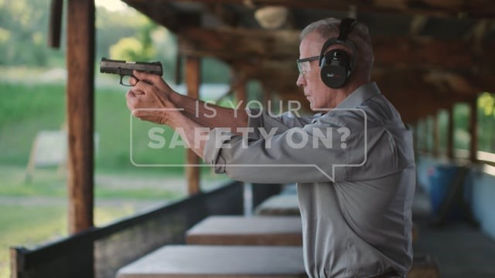
Warning – viewers will hear two gunshots at the beginning and end of the video​
Courtesy - Utah Suicide Prevention Coalition​
Notes:
Participants will view this PSA from the Utah Suicide Prevention Coalition, illustrating that suicidal risk is temporary and that when things get better gun owners can get back to enjoying and engaging in shooting sports. Warn participants that they will hear two gunshots at the beginning of the video.
Utah PSA – strong response friend response
https://vimeo.com/175761640 (Utah PSA - gun range)

Slide 7

COMMANDMENTS OF FIREARM SAFETY
Treat every firearm as if it were loaded.
Always point the muzzle in the safest direction.
Keep your finger off the trigger until you are ready to shoot
Be sure of your target – and what’s beyond.
Know how to safely operate and maintain your firearm before shooting.
Be sure that your firearm is safe to operate.
Be sure your firearm and ammunition are compatible.
Wear eye and ear protection when shooting.
Never use alcohol or other drugs when operating or cleaning firearms.
Safely store all guns to prevent theft and unauthorized access.
11. Consider temporary off-site storage or use safe storage strategies if someone in the home may be suicidal or is going through a rough time.
Notes:
Reinforce that we are talking about firearm safety. Acknowledge that most gun owners are safe, responsible users of firearms who abhor the unsafe handling of firearms. This training does not endorse involuntary restriction or limiting the use of a firearm for hunting, self-protection, or enjoyment. Rather, this training focused on enhancing safe, responsible, and legal gun ownership by incorporating safe storage practices into their safe handling strategies to prevent not only accidental injury but to prevent firearm suicide.
These are in no particular order but are consistent with firearm industry standards and published safety recommendations.

Slide 8

Consider temporary off-site storage or safe storage strategies
for firearms and any other lethal methods if you or a family member may be going through a rough time or having suicidal thoughts and feelings
Notes:
The Safer Homes Collaborative wants participants to include in their standard home safety practices the responsible, safe, and legal storage of firearms to prevent the tragedy of firearm suicide. Reducing access to firearms through off-site storage or utilizing safe storage strategies is an evidence-informed practice that is supported by research.
Note to Instructor: Most people who attempt or die by suicide exhibit observable warning signs when they are at risk for suicide. However, we often hear from loss survivors that they did not recognize the warning signs before the suicide attempt. When there is quick and easy access to a firearm that has not been stored responsibly, safely, or legally, the risk of dying in a suicide attempt increases. Being proactive about creating a suicide safer home environment by layering safe storage practices before someone is at risk for suicide or considering voluntary and temporary off-site storage of firearms when someone in the home is at risk for suicide, can prevent the tragedy of suicide.

Slide 9
RISK FACTORS FOR MILITARY MEMBERS AND VETERANS
INDIVIDUAL RISKS:
COMMUNITY & SOCIETAL RISKS
Barriers to healthcare
Cultural and religious beliefs that suicide is noble
Exposure to suicidal behaviors
Stigma associated with mental illness or help-seeking
Easy access to lethal means, especially firearms
Recent separation from the military
Mental health challenges such as PTS, anxiety or depression
Substance misuse & abuse
Discharged for disability, disqualification, or misconduct
Struggle to reintegrate into civilian life
Thwarted belongingness – loss of identity
Criminal or legal problems
Financial problems or job problems (loss)
Impulsive or aggressive tendencies
History of repeated TBIs
History of childhood trauma
Loneliness or lacking a sense of connectedness
Familiarity & comfort with firearms
Perceived burdensomeness to family
US Dept of Veteran Affairs, 2021
Notes:
Definition of risk factors: Risk factors are any attribute, characteristic, or exposure of an individual that increases the likelihood of developing suicidal thoughts or behaviors. Risk factors for suicide typically fall under individual risks, relationship risks, and community or societal risk factors.
Invite participants to brainstorm known risk factors for suicide. For virtual participants, invite them to list known risk factors for suicide in the chat box. After participants have named known risk factors, reveal the CDC-defined risk factors for suicide and highlight one or two risk factors that participants hadn’t identified.
Emphasize that the reason for suicide is complex. No singular risk factor by itself means that someone is at risk for suicide. Because we cannot predict who will attempt suicide, it is important that we are aware of the risk factors and intervene early. The more risk factors that are present in one’s life, the greater the potential risk for suicidal thoughts and behaviors. The sooner we intervene when we recognize the risk for suicide, the better the potential that suicidal thoughts will not become suicidal behaviors. Thwarting suicidal behavior saves lives. As previously mentioned in an earlier slide, we cannot predict who will attempt suicide and often survivors of suicide loss share that they didn’t see any of the signs before their loved one attempted or died by suicide. That is why it is important that everyone is trained to recognize the risk factors and warning signs for suicide.

Slide 10
OBSERVE WARNING SIGNS – a change from what is typical or expected
Mood – depressed, angry, impulsive, lethargic
Major life change – facing a breakup, legal/money challenges, or another personal setback that represents a loss
Substance use or misuse – increase in prescription or recreational drugs or alcohol
Behaviors – withdrawing from usual activities, writing or drawing about suicide/death, absenteeism or presenteeism, reckless behaviors, giving things away, acquiring or having access to lethal means
Affect/Emotion – hopeless, sense of burden, trapped or stuck with no way out of the circumstances, unexplained euphoric shift like the weight has lifted off their shoulders
CDC, 2021
Notes:
Define warning signs: Warning signs are the observable changes in thoughts, feelings and behaviors that are commonly exhibited when an individual is contemplating suicide or is planning for suicide.
Ask participants to brainstorm known warning signs then click to reveal the CDC warning signs for suicide. This list is some of the commonly observed warning signs. Emphasize that noticing changes from what is typical or expected is important and varies by person. Reinforce that most people exhibit warning signs to someone before they attempt suicide. They may not exhibit warning signs to everyone around them or those closest to them who would recognize that it is a change from typical. This explains why survivors frequently say there were no signs. However, if we recognize these warning signs in someone it is important that we ask them if they are thinking about suicide or ending their life.

Slide 11



REDUCING ACCESS TO LETHAL MEANS IS EFFECTIVE SUICIDE PREVENTION
1
2
3
Heights
Poisons
Firearms
Notes:
Heights: Bloor Viaduct in Toronto was a hotspot for individuals to end their lives in North America; second only to the Golden Gate Bridge. Prior to the barriers being installed in 2003 an average of 9 people a year died by jumping from the bridge. According to a 2017 report, only 1 person managed to circumvent the barrier to die by suicide at the bridge in the previous 14 years.
Poisons: Pesticide self-poisoning is one of the most commonly used methods of suicide in Asia, with an estimated 300 000 deaths each year. Previous research indicates that pesticide poisoning accounts for two-thirds of Sri Lanka's suicide deaths. Restrictions on the import and sales of WHO Class I toxicity pesticides in 1995 and endosulfan in 1998 coincided with reductions in suicide in both men and women of all ages. In the 10 years after 1995, Sri Lanka's suicide rates declined by 50%, 19,769 fewer suicides occurred in 1996–2005 as compared with 1986–95. Secular trends in unemployment, alcohol misuse, divorce, pesticide use, and the years associated with Sri Lanka's Civil war did not appear to be associated with these declines.
Firearms: Switzerland has compulsory military service for to all male Swiss citizens beginning at the age of 18. Regulations of the Swiss militia system stipulate that the soldiers keep their own personal equipment, including all personally assigned weapons and ammunition at home.
In 2003, with the goal of restructuring and resizing the army, new legislation commonly referred to as “ArmyXXI” reduced the number of soldiers from approximately 400,000 to 200,000, subsequently reducing the number of army-issued firearm availability.
before Army XXI, upon separation from the Army, soldiers were allowed to keep their military issued firearms. After Army XXI, troops had to buy their military issued firearm if they intended to keep it. Although discharged soldiers could buy their army weapons, not everyone made use of this offer and consequently the number of army-issued firearms decreased abruptly by 20%
In 2007, ammunition was required to be stored on base, as opposed to storage at home.
Additionally. Since Army XXI, gun licensure is required for all gun owners.
Based on a 2013 analysis of Switzerland's suicide data between 1995 to 2009, the reduction in gun ownership resulted in a 4.09% reduction in firearm-suicide rates for all genders but a 9% reduction in firearm-related suicides of men. The effect on women was not statistically significant. The Army reform had no statistically significant impact on non-gun suicide rates.
1. Sinyor M, Schaffer A, Redelmeier DA, et al, Did the suicide barrier work after all? Revisiting the Bloor Viaduct natural experiment and its impact on suicide rates in Toronto, BMJ Open, 2017;7:e015299. doi: 10.1136/bmjopen-2016-015299
2. D Gunnell and others, The impact of pesticide regulations on suicide in Sri Lanka, International Journal of Epidemiology, Volume 36, Issue 6, December 2007, Pages 1235–1242, https://doi.org/10.1093/ije/dym164
3. Reisch, T., Steffen, T., Habenstein, A., & Tschacher, W. (2013). Change in suicide rates in Switzerland before and after firearm restriction resulting from the 2003 “Army XXI” reform. The American Journal of Psychiatry, 170(9), 977–984. https://doi.org/10.1176/appi.ajp.2013.12091256

Slide 12
REDUCING ACCESS TO LETHAL MEANS IS EFFECTIVE SUICIDE PREVENTION
1
Ambivalence
2
Transient/Temporary
3
Urgency
4
Lethality

Slide 13

AMBIVALENCE
Notes:
1st Image of Kevin Berthia on GGB
Group Discussion – “What do you see happening in this picture?” “What do you see NOT happening?” - The photo of Kevin Berthia standing on the wrong side of the Golden Gate Bridge demonstrates not only ambivalence about living and dying, but also the power of time, delaying, and interrupting the suicidal behavior in preventing the tragedy of suicide.
Officer Kevin Briggs & Kevin Berthia – in March 2005, Kevin Berthia attempted to end his life at the GGB, he says – “I parked and walked towards the bridge. As I jumped over the railings, I heard someone say: “Hey, wait a minute.” I was convinced I was going to end my life, but at the last moment, his voice made me stop and grab the railings. That’s what you see in the picture – me standing on the ledge. I now know that was Officer Briggs (center, leaning on the railings). He snapped me back to reality. I was on that ledge for 92 minutes, and for 89 of those, I just talked. I got everything out and he listened without judging.’
Many people who survive highly lethal attempts say something like this, “I instantly realized that everything in my life that I’d thought was unfixable was totally fixable—except for what I’d just done.” Tad Friend, “Jumpers.” The New Yorker (2003) {jumping from the Golden Gare Bridge} I call this the “Oh, shit!” moment.
In fact, research shows that more people begin to make an attempt and stop, (15% in a study of suicidal college students) than follow through with an attempt (12%). Drum, Brownson, Denmark, Smith. Professional Psychology: Research & Practice, 2009.

Slide 14
THOUGHTS OF SUICIDE CAN BE TRANSIENT/TEMPORARY
Owens, Horrocks & House, 2002
Notes:
Ask participants what percent of veterans who attempt suicide eventually die by suicide. According to a 2011 (Weinart, et al.) retrospective study with military veterans receiving inpatient treatment between 1993-1998 at US VA medical facilities, following a suicide attempt, 13.1% eventually died by suicide. Compared to the general population in which less than 10% of people who attempt suicide eventually die by suicide.
If we prevent a suicide death today, there is a good chance that we have saved that life for the long term
But we need to put that in perspective.
Because the inverse is that about 13 per 100 survivors of an attempt will go on to die by suicide.
That is 13 per 100 attempt survivors will eventually die by suicide.
Therefore, it’s important to create suicide safer living environments.
In the general population, only 13 per 100,000 die by suicide.
That is why a previous suicide attempt is such a significant risk factor.
Weiner, J., Richmond, T. S., Conigliaro, J., & Wiebe, D. J. (2011). Military veteran mortality following a survived suicide attempt. BMC Public Health, 11(1). https://doi.org/10.1186/1471-2458-11-374

Slide 15
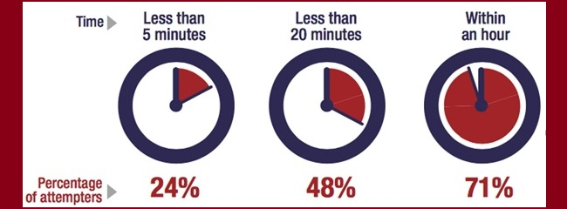
URGENCY – to end despair or pain, the decision to act on suicidal thoughts is reached quickly, particularly among young Veterans
The time between suicide as an option and an attempt
Putting time and distance between a suicidal person
and lethal means MAY save a life
Notes:
In a study with near-lethal suicide attempt survivors in 2005, survivors were asked how much time transpired between the decision to end their life and the suicide attempt. Forty-seven percent said less than an hour, while 24% said it was less than five minutes. The transition from thoughts about suicide to engaging in suicide behaviors can be urgent, or seemingly impulsive. Most gun owners underestimate their unique risk of dying in a firearm suicide attempt when firearms in the home are not stored unloaded and locked up or temporarily removed from the home when there is a person at risk. Because the time between making the decision to engage in the act of suicide is quite brief, it’s important that gun owners be proactive about safely, responsibly, and legally storing their firearms.
Citation:
Simon, T.R., Swann, A.C., Powell, K.E., Potter, L.B., Kresnow, M., and O’Carroll, P.W. Characteristics of Impulsive Suicide Attempts and Attempters. SLTB. 2001; 32(supp):49-59.

Slide 16
LEADING LETHAL METHODS OF SUICIDE FOR MO VETERANS
US Dept. of Veteran Affairs, 2020
Notes:
Ask participants to rank these suicide methods in descending order of the most common methods for suicide in Missouri. In virtual platforms, participants can type their responses into the chat box. For skilled instructors using Zoom, you may also set up a poll. Click the slide to reveal the results.
In 2020,
Males were more likely than females to use firearms
(66% vs. 47%)
Females were more likely than males to overdose or use poisons
(19% vs. 3.6%)
or use suffocation
(25% vs. 23%)

Slide 17
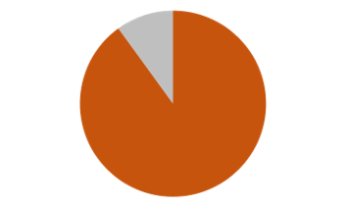
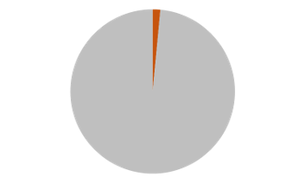
LETHALITY
1-2% fatal
90% fatal
Firearms
Most frequent methods
(sharps & drugs/poisons)
Spicer & Miller (2000)
Notes:
Be careful with this information if you are presenting to an “at risk” audience. We do not want to encourage people to use more lethal means.
This slide demonstrates the findings of a 2000 study by Spicer and Miller about the lethality of various methods by attempt survivors presenting at the emergency department. In their study, Spicer and Miller discovered that 90% of suicide attempts with a firearm were lethal. Comparatively, only 1-2% of attempts by overdose or self-injury are fatal. Clinicians and the general public are often surprised at how low the lethality is for sharps or overdose.
Most people overestimate the odds of dying by less lethal methods – often guessing around 30%. While we caution not to promote using more lethal methods for suicide, the point is that if someone was planning to attempt suicide by firearm but could not access the firearm because it had been stored safely, responsibly, and legally, or temporarily away from the home, they are more likely to survive an attempt by any other method. In summary, lethality varies greatly by method.
(Cover the issue that the specific numbers re low lethality of pills and sharps shouldn’t be discussed with patients or in the media. The fact that most people overestimate the odds of dying with these methods – often guessing around 30% - probably saves a lot of lives.)

Slide 18
WHY FOCUS ON FIREARMS?
Frequency: +76% of Veteran suicides in Missouri are with a firearm
Lethality: almost always fatal
Impulsivity: <10 minutes between thoughts and action
Availability: 64% of Veterans own or have access to a firearm in the home
Cultural Acceptability: ‘shall issue/open carry’ state
Notes:
States with more restrictive gun laws, such as waiting periods, requirements for firearm safety training, and requirements for safe storage of firearms, have lower suicide rates than states without those laws.
Citations:
¹ Miller M, Azrael D, Barber C. Suicide mortality in the United States: The importance of attending to method in understanding population-level disparities in the burden of suicide. Annual Review of Public Health. 2012; 33:393-408.
² Youth Suicide Fact Sheet, NVISS data
³Duff-Brown, B. (2020, June 3). Handgun ownership is associated with a much higher suicide risk. Stanford Medicine News Center. Retrieved from https://med.stanford.edu/news/all-news/2020/06/handgun-ownership-associated-with-much-higher-suicide-risk.html

Slide 19
ACCESS TO FIREARMS INCREASES SUICIDE RISK
Suicide rates vary with rates of firearm ownership.
Men who own handguns are eight times more likely to die of gun suicides, and women who own handguns are 35 times more likely than women who don’t.
Two out of three firearm-related deaths in the U.S. are a suicides.
Active-duty military personnel with recent thoughts about death or self-harm were much less likely than non-suicidal service members to store their firearms locked and unloaded.
Notes:
States with more restrictive gun laws, such as waiting periods, requirements for firearm safety training, and requirements for safe storage of firearms, have lower suicide rates than states without those laws.
¹ Miller M, Azrael D, Barber C. Suicide mortality in the United States: The importance of attending to method in understanding population-level disparities in the burden of suicide. Annual Review of Public Health. 2012; 33:393-408.
² Youth Suicide Fact Sheet, NVISS data
³Duff-Brown, B. (2020, June 3). Handgun ownership is associated with a much higher suicide risk. Stanford Medicine News Center. Retrieved from https://med.stanford.edu/news/all-news/2020/06/handgun-ownership-associated-with-much-higher-suicide-risk.html
⁴ CDC WISQARS, 2015-2019 firearm-related deaths in the U.S.

Slide 20
MAYBE IT’S NOT THE GUNS
Are people who live in homes with guns more likely to have…
… a mental health problem? | Yes | No
… seriously consider suicide? | Yes | No
… attempt suicide? | Yes | No
Gun owners aren’t likely to be more suicidal,
just more likely to die if they make an attempt.
Notes:
1 in 4 adults will develop a mental health condition at some time during their lifespan, regardless of gun ownership status. Gun owners are no more likely to develop suicidal ideation or attempt suicide than non-gun owners. However, access to a highly lethal method increases the likelihood of death 9/10) if they engage in suicidal behaviors with a firearm. Unlike less lethal methods, such as sharps or poisons/overdose, the opportunity for medical intervention to save a person’s life after a firearm suicide attempt is less likely to be successful.

Slide 21


Encourage putting time and distance between a person in emotional crisis and access to
ALL/ANY lethal means
to POTENTIALLY save a life
Notes:
Who can benefit from learning how to have a Conversation about Suicide Safer Homes?
Anyone can benefit from learning to have a conversation about putting time and distance between a person in emotional crisis and access to lethal means because we know that thoughts of suicide are about hopelessness, despair, feelings of being a burden, a desire to end an emotional pain that has become too heavy to bear.’
We know thoughts of suicide are related to ending emotional pain, talking about that pain can de-escalate the situation and help the person think more clearly.
A conversation on access to lethal means could mitigate making a specific plan for suicide and connect the person to help sooner
Research & lived experience tells us that compounding stressors make clear thinking difficult

Slide 22
WHY HAVE THE CONVERSATION?
You recognize the warning signs or have a gut feeling
Mood – depressed, angry, impulsive, lethargic
Major life change – facing a breakup, legal/money challenges, or another personal setback that represents a loss
Substance use or misuse – increase in prescription or recreational drugs or alcohol
Behaviors – withdrawing from usual activities, writing or drawing about suicide/death, absenteeism or presenteeism, reckless behaviors, giving things away, acquiring or having access to lethal means
Affect/Emotion – hopeless, sense of burden, trapped or stuck with no way out of the circumstances, unexplained euphoric shift like the weight has lifted off their shoulders
Notes:
Participants are reminded of the warning signs that are commonly present when someone is at risk for suicide. Highlight that these are changes in what would be expected or typical mood, behaviors, or emotions for that person.

Slide 23

Courtesy of Worried About A Veteran
Notes:
Let's hear Elena describe the warning signs she was seeing in her husband's behavior and the steps she took to see if others were noticing the warning signs too.
Debrief questions or discussion points
What warning signs did you hear Elena mention she and Luis have noticed caused them to be concerned for Manny? (Had that sense of "What if Manny had done something to himself?", found empty liquor bottles shoved under things in the trash, not sleeping, not going to work every day, weight loss, things are not great at work or at home)
Sometimes a spouse or family member is too close to the situation, worries they are overreacting, or maybe in denial that someone's behaviors, moods or substance misuse has worsened. Getting input from trusted others about what they are seeing can be helpful to getting a clearer picture.
Likewise, sometimes a spouse or family member isn't willing to listen to their (spouse, parent, adult children) about their concerns for suicide risk. But they may be more open to hearing the concern from someone outside the family whom they trust and respect. That's when it can be helpful to get outside help to have the conversation.
Use this video for general audiences and gun owners. This video demonstrates what recognizing the warning signs may be like. If the video does not download to your slides the video can be downloaded from https://vimeo.com/668732659 or https://worriedaboutaveteran.org/warning-signs/

Slide 24
WHEN & WHERE TO HAVE THE CONVERSATION?
ASAP – life vs death
Concern for safety
Where it’s convenient, familiar, private, and safe
Notes:
Stress the safety focus – keep people who may be at risk safe and alive
Have the conversation as soon as possible, mutually convenient place that is non-threatening and safe.

Slide 25
START THE CONVERSATION – ask about suicide
Express care and concern for their well-being
“Because of X, Y, Z, I am worried about you.”
“I have noticed lately you’ve been X, Y, and Z. Are you okay?”
Ask directly about suicide
“Are you thinking about suicide?”
“Are you thinking about killing yourself?”
“It’s not uncommon for people to think about suicide when they are going through a hard time like you are. I’m wondering if you have thought about ending your life.”
Notes:
Participants are introduced on how to start the conversation when there is a concern for risk of suicide. Participants will be practicing asking about suicide directly. Begin by addressing care, illustrating the observed risk factors that have raised concerns. Often times, individuals who are at risk for suicide are not aware that others are noticing the changes in their behaviors, moods, or emotions. When someone approaches the conversation from a place of genuine care and concern for their well-being, they often feel a sense of relief for the opportunity to open up. It is true that some people hesitate to open up and disclose their thoughts and feelings about suicide, but with persistence and consistent care and concern the likelihood they will open up and be willing to seek help increases.
Emphasize to participants the importance of asking directly about suicide. Euphemisms about “hurting yourself” or “go to sleep and never wake up” may not be direct or specific enough to know whether or not the person is having thoughts about suicide. It is a myth that bringing up suicide as a concern will cause people to engage in suicidal behaviors. In fact, the opposite is true. Asking directly and specifically about suicide demonstrates a willingness to listen to their pain and a desire to help them alleviate the mental, emotional, and physical pain.

Slide 26
Practice asking the question – ask about suicide
“Are you thinking about suicide?”
“Are you thinking about killing yourself?”
“NO”
Notes:
Invite participants to practice asking the question. Explain that this is a safe place to practice asking the question so that the first time you ever ask it isn’t in a moment of crisis.
Directions for introducing the exercise: Participants will practice asking the instructor the two direct suicide questions, “Are you thinking about suicide? Are you thinking about killing yourself?” It is going to sound garbled with everyone participating. That’s okay. It allows you to just get the words out. The instructor will then reply with a “No” response. This allows the participant the opportunity to experience what it feels like to ask the question and hear a response.
Pause for a moment of self-reflection. If time allows, ask participants to share what that experience felt like. Acknowledge that it is normal for it to feel uncomfortable or awkward at first. Similar to learning how to give CPR was uncomfortable and awkward. But the more this skill is rehearsed the less uncomfortable and awkward it will be when they need to ask it. Encourage participants to continue rehearsing by asking the questions about suicide when they are looking in the mirror, getting ready for the day, driving alone in their car, and when they are by themselves so that they can develop a bit of “muscle memory” and confidence in the event they ever need to ask the question.
Process next steps when the answer is “No” on the next slide.

Slide 27
CONTINUE THE CONVERSATION – when the answer is “No”
Reinforce your care and concern
“I’m glad to hear that you’re not thinking about suicide, now.”
“I want you to know that I care about you.”
“I want you to know I am here for you if you ever do start to think about suicide.”
“If that should ever change, free and confidential help is available.”
Notes:
Even if the person at risk denies thinking about suicide, share with them a way to access resources for help. If they do develop thoughts of suicide or begin making a plan, they can always call the Suicide Crisis line for assistance. The Suicide & Crisis Line 988 went live on July 16, 2022.
They can also call the Suicide & Crisis Lifeline at 988.

Slide 28
CONTINUE THE CONVERSATION – when the answer is “No”
When you know there is access to lethal means in the home
“When someone is going through a rough time, like you are, thoughts of suicide are not uncommon. I know you have firearms in the home. I care about you. Can we work together to make sure your firearms are stored safely and responsibly, or even temporarily remove them from the home until things get better?”
Notes:
Even if the person at risk denies thinking about suicide, share with them a way to access resources for help. If they do develop thoughts of suicide or begin making a plan, they can always call the Suicide Crisis line for assistance. The Suicide & Crisis Line 988 went live on July 16, 2022.
They can also call the Suicide & Crisis Lifeline at 988.

Slide 29
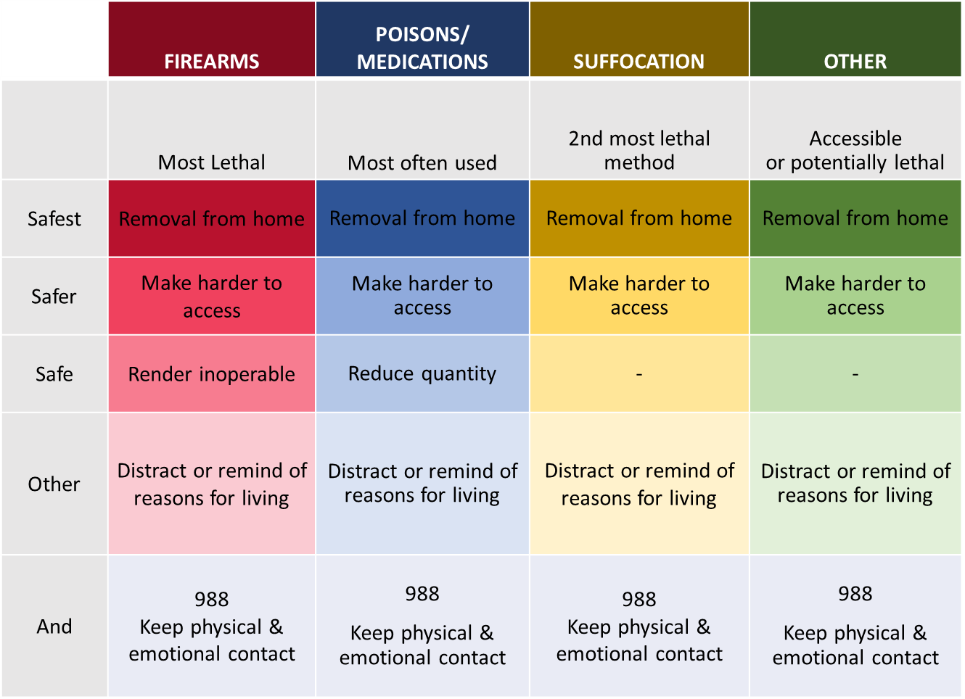
SHIFT THINKING TOWARD SAFETY

Slide 30

Courtesy of Worried About A Veteran
Notes:
Elena and Luis have recognized changes in Manny's moods, behaviors, increased substance use and are concerned he's at risk for suicide. Even though Manny denied he is thinking about suicide, let's hear from Luis about how he and Manny worked together to shift toward safety without removing the firearm(s) from the home.
Debrief discussion points
Elena and Luis worked together to have a discussion about their concerns for Manny. Elena, as his wife, took care of the "touchy feely" part, and Luis was able to provide practical help by addressing the firearm and field stripping it so that it could not be fired.
Some gun owners won't be comfortable removing their firearms from the home, but may be willing to make the firearm inoperable for the time being. This is still a good outcome.
We heard Manny say that he felt uncomfortable taking Manny's gun, even though he has a gun permit. There are no laws or requirements in Missouri that would prohibit the legal transfer of firearms from one individual to another. If you are providing assistance to someone in another state you will want to familiarize yourself with state's laws and requirements before taking possession of someone's firearm.
Working together as a unit, expressing concern for Manny's well-being, and emphasizing that this is just temporary helped to persuade Manny to shift towards safety to prevent suicide in a moment of escalation.
If the video does not download to your slides the video can be accessed at https://worriedaboutaveteran.org/starting-the-conversation/#anchor_page_Watch%20More

Slide 31
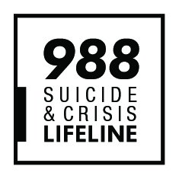
Practice asking the question – ask about suicide
“Are you thinking about suicide?”
“Are you thinking about killing yourself?”
“YES”
You are not alone in this conversation. Call the Suicide & Crisis Lifeline if you need help continuing the conversation.
Contact the Veterans Crisis Line: Dial 988 then Press 1, chat online, or text 838255
Notes:
Directions for introducing the exercise: Participants will practice asking the instructor the two direct suicide questions, “Are you thinking about suicide? Are you thinking about killing yourself?” It is going to sound garbled with everyone participating. That’s okay. It allows you to just get the words out. The instructor will then reply with a “No” response. This allows the participant the opportunity to experience what it feels like to ask the question and hear a response.
Process next steps when the answer is “No” on the next slide.

Slide 32
CONTINUE THE CONVERSATION – when the answer is “Yes”
Thank them for being honest, and express concern for their safety
“Thank you for trusting me with that. How can I help you?”
“You must be feeling really stuck, without options.”
“I’m really worried about you. How long have you been feeling this way?”
“I’m glad you shared it with me. You’re not alone. I want to help keep you safe.”
You are not alone in this conversation. Call the Suicide & Crisis Lifeline
if you need help continuing the conversation.
Contact the Veterans Crisis Line: Dial 988 then Press 1, chat online, or text 838255
Notes:
Directions for Activity: Participants will have the opportunity to ask the instructor the suicide question, “Are you thinking about suicide?”, “Are you thinking about killing yourself?” again. This time the instructor’s response will be “Yes”. This activity is intended to afford participants the opportunity to experience what it feels like to not only ask the question but to hear that the person they are concerned about is thinking about suicide.
After the activity debrief by processing the next steps, thanking them for being honest, and express concern for their safety.
When someone indicates they have had thoughts of suicide, they usually feel a sense of relief that someone knows. One of the best ways to help them is to listen to them, let them know you care and want to help, and guide them to appropriate help.
While it is normal to feel anxious and uncomfortable when someone discloses that they are having suicidal thoughts remaining calm is important. You do not have to have all the answers or solutions. That is what the crisis counselors at the Suicide and Crisis Lifeline are there for. Perhaps suggest: "How about the two of us call the Suicide and Crisis Lifeline (988) to talk through this with someone with more training than me."

Slide 33
CONTINUE THE CONVERSATION – when the answer is “Yes”
Explore access to lethal means
“Have you thought about how you would kill yourself?”
“Do you have easy access to the (insert method) you would use to end your life?” – helps determine the immediacy of risk
“How quickly could you have access to (insert method) you would use to end your life?” – establishes a potential timeline
You are not alone in this conversation. Call the Suicide & Crisis Lifeline if you need help continuing the conversation.
Contact the Veterans Crisis Line: Dial 988 then Press 1, chat online, or text 838255
Notes:
During the conversation explore their access to lethal means by asking if they have thought about how they would kill themselves. Ask them about access to the identified lethal method, do help determine the immediacy of their risk. The closer proximity to accessing the lethal method the greater risk for engaging in suicidal behaviors. However, distal proximity to lethal methods should not be conflated with decreased or no risk for engaging in suicidal behaviors.

Slide 34
SHIFT THINKING TOWARD SAFETY

Slide 35

Courtesy of Worried About A Veteran
Notes:
Quick and easy access to firearms during a time of crisis or an emotional state can lead to suicide or accidental discharge & injury. Having conversations about creating suicide safer homes can keep everyone in the home safer from accidental injuries.
Sometimes the person at risk for suicide may be resistant and unwilling to listen to you when firearms are not stored in a manner that is safer during a stressful period. You may need to get help in having the conversation. Let's hear how Barbara got help from her father-in-law to have a conversation with her husband, Mike.
If the embedded video does not work instructors can access the video at https://vimeo.com/668733014 or https://worriedaboutaveteran.org/check-in-with-others/

Slide 36
SHIFT THINKING TOWARD SAFETY
FIREARMS​
Safest​ | Removal from home​ | A trusted friend or relative | Gun range or retailer
 |  | Self-storage facility | Pawn Shop
Safer​ | Make harder to access​ | Remove ALL ammunition from the home | Store ALL ammunition separately and locked up
 |  | Store ALL guns unloaded & in a secured safe or lock box | Install a trigger, clam or cable lock on ALL firearms.
 |  | Change combination to the safe or store keys away from home
Safe​ | Render inoperable​ | Remove a key component such as the firing pin, slide, bolt, or cylinder
Other​ | Distract or remind of reasons for living​ | Adhere a 988 sticker to gun safe | Leave photos of loved ones or ​ reasons for living in the safe​
 |  | Freeze keys to the safe in ice | Store keys in a safety deposit box at bank​
And​ | 988​ Keep physical & emotional contact​ | Program 988 – Suicide & Crisis Lifeline into phone so they can reach out for help. Keep bedroom doors open to maintain eyes and ears on them

Slide 37
KEEP THE CONVERSATION GOING
Identify people who could help
“Who do you trust to hold on to your firearms while you/your loved one is at risk and unsafe?”
Explore concerns about temporary removal of lethal means
“What are the roadblocks to temporarily removing or increasing the safe storage of firearms in your home ?”

Slide 38
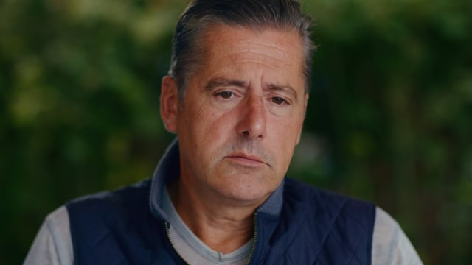
Courtesy of Worried About A Veteran
Notes:
This video demonstrates what a conversation about reducing access to lethal means might sound like. Participants can be assured that they do not have to be perfect in having this conversation with someone at risk for suicide. Genuine care and concern for a person at risk for suicide can be sufficient to result in a good outcome. Let's hear how Fred was able to help Mike secure his firearms .
Notice how Mikey's dad asks about reducing access to lethal means, "I’d feel a whole lot better if you let me babysit these guns””
Mikey wasn’t comfortable removing his firearms from the home because he has a nice collection. But he was willing to have his dad change the combination to the gun safe. His dad also put all the guns in the safe, even the guns from the bedroom and the vehicle. A couple of additional layers of safety they could have used were trigger locks on all the guns in the safe or removing the ammunition from the home. Those extra steps would require more time, and a chance to change one’s mind, if he were able to gain entry to the gun safe. Remember, all of these extra layers are about creating safety, making it a bit harder for someone to end their life in a moment of despair.
If the embedded video does not work instructors can access the video at https://vimeo.com/668732342 or https://worriedaboutaveteran.org/check-in-with-others/

Slide 39
ON-SITE STORAGE OF FIREARMS
Explore safe storage strategies to store firearms safely in the home
“What are some things that would increase firearm safety in the home?”
“What would you feel comfortable doing to increase the safe storage of your firearms?”
Field strip or remove the firing pin from the firearm.
Notes:
If off-site storage isn’t an option, recommend locking all guns unloaded in a gun safe or lock box.
Keep ammunition out of the home for now or locked separately.
If their guns are already locked, advise that they change the combination or key location if the person at risk knows them. A locked gun is of little use if the person at risk has access to the key.
Trigger locks, cable locks, and clamshell locks aren’t as safe as locking in a secure gun safe—but are far better than not locking at all.
Trigger locks are available free of charge at most local law enforcement agencies through Project Child Safe. Participants can call their local law enforcement agency to inquire about the type or quantity of trigger locks they have available for distribution.

Slide 40
ON-SITE STORAGE OF FIREARMS
FIREARMS​
Safest​ | Removal from home​ | A trusted friend or relative | Gun range or retailer
 |  | Self-storage facility | Pawn Shop
Safer​ | Make harder to access​ | Remove ALL ammunition from the home | Store ALL ammunition separately and locked up
 |  | Store ALL guns unloaded & in a secured safe or lock box | Install a trigger, clam or cable lock on ALL firearms.
 |  | Change combination to the safe or store keys away from home
Safe​ | Render inoperable​ | Remove a key component such as the firing pin, slide, bolt, or cylinder
Other​ | Distract or remind of reasons for living​ | Adhere a 988 sticker to gun safe | Leave photos of loved ones or ​ reasons for living in the safe​
 |  | Freeze keys to the safe in ice | Store keys in a safety deposit box at bank​
And​ | 988​ Keep physical & emotional contact​ | Program 988 – Suicide & Crisis Lifeline into phone so they can reach out for help. Keep bedroom doors open to maintain eyes and ears on them
Notes:
If off-site storage isn’t an option, recommend locking all guns unloaded in a gun safe or lock box.
Keep ammunition out of the home for now or locked separately.
If their guns are already locked, advise that they change the combination or key location if the person at risk knows them. A locked gun is of little use if the person at risk has access to the key.
Trigger locks, cable locks, and clamshell locks aren’t as safe as locking in a secure gun safe—but are far better than not locking at all.
Trigger locks are available free of charge at most local law enforcement agencies through Project Child Safe. Participants can call their local law enforcement agency to inquire about the type or quantity of trigger locks they have available for distribution.

Slide 41
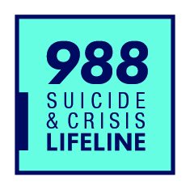
KEEP THE CONVERSATION GOING
Make a specific plan and follow up
“We agree that to keep you/your loved one safe we need to…”
Provide them with resources to access help for themselves in the event they need help in the future
Putting time and distance between a suicidal person and highly lethal means MAY save a life
Notes:
Additional questions that could be asked include
Who do you trust to hold onto your firearms?
What would make it harder for you to temporarily remove firearms from your home?
Would you be willing to explore safe storage options?
When you've made a plan, repeat it back to the person at risk. "We agree that in order to keep you safe, we need to, A, B, C."

Slide 42
PERSONAL PROTECTION FIREARMS
In the immediate future, suicide is a greater risk than home invasion
Two out of three firearm deaths in the U.S. are suicides.
Consider other means of self-defense
Baseball bat, mace or pepper spray, or a home security system
If self-defense is essential urge someone else, not the person at risk, to keep the firearm either:
In a quick-access or biometric gun safe
Always holstered and on their person
Stored in a gun safe when not physically in their control
Notes:
Many people own firearms for personal protection. Most firearm-related deaths in the U.S. are the result of suicide. CDC WISQARS, 2015-2019 firearm-related deaths in the U.S. demonstrated that six out of ten firearm deaths are a suicide. Firearm safety instruction or hunter safety education does not protect a person at risk for suicide from suicide behaviors. In fact, some studies suggest that knowledge of how to handle a firearm may actually increase the risk of dying in a suicide attempt. Until the person receives the help that is available and is no longer at risk for suicide, they are more at risk to themselves than they are at risk of someone causing them harm.
Encourage them to put some time and distance between the person at risk and the firearm for a temporary time period.
Encourage the use of other personal safety strategies such as a home security system, a baseball bat, mace, or pepper spray.
Emphasize that this is only temporary. When they are no longer at risk for suicide then they can increase access to the personal protection firearm.
If a firearm for self-defense or home defense is essential, urge someone other than the person at risk for suicide to retain control over the firearm.
If there are multiple firearms in the home, lock up all but the personal protection firearms.
Store the personal protection firearm in a quick-access or biometric safe so that the person at risk for suicide is not able to access the firearm. Keep the firearm holstered and on their person at all times or store it in a gun safe when they cannot keep it in their physical control.

Slide 43
REDUCE ACCESS TO OTHER LETHAL METHODS
Notes:
Don’t forget to address reducing access to large quantities or unused medications during this time. Proper disposal of medications is important so that the water system is not contaminated, and others cannot inadvertently obtain disposed of medications. Drug deactivation kits can be purchased at pharmacies or sometimes are available at no cost from local public health departments. Check with the local public health department or local law enforcement agency if there is a medication drop box available in the community.
Pill safes can be purchased at pharmacies or ordered online. While not 100% tamper-proof, a pill safe can increase the time it would take for a person at risk for suicide to access a lethal quantity of medications, allowing time for the suicide crisis to pass. The time it would take for them to access a lethal dose of medication that has been stored in a pill safe may delay, deter, or prevent a suicide attempt.
Work with pharmacists or poison control to determine safer quantities of medications to have around the house. Medications that are dosed in blister packs increases the time one can access a lethal dose. If dispensing prescriptions in large quantities is unavoidable, work together to dispense medications in smaller doses using pill organizers, asking someone outside the home to hold onto the large quantities of medication, or locking them up in a pill safe so the person at risk for suicide cannot access them.

Slide 44
​POISONS/MEDICATIONS
Safest​ | Removal from home​ | Do not flush or pour down the sink or toilets | Purchase a drug deactivation kit from local pharmacy
 |  | Law enforcement medication drop box or drug take back events
Safer​ | Make harder to access​ | Store large quantities & infrequently used medications in a pill safe or lock box | Keep daily or weekly doses in a pill organizer
 |  |  | Switch to blister packs
Safe​ | Render inoperable​ | Talk to the pharmacist about dispensing prescriptions in non-lethal quantities | Contact Poison Control to determine safe quantities
Other​ | Distract or remind of reasons for living​ | Identify ways to distract from suicidal thoughts (art, movement, hold on to ice cubes, take a shower, journal, call a friend) | Leave photos of loved ones, pets, or ​ reasons for living in common places
And​ | 988​ Keep physical & emotional contact​ | Program 988 – Suicide & Crisis Lifeline into phone so they can reach out for help. Keep bedroom doors open to maintain eyes and ears on them
Notes:
Work with pharmacists or poison control to determine safer quantities of medications to have around the house. Medications that are dosed in blister packs increases the time one can access a lethal dose. If dispensing prescriptions in large quantities is unavoidable, work together to dispense medications in smaller doses using pill organizers, asking someone outside the home to hold onto the large quantities of medication, or locking them up in pill safe so the person at risk for suicide cannot access them.

Slide 45
​SUFFOCATION
Safest​ | Removal from home​ | Almost impossible to remove all implements for suffocation or hanging
Safer​ | Make harder to access​ | When not in use, secure, lock up implements in the home that could be used for suffocation or hanging | Avoid storing implements for suffocation or hanging in the person's bedroom
Safe​ | Render inoperable​ | Almost impossible to render implements for suffocation or hanging inoperable
Other​ | Distract or remind of reasons for living​ | Identify ways to distract from suicidal thoughts (art, movement, hold on to ice cubes, take a shower, journal, call a friend) | Leave photos of loved ones, pets, or reasons for living in common places
And​ | 988​ Keep physical & emotional contact​ | Program 988 – Suicide & Crisis Lifeline into phone so they can reach out for help. Keep bedroom doors open to maintain eyes and ears on them

Slide 46
​OTHER
Safest​ | Removal from home​ | Almost impossible to mitigate for all other methods of suicide, but removal should be considered when possible.
Safer​ | Make harder to access​ | Secure implements that can be locked up, (i.e., scissors, knives, razor blades, car keys, etc.) | Use under supervision
Safe​ | Render inoperable​ | Almost impossible to render all other implements inoperable
Other​ | Distract or remind of reasons for living​ | Identify ways to distract from suicidal thoughts (art, movement, hold on to ice cubes, take a shower, journal, call a friend) | Leave photos of loved ones, pets, or reasons for living in common places
And​ | 988​ Keep physical & emotional contact​ | Program 988 – Suicide & Crisis Lifeline into phone so they can reach out for help. Keep bedroom doors open to maintain eyes and ears on them

Slide 47
REMEMBER
Begin with concern and empathy
“I care about you and want you to be safe.”
Ask directly about suicide
“Are you thinking about suicide?”
“Are you thinking about killing yourself?”
Focus on increasing safety
Discuss the temporary nature of both suicidality and limited access to lethal means.
Familiarity with medications or firearms may increase rather than decrease risk
Involve others in preventing suicide
Call the Suicide and Crisis Lifeline by calling 988 then Press 1 to speak to a Veteran, chat online @ veteranscrisisline.net, or text 838255
Notes:
A quick recap of the key take-aways from the training

Slide 48

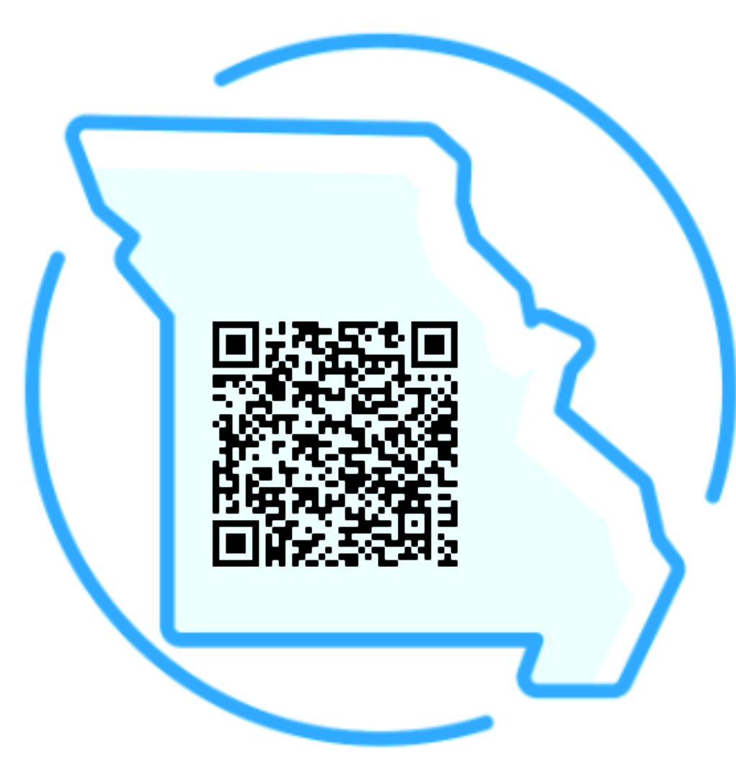
Contact the Veterans Crisis Line:
Dial 988 then Press 1,
chat online @ veteranscrisisline.net,
or text 838255
MOGOVChallenge.com
Missouri Firearm Safe Storage Map
SaferHomesCollaborative.org
Starting Jan. 17, 2023, Veterans in acute suicidal crisis can go to any VA or non-VA health care facility for emergency health care at no cost – including inpatient or crisis residential care for up to 30 days and outpatient care for up to 90 days. Veterans need not be enrolled in the VA system to use this benefit.
Notes:
There is a designated Suicide and Crisis Lifeline for Veteran's. The number is 988, then press 1 to be routed to the Veteran's Crisis Lifeline. There is also the option of chatting online or via text message.
The Missouri Governor's Challenge to Prevent Suicide Among Service Members, Veterans & Their Families has a website with additional information and veteran specific resources for help. Also, effective January 2023, Veterans in acute suicidal crisis will be able to go to any VA or non-VA health care facility for emergency mental health care at no cost – including inpatient care for up to 30 days and outpatient for up to 90 days. Veterans do not have to be enrolled in the VA system to use this benefit.
The Safer Homes Collaborative has created a firearm safe storage map for Missouri. They have identified firear retailers who provide storage services. Terms, conditions, and cost of storage are at the discretion of each retailer, so they recommend you contact the retailer first to determine if their process will work for your needs.

Slide 49
[Instructor name(s)]
[Professional Title]
[Organization]
Phone: [Optional]
Email: [yourname@yourorg.com]
[Address 1 – optional]
[Address 2 – optional]
[City, State, Zip Code – optional]
[www.yourorgwebsite.com - Optional]

